Slide 1

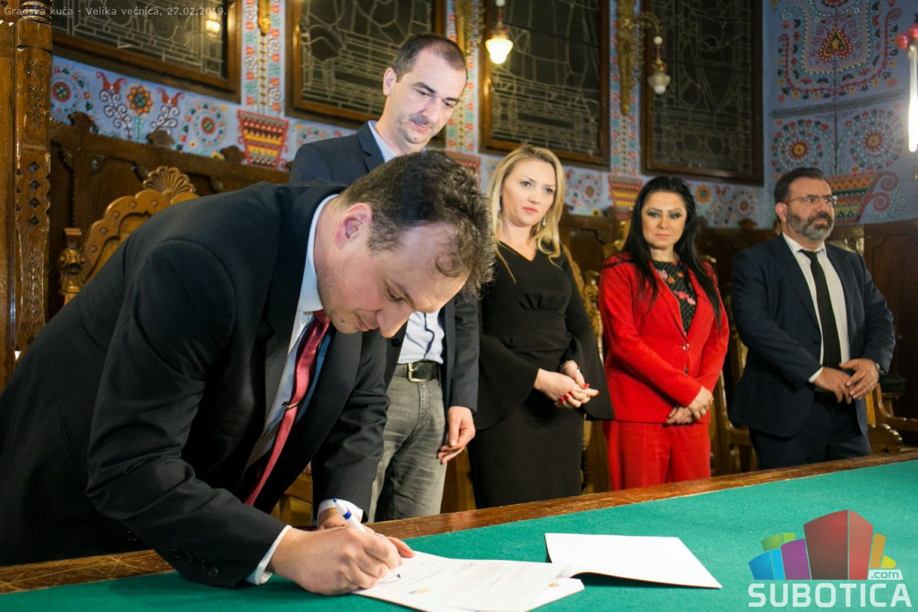
Strengthening the relations between utilities and municipal governments – the case of Subotica, Bijeljina, Novi Sad and Szeged
Sugár György, Director, JKP Vodovod I kanalizacija Subotica, Serbia

Slide 2

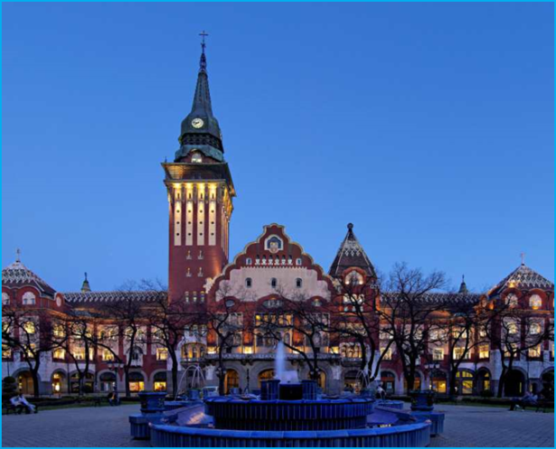
SUBOTICA - OPEN CITY
Geographically, historically, cultural and economically located "on the Balkans and at the door of Europe"
Subotica is located in the north of Republic of Serbia, beside its border with the Republic of Hungary
Today the city of Subotica, including its surrounding settlements has approximately 150.000 citizens
There are 23 different ethnic groups that live together in Subotica

Slide 3
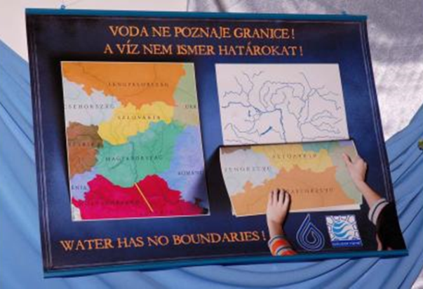
JKP „VODOVOD I KANALIZACIJA“ SUBOTICA
Founded in 1962
Founder and seat of the first Business Association of Water Supply and Sewerage
Member IWA - IAWD and participant in the Danube Water Program – DWP
Participants in the United Nations Global Water Partnership Project - GWOPA with Budapest City Waterworks
Traditional cooperation with the City of Szeged Waterworks

Slide 4
JKP „VODOVOD I KANALIZACIJA“ SUBOTICA
Good relationship with local self-government, especially on the search for investment funds (Budget, EBRD, KfW ...)
From our existence, we encourage the free and interactive flow of knowledge, innovations, experiences and good practices, both in the region of North Backa, and with the companies of the Vojvodina, Serbia, Ex Yugoslavia, and especially the Waterworks Hungary. We work together on the fact that the boundary between us is not the one who divides us - but merges!

Slide 5
Partnership agreement
A G R E E M E N T
ON PARTNERSHIP FOR UTILITY WATER MANAGEMENT IMPROVEMENT
AND EXCHANGE OF KNOWLEDGE, EXPERIENCE AND GOOD PRACTICES (1)
Representatives of the management Water Company from Subotica, Novi Sad and Szeged analyzed the Final Benchmarking Report (DWP) for 2016
On that occasion, the idea was to sign the Agreement on Partnership fot Utilitty Water Management Improvement and Exchange of Knowledge, Experience and Good Practices between Water Companies and Cities of Subotica, Novi Sad, Bijeljina and Szeged
The agreement was signed at the Annual Benchmarking Conference in Subotica, on February 28, 2019

Slide 6

Partnership agreement
I BASIC PRINCIPLES
The right to water is one of the basic human rights.
Water represents the natural good and the heritage of mankind.
It should be handled in a socially responsible and fair manner in order to preserve it for present and future generations.
Local authorities and water operators transparently promote partnerships and exchange of knowledge and experiences about good practices with the goal of continuous performance improvement in order to satisfy all users with quantity and quality of service.
A socially responsible, effective and sustainable management of water resources requires a long-term vision, an approach based on fixed infrastructure and other assets, and co-operation with other activities, such as agriculture and industry.

Slide 7
Partnership agreement
II GOALS OF THE PARTNERSHIP
awareness raising of current and future users about the importance of drinking water resources and its sustainable use
capacity strengthening of local authorities and water and sewage companies to manage, oversight, control, organize, operate and develop the activities of water intake, processing, distribution, atmospheric waters and wastewater collection, disposal and treatment and protection of receiving waters
improvement of operational performances in terms of efficient, economical and technical-technological functioning of the system
achieving an integrated management of infrastructure and assets
improving cooperation with service users and other stakeholders

Slide 8

Partnership agreement
III STRUCTURE OF PARTNERSHIP DEVELOPMENT
In order to create the partnership the participants of the agreement, will develop the following structure:
  Partnership Committee
  Working groups
  Secretariat

Slide 9
Partnership agreement
IV The working groups
As a minimum, the working groups will cover the following areas:
  Organizational and ownership (re)structuring, infrastructure and asset management, financing and tariffs
  Efficiency and quality of services
  Communication with customers
  Development and modernization of services and submission of projects for fund-raising
  Cooperation with national and international associations in the field of communal water management.
Working groups identify topics in the areas of their work and, on the principle of sharing knowledge, experiences and good practices, organize thematic workshops and short-term staff exchanges on a half-yearly basis.

Slide 10

Partnership agreement
FIRST INITIATIVES FOR THE WORK OF WORKING GROUPS
Organizational and ownership (re)structuring - Experience Water Management Segedin (and Temishvar)
Non Revenue Water – Water Losses – Waterworks Bijeljina
Production of green energy in the process of wastewater treatment - Waterworks Subotica
The application of innovative „Blue Green Dream“ technologies in cities - the initiative of Professor Čeda Maksimović (Imperial College London) and Toth Godo Valerije (Szeged Waterworks)

Slide 11
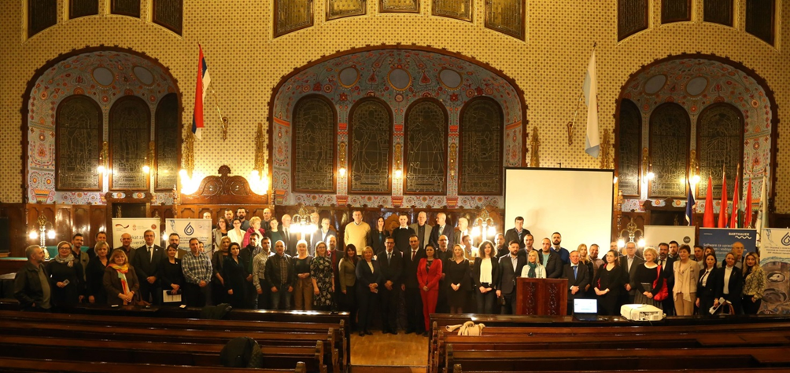
2019 Danube Water Conference
Achieving resilience in water and wastewater utilities in the Danube region
Thank you!

