Slide 1
NAIAD – NAture Insurance value: Assessment and Demonstration Reducing dependency - increasing quality for water utilities in the Lower Danube basin: NAIAD - a new collaborative approach for strengthening water services using Nature Based Solutions Florentina Nanu Business Development Group Romania
Danube Water Conference
Vienna, May 2-3, 2018

Slide 2
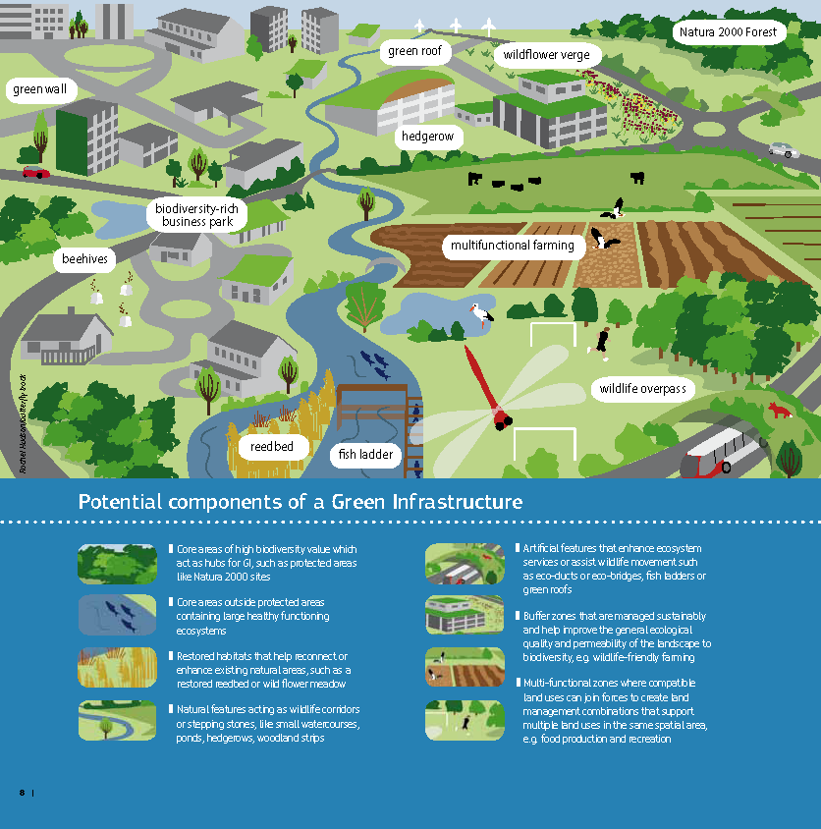
Content
About NAIAD: project purpose, objectives, added value
Demo cases across Europe
Specifics of the Lower Danube Demo case
NAIAD collaborative approach for sustainable water services

Slide 3
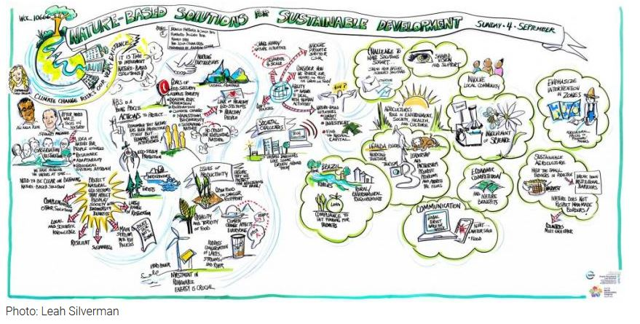
About NAIAD -Project purpose
Design concrete Nature Based Solutions (NBS) approach in response to specific water risks in 9 demo sites across EU
Deliver replicable methods to support NBS implementation independent or in combination with grey and soft measures
Develop novel business models to capture positive externalities of these projects and convert them in to revenue streams that pay back for the investments made
Increase capacity of policy decision makers to integrate NBS in development planning and contribute to general awareness of need of NBS and socio-economic opportunities arising with their implementationn at local, regional or EU level.

Slide 4
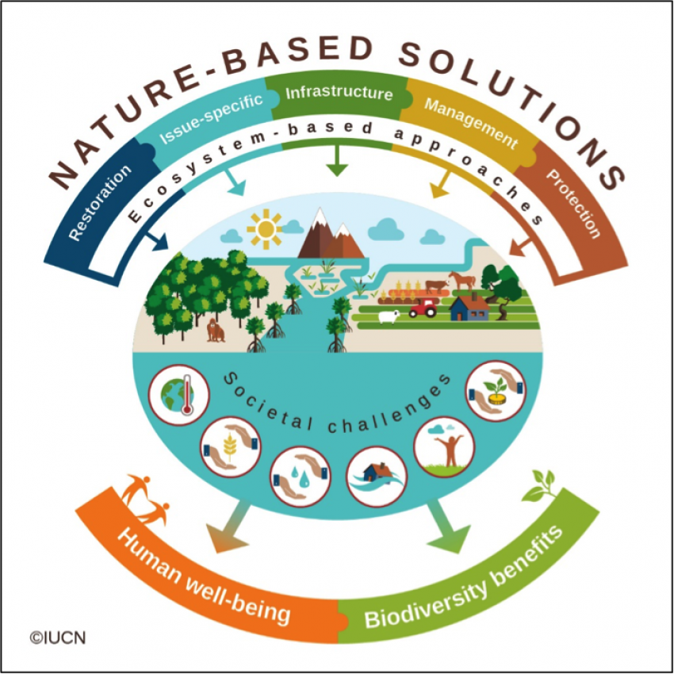
About NAIAD –Project Objectives
Objective 1 – Synthesis of biophysical and socio-economic knowledge
Providing assessment framework for testing, evidence data collection and operationalization of NBS in support of mitigation or prevention of water related risks
Combining research, secondary data collection and analysis and stakeholder participation approach.
The goal is to deliver a robust informed decision support and planning tool for NBS implementation.

Slide 5
About NAIAD – Project Objectives
Objective 2 – Operationalization of the framework
Testing of the framework on selected demo sites,
Fine tuning and upgrade of the decision support and planning tool, through stakeholder engagement and implementation experience,
Involving investment, business and insurance sector to participate in identification of novel business and financial opportunities with NBS measures implementation.
The goal is to test the theoretical knowledge and upgrade it through testing in real environment, while at the same time co-develop novel financial and business models in support of their implementation and replicability.

Slide 6
About NAIAD –Project Objectives
Objective 3 – Policy uptake, communication, dissemination and capacity building
Build awareness at government, business, insurance sector, civil society and academia on the benefits and risk provided through NBS implementation,
Provide targeted recommendations and guidance to utilize natural assurance schemes to improve economic, social and environmental conditions on the field at EU level.
The goal is to contribute, through financially viable and technically sound NBS informed decision support and planning tools, to socio-economic prosperity and sustainability of natural environment.

Slide 7
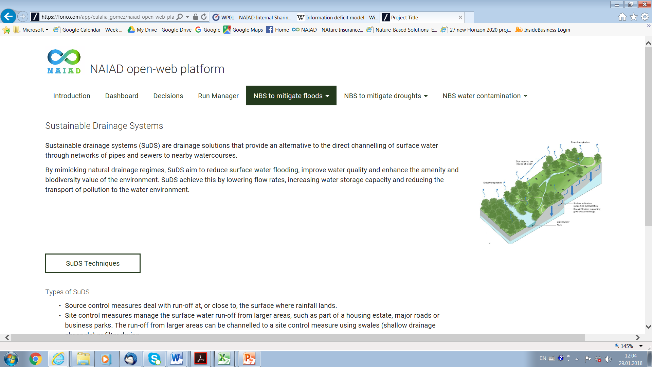
About NAIAD – Project Activities
demo sites characterization (geomorfology and hydrology)
multi-hazard risk modelling: Eco-Actuary and CoSting Nature
big scale (basin level) to small areas (city/parts of a city)
for the use of authorities and insurance sector
evaluation of the social risk perception
interviews and consultations with stakeholders on drivers and actions at local level
research on the insurance value of ecosystems,
evaluate national systems and the the extent to which they take into account risks related to water / natural hazards and recognize green solutions as potential flood / desertification / erosion risk prevention solutions
institutional analysis
3 levels: EU, national and demo areas
Innovative business models, economic and financial instruments
also considering opportunity costs and co-benefits
Integrated decision making instrument for the selection, development and implementation of green solutions
user-friendly platform to support decision making at local level
public policy recommendations

Slide 8
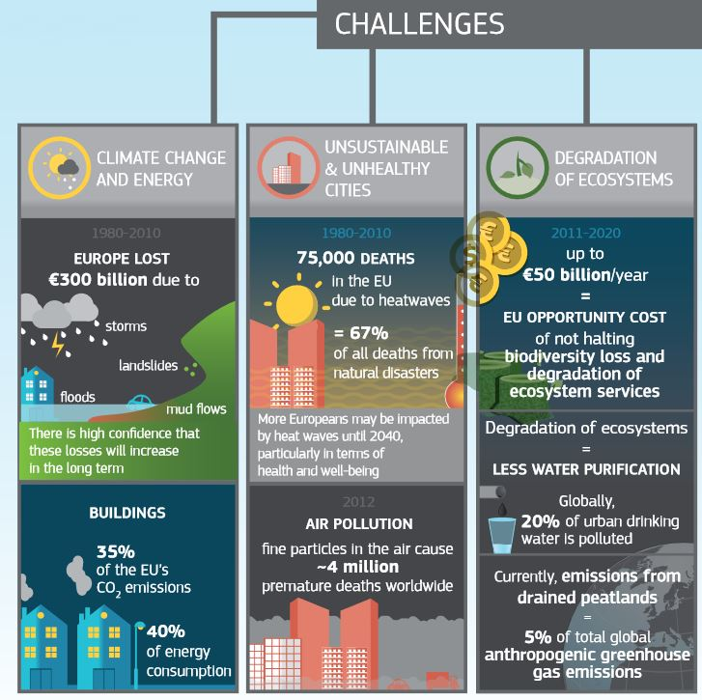
About NAIAD – The Added Value (1)
FOR PUBLIC INSTITUTIONS IN THE WATER SECTOR
Tested, applicable, sustainable, technically sound and financially viable solutions to mitigation of water security
Solutions in-line with EU strategic goals on sustainable development, green economy, development with nature, Millennium Development Goals,
Solutions, opening novel possibilities of public-private partnerships or community led initiatives and social innovation.

Slide 9
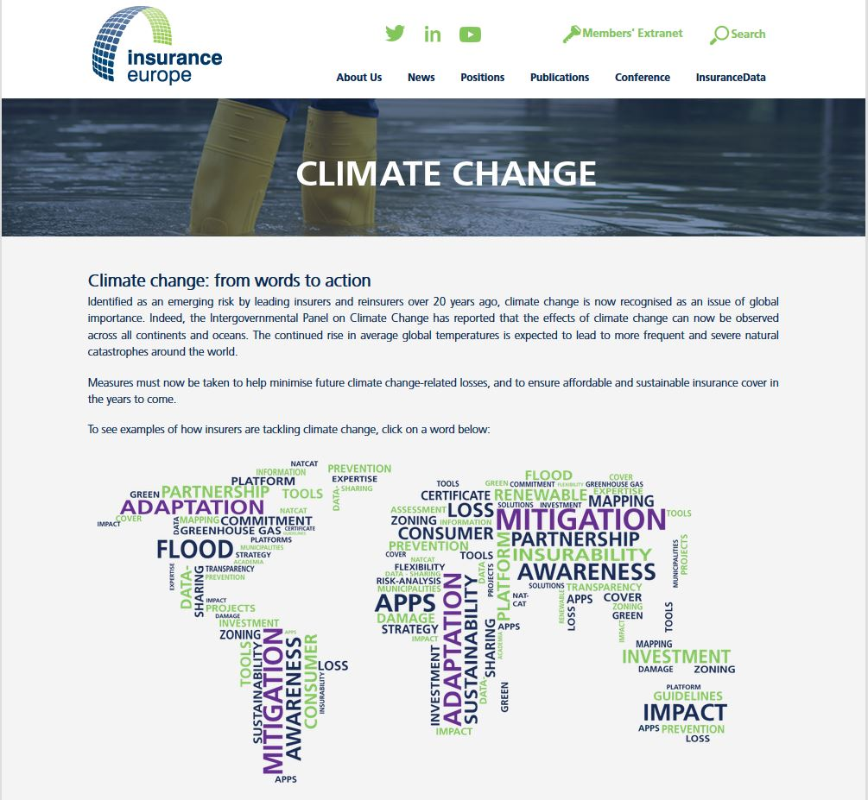
About NAIAD – The Added Value (2)
FOR PRIVATE SECTOR, INVESTORS AND INSURANCE COMPANIES
Increasing knowledge on causal connection of natural events to environmental and socio-economic damage their mitigation or prevention, leading to,
Need for new technical, consultancy, financing mechanism in support for their implementation, making it interesting for,
Insurance sector to further explore viability of these solutions as part of their insurance business, responding to climate change and changing socio-economics in light of new development paradigms e.g. green economy, cyclic-economy, community led development.

Slide 10
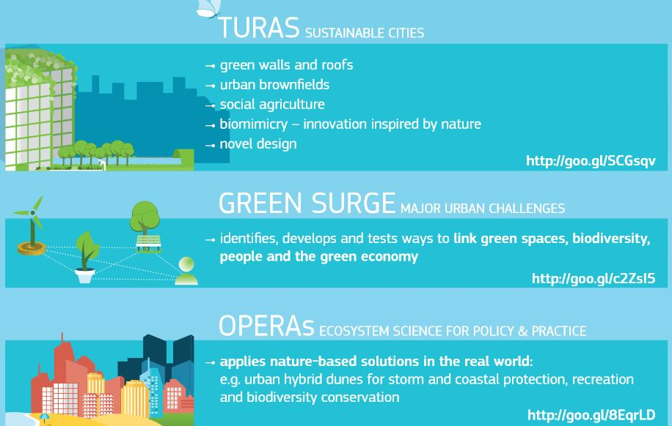
About NAIAD – The Added Value (3)
CONTRIBUTION TO KNOWLEDGE AND SUSTAINABLE DEVELOPMENT
Several IT tools in support of NBS planning and implementation will be developed / upgraded – most interestingly decision support and visualization tool for NBS planning,
Deeper understanding of ecosystem dynamics and capacity to use this dynamics as part of mitigation or solution to natural hazards,
Promotion and demonstration of novel business models and insurance products, that can be replicated.

Slide 11
NAIAD Demo Sites (1)
Location | Focus
DENMARK, COPEHNHAGEN | City of Copenhgen aims to develop a modelling framework to assess the insurance value of blue and green infrastructure ecosystems with respect to urban surface - and groundwater management for the benefit of the citizens, water companies and various water users
FRANCE, ROHN – MEDITERRANEAN BASIN (Bièvres-Liers-Valloire) | Improved knowledge on torrential flood processes (wildfires and woody debris aggravation roles, etc.). Definition of alternative insurance business models and new multi-criteria decision making tools accounting for ecosystems and protection systems effectiveness
THE NETHERLANDS, ROTTERDAM | The demo site will be used to design, develop and demonstrate the impact of applying a Micro Urban Wetlands strategy to prove the feasibility of decentralized solutions to collect, store, inﬁltrate and recover urban surface runoff as nature-based solution to prevent damages due to pluvial ﬂooding and drought in the city of Rotterdam
POLAND, LODZ | The demo aims at efficient water management towards multifunctional areas and to link the water regulation with provisioning services for urban various use and users
SLOVENIA, GLINŠČICA | The main aim is to prevent flooding but multiple benefits measures will be sought through ecosystem services among which aquifers recharge, irrigation and secure water management for all users

Slide 12
NAIAD Demo Sites (2)
Location | Focus
SPAIN, DUERO BASIN | The aim is to analyze and to value the role of groundwater‐related ecosystem services as natural insurance for hazard mitigation in a context of increasing climatic variability and to propose viable business options for the public/private financing of management measures that increase the provision of groundwater‐related ecosystem services
GREAT BRITAIN, THAMES | The demo aim is to develop and test the eco:actuary policy support tool with project partners & stakeholders in London and surrounding towns. Key risks to be analyzed are urban drainage and upstream fluvial floods
FRANCE KARST | Flood is the first risk in France (it represents almost 60 % of the total natural disasters). Drought risk for farming is supposed to increase in the future causing economic and financial problems to an industry already suffering. Extreme drought not only to affect the yearly crops with important yield and revenue losses but also to affect perennial crops and farm financial health for several years, potentially jeopardizing the survival of farms and implying resilience mechanisms
ROMANIA, LOWER DANUBE BASIN | The main goal is to create an efficient network of stakeholders to apply collaborative protocols for water security measures implementation and promotion of sustainable development for extreme events mitigation by using the ecosystems services, ecological (re)construction and green solutions

Slide 13
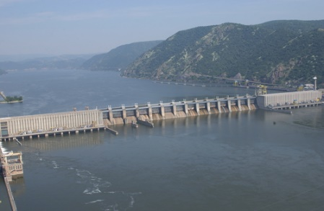
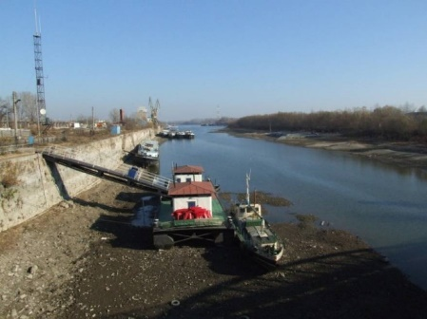
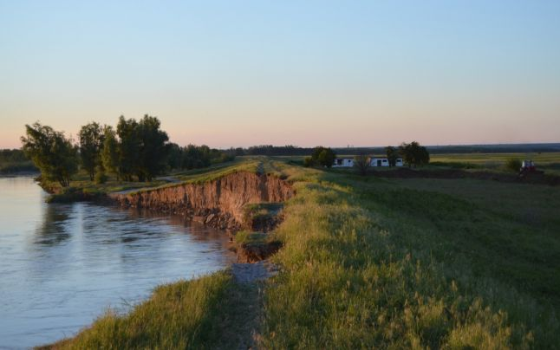
ROMANIA: The Lower Danube Demo case
300 km²
Floods
Drought
Erosion
Water Quality
Desertification

Slide 14
Lower Danube Demo – main risks for the water services
Lack of water resources with adequate quality and their uneven distribution in the target area
Many communities do not have other water resources besides underground water sources
Ground water pollution (phreatic and average depth)
currently the main source of water supply for the settlements through public or private wells;
Reduced number of emissaries that could be used for the discharge of treated wastewater
Desertification process, accelerated by the deforestation in the Danube and its tributaries watersheds.

Slide 15
Lower Danube Demo – main risks for the water services
quality of the surface waters is generally good, but their flows are variable and mostly low (except for the Danube);
the discharge of insufficiently treated wastewater affects the quality of these resources
the groundwater resources are the only alternative for public water supply in some localities
the groundwater resources are affected by pollution, exceeding the concentration limits for a series of indicators

Slide 16
Preliminary SWOT analysis
Water source | Characteristics | Technology | Strong points | Week points
Precipitations in urban areas | Water collected in the urban area (Calafat, Bailesti) by rainwater collection systems; Total atmospheric precipitation in: Calafat - 250-650 mm, Baliesti 250-400 mm. | Underground storage basins | Accumulation of large quantities of water that would otherwise be lost due to runoff and evaporation | Pollution from runoff on urban surfaces; High investment costs (underground retention basin); Irregularity of the rain phenomena.
Surface waters | Springs, temporary streams | Infiltration basins; Infiltration canals; Mini dams for water accumulation; Others, dependent on the local conditions. | Balancing the temporal water balance; Good water quality; Recharge of groundwater in phreatic aquifers. | Existence of favourable local conditions; Efficiency dependent on the water flows; Relatively fast clogging, which require unclogging works.
Properly treated wastewater | Treated water from the localities that have economic and industrial activities; Localities that do not have a natural emissary for wastewater discharge | Infiltration basins; Infiltration canals; Others, dependent on the local conditions. | Solution for the disposal of treated water, where there are no other possibilities | Difficulties in obtaining environmental permits for infiltration - strict, rigorous water treatment conditions
Danube River | Water abstraction from the Danube and its gravitational transport; Choosing the outlet points in order to permit gravitational transport. | Infiltration basins; Infiltration canals; Others, dependent on the local conditions. | Reducing energy costs for pumping the water; Improving water quality parameters; Disruption in the abstraction flow is possible in case of accidental pollution in the Danube. | Higher costs for water transport systems (canals and their works); Loss of water in the transport network; Degradation of water quality in the transport network (increasing concentrations of various soluble compounds through water evaporation).
Lakes and lacustrine reservoirs | In the study area a number of 150 lakes / ponds can be found, some of them with considerable water volumes | Infiltration canals Injection pumping systems | A fairly large number of lakes dry up due to high evaporation values, thus storing water in the underground during drought can be a solution | Many of the lakes have an overwhelming ecological importance, binding a range of habitats and ecosystems (ROSCI0039 - Ciuperceni-Desa; ROSCI0045 - Jiu Corridor); Sometimes the water needs a pre-treatment; Energy consumption.
Medium and deep (artesian) aquifer systems | The Dacian aquifer system has flows of 3-8 m/s, but there are situations in which the aquifer collector is coarse (medium - coarse sand with small gravel items) and the drilling have flows of over 10 l/s; The piezometric level is found near the soil surface or artesian. | Open wells; Hydraulic connection. | Low power consumption (for artesian systems); The high quality of used water will lead to a significant improvement in the phreatic aquiver. | Innovative systems of communication management – specialized personnel

Slide 17
Potential NBS measures in the Lower Danube Basin
Potential NBS measures | Why | How
MANAGED AQUIFER ARTIFICIAL RECHARGE | To mitigate water scarcity during drought periods and to improve groundwater quality | Creating re-filtration ponds or ditches in a soil with sufficient permeability
SMALL RETENTION AREAS | Torrential rains can be mitigate with small areas of water retention for flood prevention. In case of droughts small dams could serve to maintain the water supply for a longer period | Creating ponds, small dams and flood areas that can accumulate water if necessary
WATER REUSE | Recycling wastewater is a solution to meet the growing demand for water for multiple users. At the same time, it is a natural way to reduce the impact on the environment and provide the nutrients that will fertilize the soil | Use of wastewater to meet irrigation needs in agricultural activities. This allows to economize water resources at first and a reduction of pollution finally
WATER TRANSFER | The transfers are useful to increase the availability of water needed for provision of drinking water, irrigation, etc. | Through hydraulic works and systems
WASTE WATER PHYTOREMEDIATION | Improve the quality of wastewater for other uses (eg irrigation of green areas or crops) | Technique that takes advantage of the ability of some plants to purify water

Slide 18
Potential NBS measures in the Lower Danube Basin
Potential NBS measures | Why | How
OPENING FLOODPLAINS / FLOODPLAINS CONSERVATION | Positive impacts such as erosion reduction, retention of sediments, increase of biodiversity, reduction of pollution, aesthetic value | Applying legal limitations for the flood plains use, restoring unnatural plains. Legislative regulation and law inforcement
DRY/WET RETENTION AREAS | Retention areas are mainly intended for floods retention. Can be use for large water volume and water release control. Contribute also to the regulation of erosion/transport issues and improvement the state of the ecosystem | Construction of embankments at the extreme external boundaries of the flood plains, redirecting flood plains to floodplains, prevention / construction on floodplains, Reduction of artificially elevated slopes of the watercourse
WETLANDS | A wetland is a generally flat area whose surface is flooded permanently or intermittently. When regularly covered with water, the soil becomes saturated, becoming devoid of oxygen and giving rise to a hybrid ecosystem between purely aquatic and terrestrial | Rerouting floods towards such areas

Slide 19
Complementary measures (soft) in the Lower Danube Basin
Potential NBS measures | Why | How
CONTROL OF ILLEGAL ACTIVITIES | There is pressure for the extraction of water resources for various activities that lead to a possible overexploitation of aquifers and surface water, due to unauthorized extractions and / or extractions over the constituted rights | Defining limits and rights of water use, supervising the unauthorized extractions and controlling that the authorized extractions are being carried out in accordance with what is indicated in the respective water exploitation rights
INCREASE OF ENVIRONMENTAL AWARENESS | Dangerous behaviors or choices might be due to a limited knowledge/awareness either of risk level and of potential impacts | With specific training and educational processes, and implementing participatory/collective decision processes
FINES AND TARIFFS | Economic tools are highly relevant to influence water use and impact on the environment | The regulatory function of the State to prevent a party that operates as a monopoly from setting high prices. Fines are needed to limit dangerous behaviors
URBAN PLANNING | The easiest and most effective protection against floods and secure water sources for various users | With an efficient and professional spatial planning at both national and local level, increasing control and using financial measures, increasing risk awareness

Slide 20
NAIAD - Collaborative Approach
NAIAD is a co-development project, understanding end-user specific challenges, enables us to better focus and fine tune the solutions, making it more robust, replicable and transferable.
Exchange of information and better understanding of bio-physical environment, enables better responses, predictions and therefore forecasts in case of natural hazards, opening business opportunities for insurance sectors to develop new insurance products or upgrade existing ones.
In connecting growing understanding of ecosystems and social innovation, private businesses can develop novel approaches to community led business initiatives, consultancy and RTD opportunities.

Slide 21
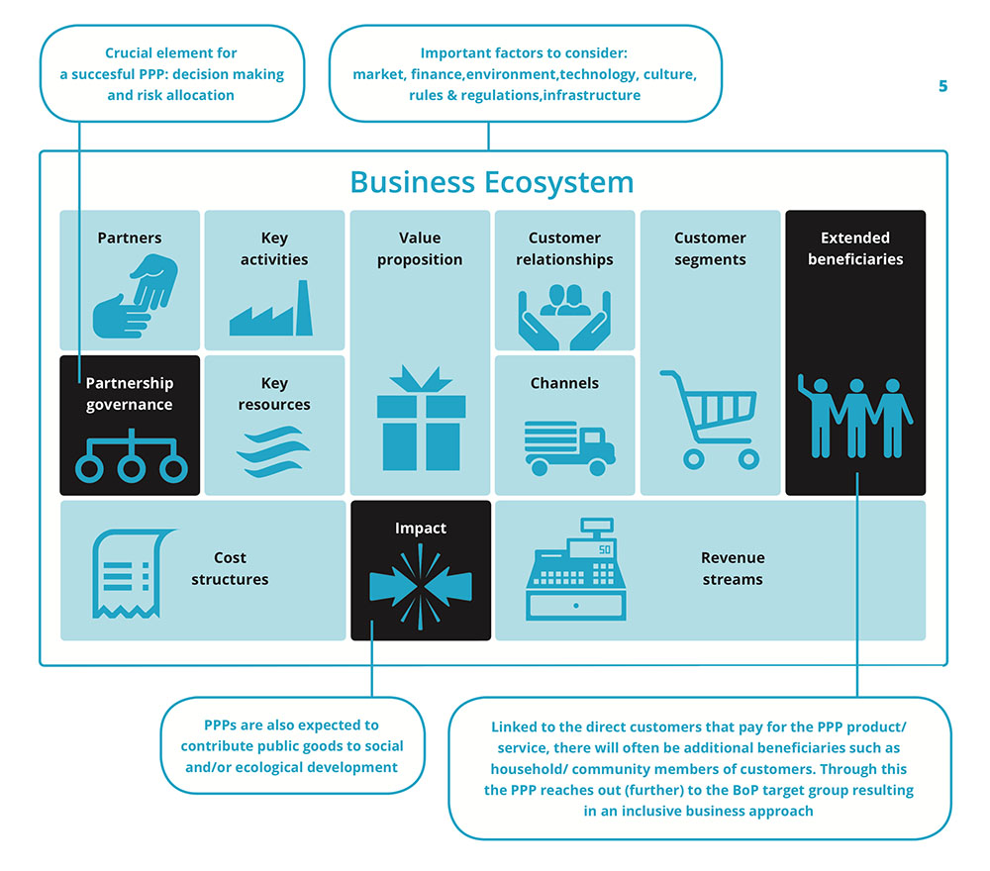
Novel Business Models - PPP for Water Services
Source: PPP Canvas from the Inclusive Business Hub
http://www.inclusivebusinesshub.org/pppcanvas-a-simple-tool-to-tackle-complex-business-models-of/

Slide 22
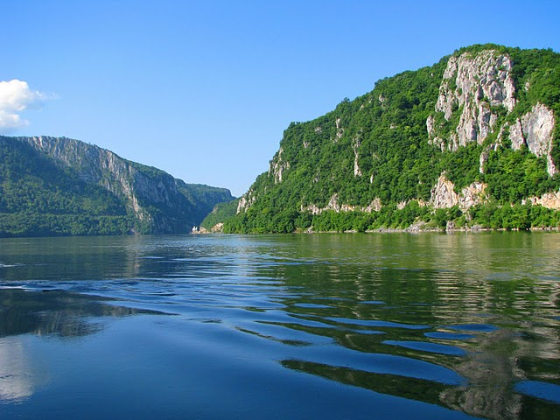
Florentina Nanu
Managing Partner
Business Development Group Romania
florentina.nanu@bdgroup.ro
www.bdgroup.ro
Thank you!
www.naiad2020.eu
More information on EU-wide partnership, expertise, relevance and achievements
Details about specific NBS solution at 8 demos sites across EU
Data and info point
Join and share your views, expectations and suggestions with NAIAD
NAIAD2020 #NAIAD2020
This project has received funding from the European Union’s Horizon 2020 research and innovation programme under grant agreement No 730497.
The opinions expressed in this document reflect only the author’s view and in no way reflect the European Commission’s opinions.
The European Commission is not responsible for any use that may be made of the information it contains.

