Slide 1
“LOW COST WASTEWATER TRETATMEN FOR SMALL COMMUNITIES – IMPLEMENTATION EXPERIENCE FROM MONTENEGRO”
Didanovic Snezana
Head of Division for Utility Development
of Ministry of sustainable development and tourism of Montenegro

Slide 2
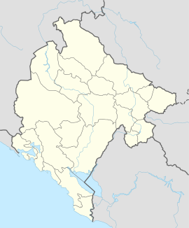
MONTENEGRO
Montenegro is located in Southeast Europe on the Balkan Peninsula. It lies on the coast of the Adriatic Sea
The territory of Montenegro occupies approximately 13,812 km²
In Montenegro there are about 620,029 inhabitants in 23 municipalities
Rich in water (4% of the world's population)

Slide 3
GENERAL ON WASTE WATER TREATMENT IN MONTENEGRO
Until 10 years ago, Montenegro had only 1 wastewater treatment plant (in Podgorica)
Other municipalities did not have wastewater treatment plants in the 20th century in Montenegro
In Montenegro, development of waste water is coming in 2005 by the adoption by the Government of Montenegro: - Master plan for sewage drainage of the Montenegrin coast and the municipality of Cetinje and - Strategic master plan for sewage and wastewater in the central and northern region of Montenegro.

Slide 4
GENERAL ON WASTE WATER TREATMENT IN MONTENEGRO
At the moment, the number of population connected to the sewage network in urban areas is 67%.
Number and Capacity of Agglomerations ("OG of MNE ", No. 078/17), 35 agglomerations have been identified in Montenegro, out of which 34 are with a load of over 2000 EC.
There are 8 operational waste water treatment plants (WWTPs) of which 5 are with secondary treatment (Podgorica, Mojkovac, Žabljak, Kotor and Tivat (common) and Šavnik), while 3 are with tertiary treatment (Nikšić, Budva i Herceg Novi).
Small plants

Slide 5
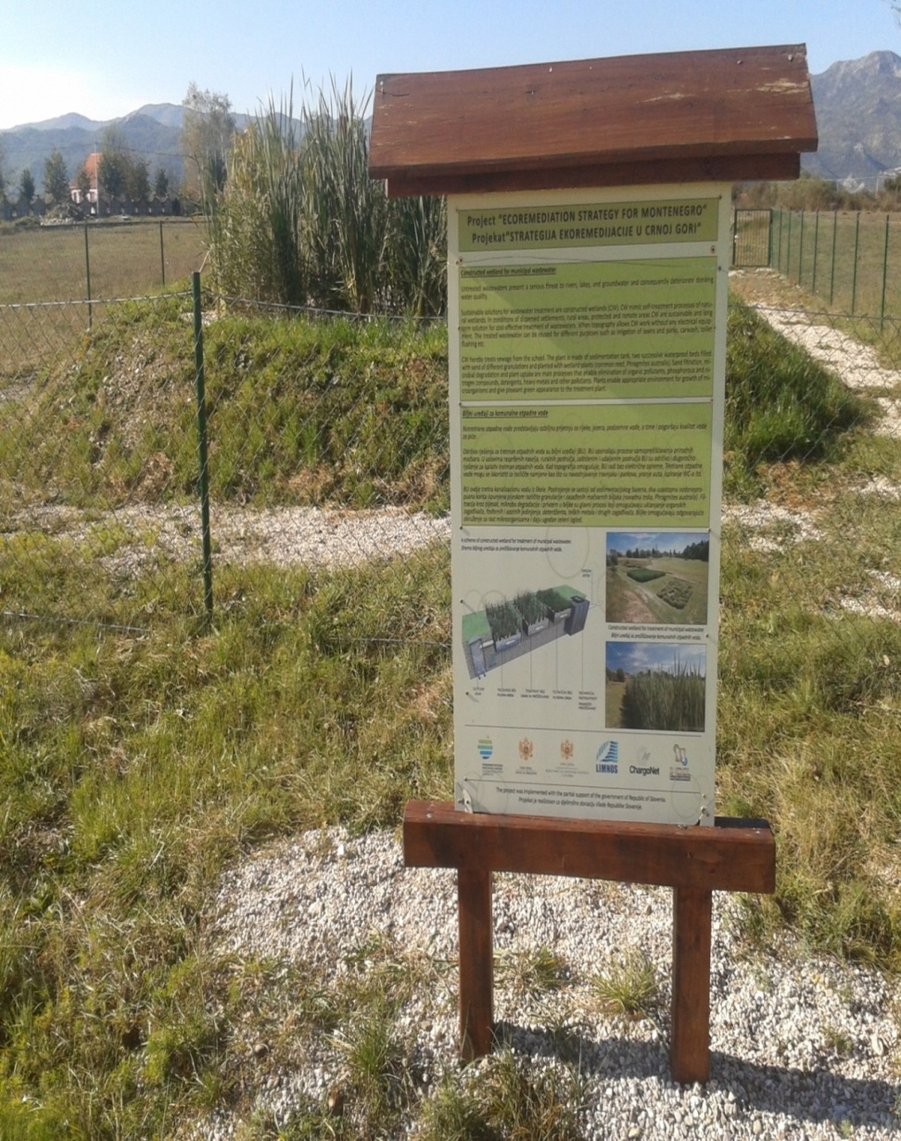
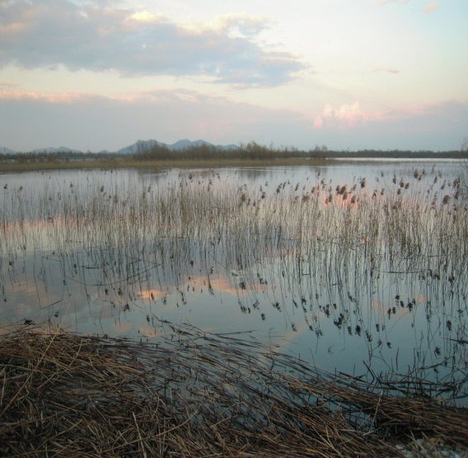
ECOREMEDIATION STRATEGY
IN MONTENEGRO
With Action Plan for the Period 2014-2020
Plant system for wastewater treatment at the Elementary School “Radoje Cizmovic” in Ozrinici

Slide 6
ACTION PLAN FOR IMPLEMENTATION OF ERM MEASURES IN MONTENEGRO FOR THE PERIOD 2014-2020
ERM/Measure/Activity | Location of Issue | Estimated funds required for implementation (EUR)
Plant device for wastewater Savnik | Savnik | 250 000
Plant device for wastewater Vranjina village | Vranjina | 250 000
Plant device for wastewater campsite at Mount Biograd | Mojkovac | 15.000
Plant device for wastewater Gusinje | Gusinje | 450 000
Sludge drying and treatment from the WWTP in Mojkovac | Mojkovac | 250 000
Reconstruction and rehabilitation of the municipal landfill in Plav | Plav | 250 000
Ecoremediation training polygon |  | 200 000-400 000

Slide 7
Plant device for wastewater Savnik
Strategic master plan for sewage and wastewater in the central and northern region of Montenegro (2005) for Savnik propose:
that total planned investments in the first phase amount to 775,123 €, of which € 509,100 € is required for the construction of a waste water treatment plant.
ECOREMEDIATION STRATEGY IN MONTENEGRO (2013)
WWTP 250 000 € is required for the construction of a waste water treatment plant.
we managed to reduce by half the cost of construction
when it comes to maintenance costs, they have been reduced several times since there is no use of electricity
We tried to reduce costs, but to meet the quality standard

Slide 8
Plant device for wastewater Savnik
Realization in the total amount of 251,500 euros (of which 50% is donation, and 50% of Montenegro's obligations through the Capital Budget).
The donation contract was signed in 2015 (September).
Contract finalised 2017 (September)

Slide 9
Plant device for wastewater Savnik

Slide 10
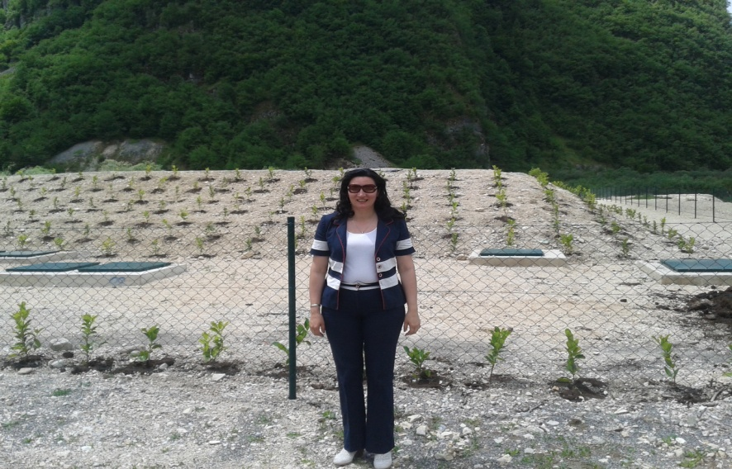
Plant device for wastewater Savnik
500 ES
Technology -reed bed/field

Slide 11
Sludge drying and treatment from the WWTP in Mojkovac
WWTP 5250 ES
WWTP STARTED TO WORK 2007
THE FIRST SYSTEM FOR THE TREATMENT OF THE SEWAGE SLUDGE ON THE BALKANS
In accordance with the donor contract signed by the Ministry of Sustainable Development with UNIDO in 2014, a donation of € 243,221 was provided, while the Montenegrin participation was provided through an in-kind form (people, offices, surveillance, etc.) and estimated at € 48,700

Slide 12
System for the treatment of sewage sludge from the wastewater treatment plant in Mojkovac
The realization of the Project of the Municipality of Mojkovac in the long run solved the issue of treatment of sewage sludge from the wastewater treatment plant. In accordance with the Directive 86/278 / EEC on the use of sludge and regulation in Montenegro, after a certain period of treated sludge can be used if there is a need for various purposes for this purpose (rehabilitation of devastated areas - excavation mines, landfills, agriculture, etc.).

Slide 13
System for the treatment of sewage sludge from the wastewater treatment plant in Mojkovac
First system in the Balkans, of this type and it represents a unique concept.
was done on the model of Denmark.
The system for the treatment of sewage sludge in municipality Mojkovac was made within the circle of wastewater treatment plant, which saves money for transport.

Slide 14
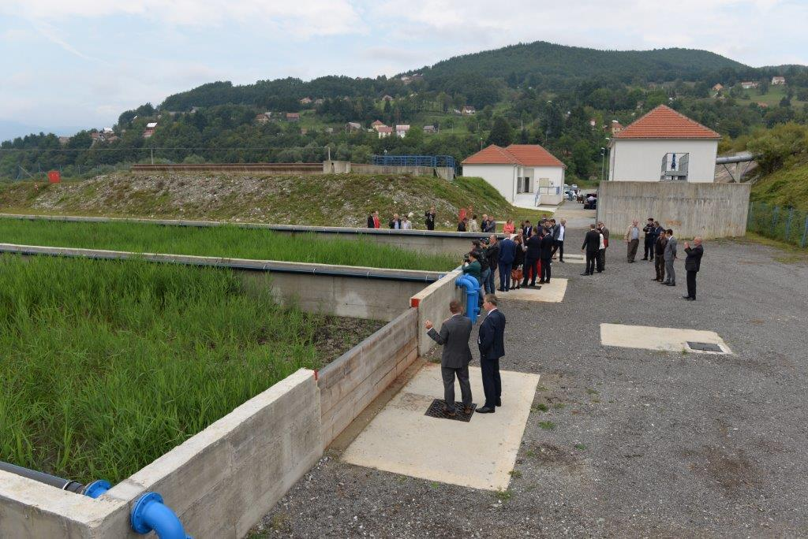

Slide 15
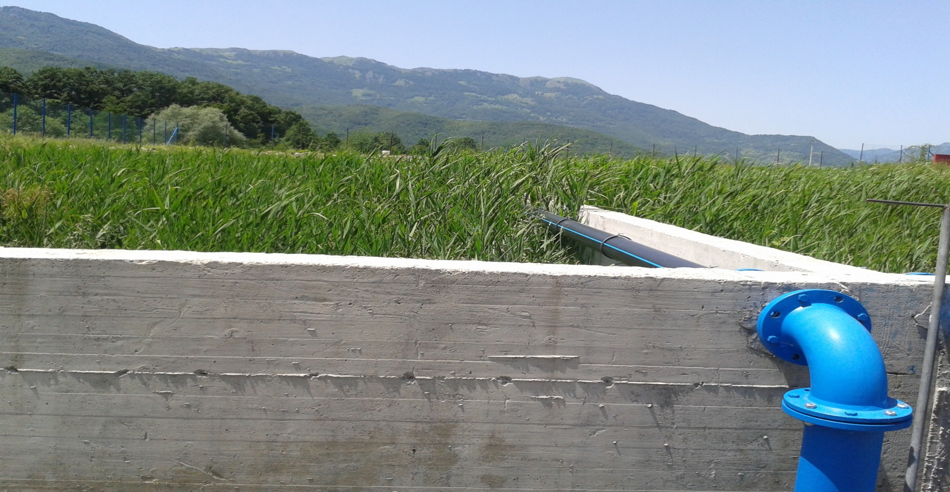
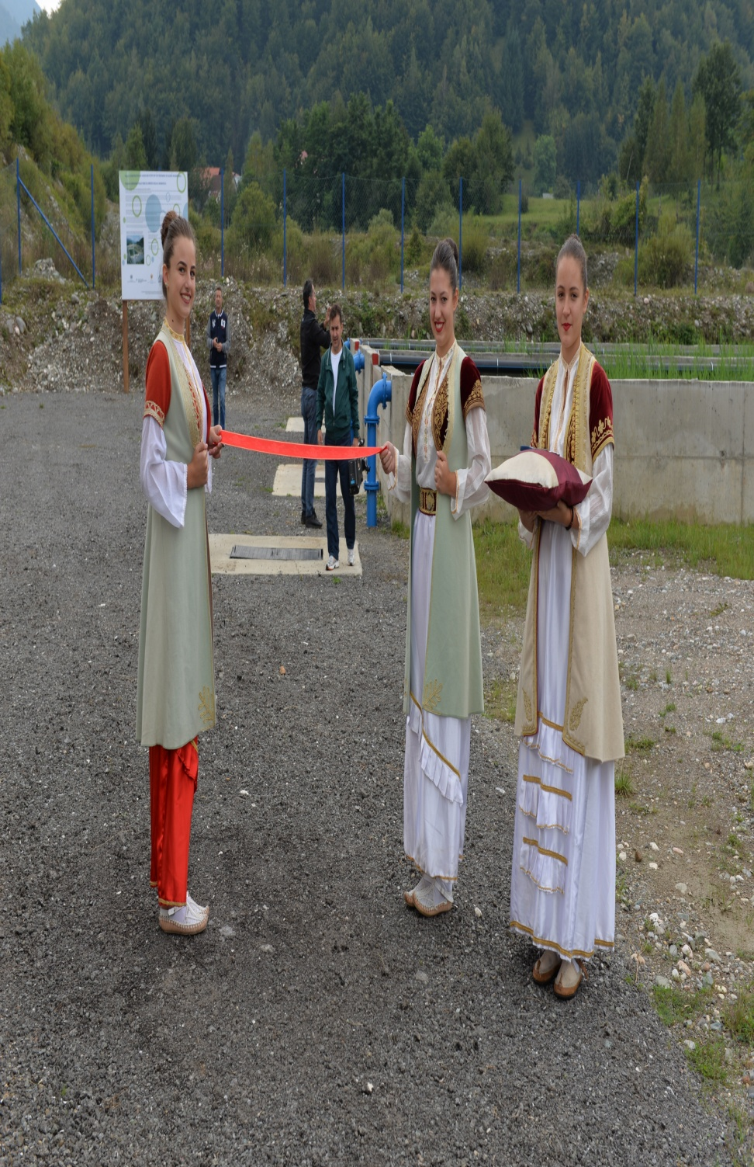
MOJKOVAC WWTP/SYSTEM FOR TREATMENT OF SEWAGE SLUDGE

Slide 16
ECOREMEDIATION CONCEPT USED:
WWTP – Primary school in Niksic
in the National Park Biogradsko Lake-protected area
For tretament sewage sludge in municipality Mojkovac, Zabljak
for remediation of waste dumps and treatment of leachate water in Zabljak
projects in progress: WWTP Vranjina, remediation of waste dump of Plav

Slide 17
using alternative technologies in small settlements
Many of environmental issues solved by ERM concept
High standard
reduced costs in relation to basic strategies (c
onstruction and maintenance)
high percentage of donations is provided

Slide 18
Thank you for your attention Snezana Didanovic Ministry of sustainable development and tourism snezana.didanovic@mrt.gov.me

