Slide 1
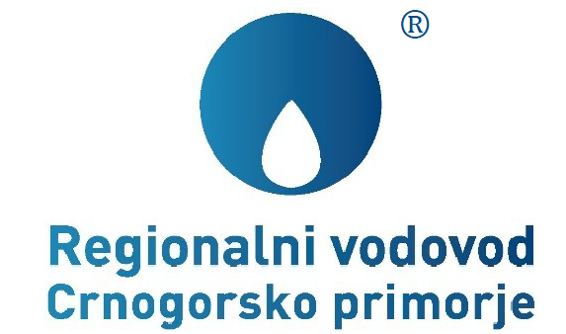
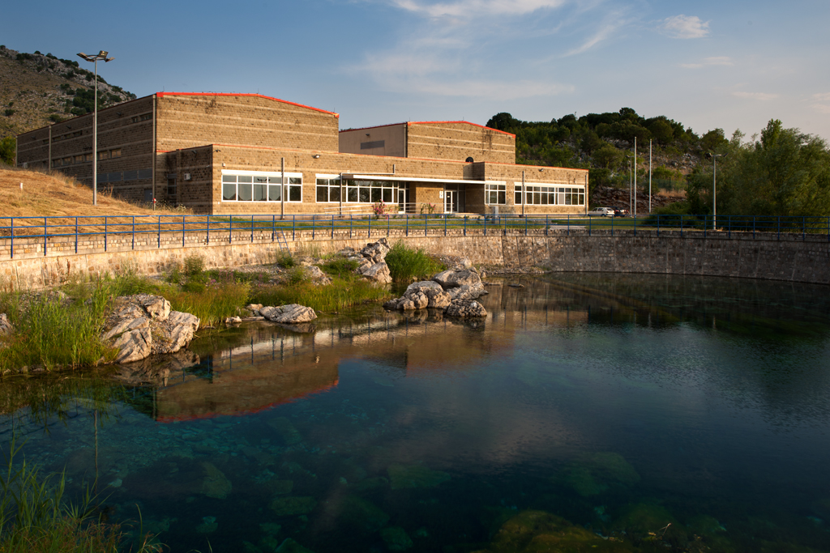
A PROJECT THAT CHANGED MONTENEGRO
INSTITUIONAL CAPACITY BUILDING
If you do not know where you are going, you will get there

Slide 2
INTRODUCTION A process of accelerated development of tourism in the Montenegrin Coastal Region started in the sixties of the last century and developed, though being interrupted by an earthquake that hit hard this area in April 1979 and the sanctions imposed on Socialist Republic of Yugoslavia by the United Nations Security Council in 1992, in different country’s constitutions, countries and under the different conditions. However, the possibilities of valorization of enormous potential for development of tourism were challenged in 1970’s of the last century due to inadequate water supply. This was the reason why the coastal municipalities decided to establish a so called “labor organization” for the regional water supply for the Montenegrin Coastal Region. Nevertheless, all those years the municipalities could not reach a consensus on either the spring for the regional water supply or on project implementation models. Meanwhile, the years passed by, the development was rather limited and the resources remained unused. Upon the proposal of the World Bank, the Government of Montenegro decided to assume from the coastal municipalities full responsibility and adopted a strategic decision to build a regional water supply system using the Bolje Sestre spring whereas the funds for project implementation were provided from the World Bank’s and EBRD’s loans coupled with local contribution.
A PROJECT THAT CHANGED MONTENEGRO
INSTITUIONAL CAPACITY BUILDING

Slide 3
At the of the journey, lasting full 34 years, from generating the idea on construction of the regional water supply to its realization, Montenegro got a grand and for a further development -crucially important infrastructure facility that provided continuous water supply to the Montenegrin Coastal Region with high quality water, classified into A1 class, from the Bolje Sestre Spring, located in the Skadar lake basin. The Regional Water Supply System is fairly complex and comprises the following structures built in a period from the year 2008 to 2012: ● 120 km of piping with diameter ranging from 500 mm to 1,100 mm; ● 4 pumping stations with an aggregate capacity of 7 MW; ● Reservoirs with an aggregate capacities of 18 000 m³; ● More than 400 smaller structures (connection joints, lock chambers); ● Integral SCADA system. The capacities of the regional water supply system have been assessed based on long term prospects of population growth but also on the accelerated growth of the tourism. By having completed the first phase for the regional water supply system, the possibility of distribution of 1.100 l/s of water has been secured, whereas the additional 500 l/s may be provided in the second phase by means of smaller investments.
A PROJECT THAT CHANGED MONTENEGRO
INSTITUIONAL CAPACITY BUILDING

Slide 4
The regional water supply system for the Montenegrin Coastal Region is the largest investment project implemented in Montenegro to date since the restoration of independence, thanks to the strategic and bold decision of the Government of Montenegro that, in times global economic crisis, took a risk and invested more than 80 Mio. EUR in construction of this system. Not only was the problem of water supply that spanned over the decades in the Montenegrin Coastal Region solved, but also the scene for development of tourism as a key branch of economy was set, resulting in 5 times increase in revenues generated from tourism. In the last ten years PE „Regional Waterworks for the Montenegrin Coast“ has been facing the demanding challenges such as the construction of the system, its commissioning and exploitation but also it is involved in the process of preparation of the forthcoming water sector reform in the Montenegrin Coastal Region. If not for the coherent strategy and considerate efforts invested in staff capacity building within the company, itself, the mentioned challenges would not have be overcome.
A PROJECT THAT CHANGED MONTENEGRO
INSTITUIONAL CAPACITY BUILDING

Slide 5
Capacity building for the construction phase of RWS Business entities, depending on their staff capacities, for implementation of the project implying complex works on construction of infrastructure, have three available options: - „To manage the project themselves“ meaning that the project is managed by the entity who is the project owner, relying on availability of a highly qualified and experienced staff. - „to rely on external consultants’ services“, assigning the special team of experts, companies specialized in managing the projects or engineering companies to manage the project; - „Self-management + external services“, meaning that company staff shall manage the project with the support of external consultants’ services. The consultant may render services varying from highly specialized services (specialized engineering, IT solutions, etc.) to services implying permanent engagement and on site presence (for example contracts related to civil engineering) on behalf of the employer. Today’s experience of managing the project in Montenegro shows that a minor number of entities is capable of managing the project independently, so that the successful implementation of the projects that will be initiated in the next period may be reached solely by means of the second and third options.
A PROJECT THAT CHANGED MONTENEGRO
INSTITUIONAL CAPACITY BUILDING

Slide 6
With respect to the staff capacities of PE “Regional Waterworks for the Montenegrin Coastal Region” that were built in a period from 2000 to 2004 when it implemented several projects financed by the World Bank (the construction of the sanitary landfill) and KfW (urgent measures aimed at improving water supply of the Montenegrin Coastal Region and Cetinje) PE “Regional Waterworks for the Montenegrin Coastal Region opted for the second option “Self-management + external services”. This option has been assessed as suitable due to the scope of works that were to be implemented on the territory of six municipalities, extremely short deadline for the project completion, but also due to the lack of staff for implementation of this demanding and large project. Therefore, regardless the significantly improved level of staff qualification, gained through the so called “ICB “ tender (open bidding procedure) prepared by the investor in accordance with the FIDIC rules, controlled and financed in accordance with procedures and operational policies of the afore mentioned financial organizations, that made this company capable of implementing those project in an optimal way, it was assessed that the project of construction of the Regional Water Supply Company required up building of the staff qualification in terms of increase in number of employees supervising the investment and their training. In that sense, the company announced the vacancy notice stating the qualifications required for the project implementation as set forth by the Law and proceeded with the process of evaluation and selection of the candidates who were recruited on the temporary basis for the purposes of the project implementation.
A PROJECT THAT CHANGED MONTENEGRO
INSTITUIONAL CAPACITY BUILDING

Slide 7
As the deadlines were extremely tight, the trainings of the employees were done within the company, thus performing the transfer of knowledge gained during afore mentioned implementation of the projects. Special attention was paid to implementation of the project in accordance to FIDIC (Yellow book and Red book) whereas the bidding procedures were implemented relaying on the staff who successfully implemented tender procedures pursuant to international standards. Hence, the team that was formed together with the consultants that were recruited to perform the professional supervision over works, successfully implemented all activities related to tender announcement, bid evaluation, conclusion of the construction contracts, implementation of the contract in accordance to FIDIC, and in the end, commissioning of the system. The success of this phase can be measured against the fact that the contract with the contractor who was awarded the works on the most demanding submerged pipeline section was terminated due to poor performance and the management was forced to take over the implementation of the contracts with the subcontractors in accordance with FIDIC, which resulted in successful implementation of the works within the planned schedule.
A PROJECT THAT CHANGED MONTENEGRO
INSTITUIONAL CAPACITY BUILDING

Slide 8
Capacity building for the Exploitation phase Given the short deadline for construction of the regional water supply system while selecting the candidate to be in charge for implementation of the contract pursuant to FIDIC, a thorough attention was paid to challenges expected to be faced throughout the phase of exploitation of the system. The selection of the candidates was done in light of their qualifications that may be of use and importance during the exploitation phase. It is very important to mention that all knowledge and skills acquired in the process of construction are being applied now when Regional Waterworks is not an “investment company” anymore but an operator of a water supply system that delivers water to the local waterworks of the coastal municipalities. Our staff that intensively worked on preparation of the conceptional designs, main designs, tender documentation, financial management, project implementation including all other procedures dealing with the project management possesses, all information and knowledge about the system and all other aspects of the project. It is obvious that these people are of competence to provide an adequate reply to any problem and challenge with respect to the system functioning. Thanks to this, the regional water supply system functions from the first day of its operation (June 2010) up to date incessantly with the almost insignificant losses.
A PROJECT THAT CHANGED MONTENEGRO
INSTITUIONAL CAPACITY BUILDING

Slide 9
Bearing in mind the year years behind us, Regional waterworks continued its practice regarding the institutional capacity building by recruiting new, young qualified people eager to learn from their senior colleagues. Occasionally, they are given opportunity to acquire knowledge and skills by means of various types of education and training programs in the country and abroad. In this way, we succeeded to properly address the new assignments that occurred after commissioning of the system. The system management (SCADA), maintenance of the system, protection of the spring, regular water sampling in order to monitor water quality and any other activity are taken as permanent challenges to which we respond with devotion, continuous learning and persistent work. For the purposes of asset management, which is in process now, we recruited new staff and carried out a training program. Due to a decade long hard work on the stated projects topped by construction of the regional water supply system in conditions and ambient faced by a small number of highly qualified experts in Montenegro, the Public enterprise has succeeded to nurture a team of professionals that may respond to the highest standards of the project management applied in developed countries. Procurement specialists, technical supervision and project reporting, financial management and reporting went through all phases of various projects financed by the leading financial organizations and commercial banks definitely possess skills and knowledge that enable them to succefully implement the investment projects. The results of such approach with respect to institutional capacity building are depicted best by the performance indicators given below:
A PROJECT THAT CHANGED MONTENEGRO
INSTITUIONAL CAPACITY BUILDING

Slide 10
A PROJECT THAT CHANGED MONTENEGRO
INSTITUIONAL CAPACITY BUILDING
TOTAL REVENUES PER YEARS
 | 2010 | 2011 | 2012 | 2013 | 2014 | 2015 | 2016 | 2017
 | € | € | € | € | € | € | € | €
Revenues from water delivered | 971,732 | 2,747,692 | 2,071,969 | 1,700,290 | 1,858,145 | 2,862,714 | 3,420,118 | 3,564,564
Revenues from the special fee | 1,257,442 | 1,189,655 | 2,493,026 | 2,378,756 | 2,006,092 | 1,428,218 | 2,500,471 | 3,403,343
Total | 2,229,174 | 3,937,346 | 4,564,995 | 4,079,046 | 3,864,237 | 4,290,932 | 5,920,589 | 6,967,907
CREDIT OBLIGATIONS PER YEARS
 | Principal amount € | Interest € | Total €
2011 | 1,083,333 | 406,671 | 1,490,005
2012 | 1,500,000 | 425,598 | 1,925,598
2013 | 2,203,195 | 574,255 | 2,777,450
2014 | 2,168,458 | 545,427 | 2,713,885
2015 | 2,312,318 | 542,478 | 2,854,797
2016 | 2,300,293 | 454,195 | 2,754,489
2017 | 1,851,263 | 234,400 | 2,085,663
Total | 13,418,861 | 3,183,026 | 16,601,887
REMARKS:
TOTAL CREDIT INDEBTEDNESS FOR CONSTRUCTION OF THE REGIONAL WATER SUPPLY SYSTEM AMOUNTED TO 32,5 MIO. EUR.
THE LOAN PROVIDED BY ABU DHABI FUND FOR DEVELOPMENT WAS RESTRUCTURED, THUS ACCOMPLISHING THE FOLLOWEING EFFECTS THAT CONTRIBUTED TO ADDITIONAL STABILIZATION OF COMPANY’S BUSINESS OPERATION.
CURRENCY FLUCTUATIONS IN AM AMOUNT TO APPROX. 1 MIO. € WERE ELIMINATED.
30 % LOWER INTEREST RATE

Slide 11
A PROJECT THAT CHANGED MONTENEGRO
INSTITUIONAL CAPACITY BUILDING
COMPARATIVE DATA ON THE ACCOUNT BALANCE AND DEPOSIT ACCOUNTS AS OF 31 DECEMBER 2017
Date | 2010 € | 2011 € | 2012 € | 2013 € | 2014 € | 2015 € | 2016€ | 2017 €
Account balance | 2,094,454 | 203,304 | 298,495 | 450,278 | 361,297 | 1,123,567 | 1,438,137 | 6,436,885
Deposit | 450,000 | 601,000 | 1,501,000 | 1,551,000 | 1,204,127 | 803,356 | 702,268 | 201,000
Total | 2,544,454 | 804,304 | 1,799,495 | 2,001,278 | 1,565,424 | 1,926,923 | 2,140,405 | 6,637,885

Slide 12
A PROJECT THAT CHANGED MONTENEGRO
INSTITUIONAL CAPACITY BUILDING
COMPARATIVE DATA WITH RESPECT TO TARIFFS FOR WATER SERVICES PROVIDED BY VIK-S
AND REGIONAL WATERWORKS
 | Tariffs for legal entities (€/m³) | Tariffs for physical persons (€/m³) | Difference RW/ViK (%)-legal entities | Difference RV/ViK (%)-physical persons
ViK Tivat | 2.08 | 1.04 | 533% | 267%
ViK Kotor | 2.2 | 1.1 | 564% | 282%
ViK Budva | 2.1 | 1.05 | 538% | 269%
ViK Bar | 1.84 | 0.96 | 472% | 246%
ViK Ulcinj | 1.87 | 0.86 | 479% | 221%
Tariff for water services provided from the regional water supply system | for continual delivery of water throughout the whole year (12 mjeseci) | 0.37 (€/m³)
 | for water delivery for the period of 6 to 12 months | 0.52 (€/m³)
 | For water delivery for the period of 3 to 6 months | 0.74(€/m³)
THE CAPACITY UTILIZATION RATE OF THE I PHASE OF RWS ON ANNUAL LEVEL (%)

Slide 13
Institutional capacity building for the planned reform of the water supply sector When it comes to water supply sector in Montenegro, all analyses done so far point out enormous potential of water sector in the Montenegrin Coastal Region that may be socially and economically evaluated provided that the whole water resources and built capacities are managed as an integral system for the benefit of all the consumers, local waterworks and PE “Regional Waterworks for the Montenegrin Coastal Region”. This approach would result in a higher efficiency degree and overall sustainability of the water supply system in the Montenegrin Coastal Region, better quality of life and conditions for development of economy and attracting new investments. The current condition in water supply sector clearly indicates that the optimal model for solving the problem is a phase merging of local water supply companies and integration and interconnection of their capacities, all springs and consumers into a few fundamental and integral water supply organizational structures for the whole state instead of current 23 nonfunctional and, from the technological and economical perspective, unsustainable local water utilities. Of course, the reform of the sector cannot take place prior setting up a new legislation and institutional framework (including thereof a regulatory framework) which shall follow new European and regional trends in terms of regionalization of the water sector and which shall secure establishing of a new organizational model that shall ensure the harmonization of functions and competences of the (local) self- governments and the competences of the state. The Reform Plan of the Water Sector which has been prepared with the technical assistance of EBRD goes the same way and will be presented soon to the competent ministries that is the Government of Montenegro, coastal municipalities and local water utilities. The essence of the Plan is presented in the next two slides.
A PROJECT THAT CHANGED MONTENEGRO
INSTITUIONAL CAPACITY BUILDING

Slide 14
A PROJECT THAT CHANGED MONTENEGRO
INSTITUIONAL CAPACITY BUILDING
Consolidated Reform Plan:
Montenegro Water Sector Reform
Plan for the Reform of the Montenegrin Coastal Region

Slide 15
A PROJECT THAT CHANGED MONTENEGRO
INSTITUIONAL CAPACITY BUILDING
The Montenegrin Coastal Water System: Institutional Asset
AS IS
TO BE
Regional Bulk Water Supply
Six service areas
Six local distributors
Six Municipalities involved, each running a small portion of the whole as if unrelated with others
No common planning
No regulation
Infrastructures ownership in the hands of Municipalities + PEW
Infrastructures accounting, maintenance, development and refurbishment not assigned
GoM involved only for concessions for water abstraction and water quality checks
A sole service operator
A sole service area
All components work in a «system» for unified planning and management
A Consortium as the place where water policy can be made, with the voice of the territory, at regional level
Nationwide regulation
Municipalities retain ownership of infrastructures and are given shares of the SSO
Maintenance, development, refurbishment and accounting of infrastructures made clear
GoM in position to make its voice heard

Slide 16
To reach the goal we need to extend further our institutional capacity, and this will be achieved through evaluation of the existing capacities which includes: ● Assessment of the existing logistics (financial proceeds, offices, IT and other equipment, car pool etc.) ● Assessment of the company’s organization ● Assessment of employee structure (education, age) ● Assessment of the general and specific knowledge; ● Assessment of the existing capacities for conducting the main business operation; ● Assessment of the existing capacities for conducting additional activities that is HUB establishing depending on the requirements imposed by future Reform of the sector; The implementation of the proposal for building the capacity of the company shall be provided through: ● Recruitment of a new staff in case that it is foreseen by the proposal; ● Training of employees by means of the workshops and already existing Asset Management and investment planning programs; ● Non-revenue water; ● Commercial efficiency; ● Access to financing; ● Water safety planning; ● Transfer of knowledge by means of a short- term exchange of employees or organization of visits to other water supply companies.
A PROJECT THAT CHANGED MONTENEGRO
INSTITUIONAL CAPACITY BUILDING

Slide 17
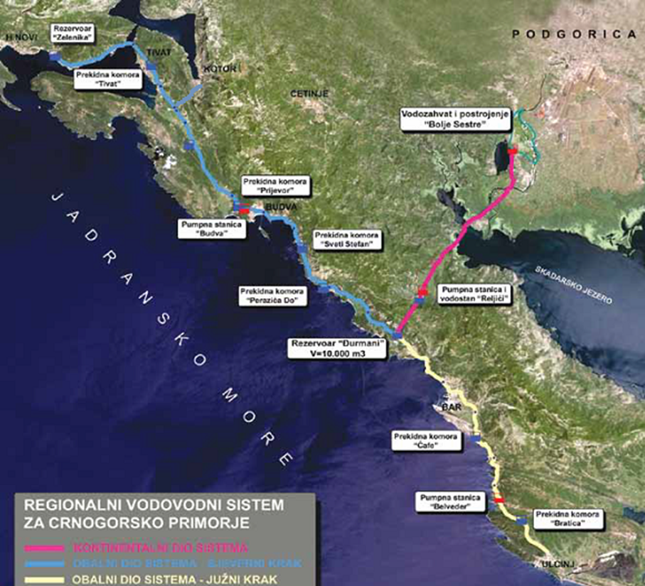
A PROJECT THAT CHANGED MONTENEGRO
INSTITUIONAL CAPACITY BUILDING
THANK YOU FOR YOUR ATTENTION !

