Slide 1
Association for Water and Environmental Protection Sector
Aquasan Network in Bosnia and Herzegovina
Strengthening Utilities and Municipal Governments Cooperation and Capacity in BiH
Vesna Muslic, Aquasan Network in BiH
Danube Water Conference, Vienna, 2 – 3 May 2018

Slide 2
Content
Who Are We?
Why Aquasan Network in BiH?
What Have We Achieved?
Concrete Actions
Further Challenges

Slide 3
Who Are We?
Sector experts from across Bosnia and Herzegovina i.e. representatives of:
Relevant state, entity and cantonal ministries,
Entity water agencies,
Local government units,
Utility companies,
NGOs,
Research institutes,
Private sector, and
Independent consultants.

Slide 4
Why Aquasan Network in BiH?
Established in 2010 as an informal network in response to challenges in the water and environmental protection sector in BiH:
Complex administrative structure in BiH: state level, two entities, 10 cantons within one of the entities and local governments;
Lack of institutionally and legally defined responsibilities in the sector;
Lack of communication amongst relevant actors at all levels – municipal, cantonal, entity and state level;
Lack of capacities to address these challenges;
Recognize the existing niche – national water utility associations and associations of local governments are not very active in the water services sector.

Slide 5
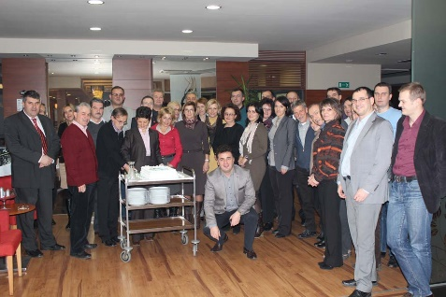
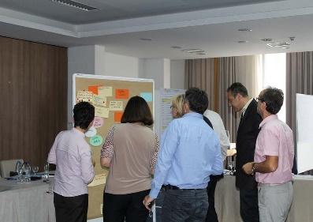
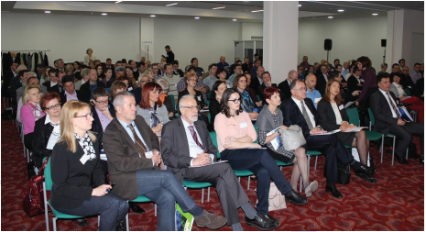
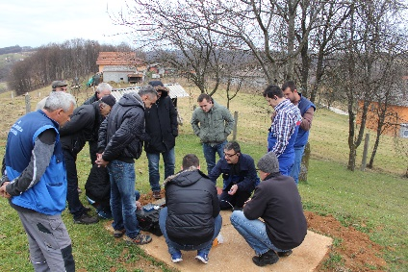
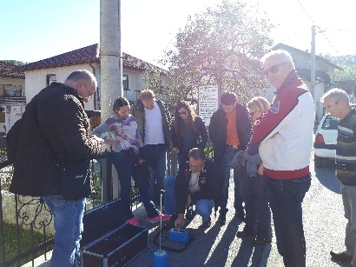
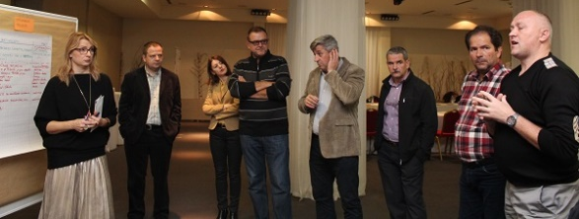
What Have We Achieved?
Better sector networking through building up trust, communication, coordination and cooperation amongst sector stakeholders at all levels;
Identification and addressing of most relevant issues in the sector through concrete initiatives and advocacy for sector improvements;
Enhanced individual, organizational and institutional capacities in the sector.

Slide 6
Concrete Actions – Strengthening Cooperation and Capacities
Aquasan Regional Conference, April 2018:
Organized in cooperation with state, entity, and cantonal ministries and with associations of water utilities and associations of local governments;
Participated by representatives of water utilities and government units;
Presenters and panelists coming from water utilities and government units;
Topics relevant for water utilities and government units and conclusions requiring action by both water utilities and government units;
Involved all stakeholders to build trust and mutual understanding about needs, challenges and solutions;
Enabled local self-governments that together with their water utilities push together for better enabling legal and business framework in BiH.

Slide 7
Concrete Actions – Strengthening Cooperation and Capacities
Capacity development programs implemented by Aquasan:
Asset management, non-revenue water and energy efficiency;
All promotional events address both water utilities as well as municipal governments – CD programs are targeting water utilities but in cooperation and with support of government units.
Enabled identification of lack of curriculum for local governments and thus improvements of the asset management program

Slide 8
Challenges – Strengthening Cooperation and Capacities
Clarify rights and obligations, roles and responsibilities between local governments and water utilities and hence strengthen their communication, coordination and cooperation;
Local governments to understand better and implement fully their legally-defined roles and responsibilities;
The need to enhance knowledge, skills and competences of local governments and water utility staff remains, if not increases.

Slide 9
Association for Water and Environmental Protection Sector
Aquasan Network in Bosnia and Herzegovina
Thank you for your attention!
Vesna Muslic, Aquasan Network in BiH
Danube Water Conference, Vienna, 2 – 3 May 2018

