Slide 1
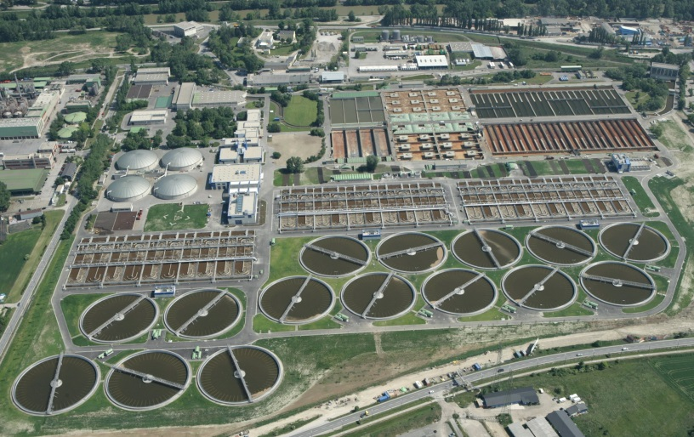
Perspectives on Financing of Water Services
Danube Water Conference, Vienna, 17.05.2017
Frank Wiederkehr
Regional Advisor for Water and Environment
Swiss Cooperation in the Western Balkans
frank.wiederkehr@eda.admin.ch

Slide 2
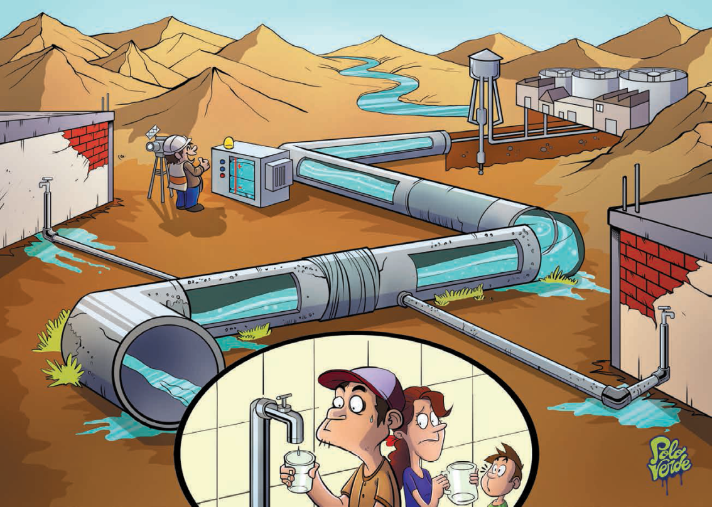
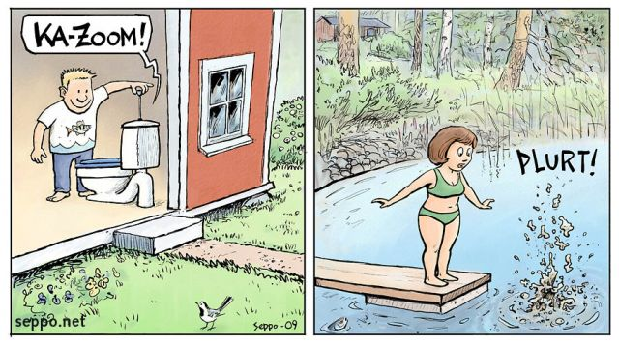
Services to be provided

Slide 3
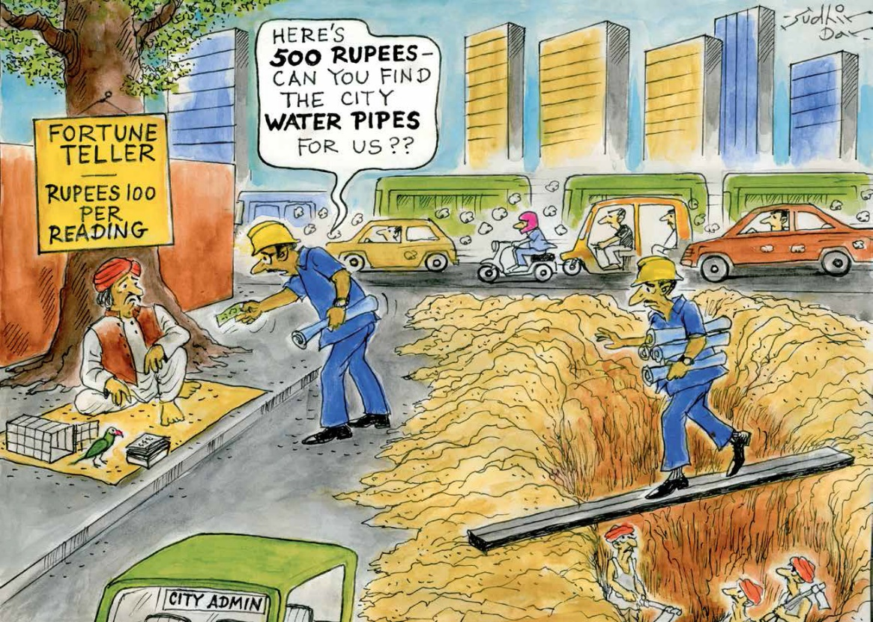
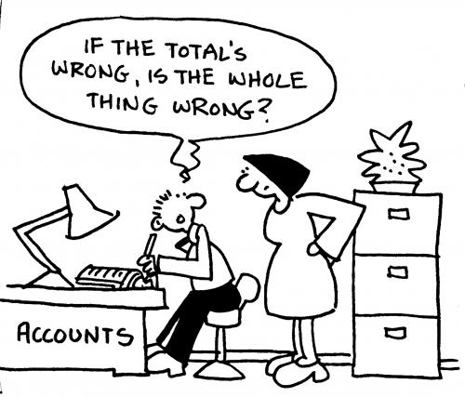
Finances for what?
Maintaining and improving the operational and financial performance requires investments in SYSTEMS:

Slide 4
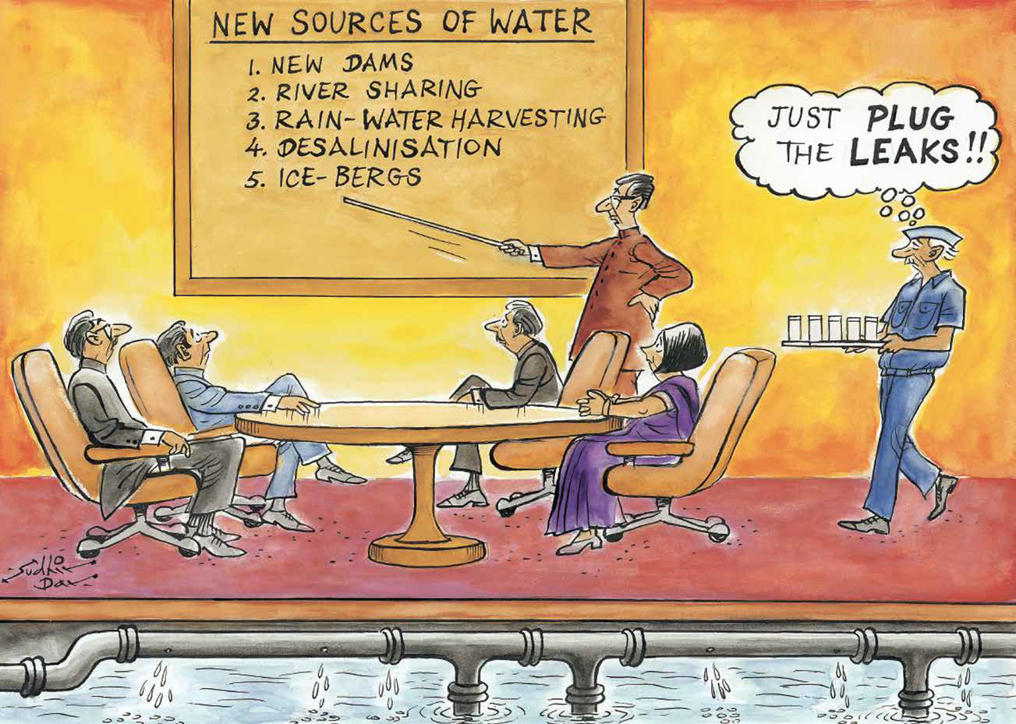
Finances for what?
Maintaining and improving the operational and financial performance requires investments in INFRASTRUCTURE:

Slide 5
Finances for what?
Maintaining and improving the operational and financial performance requires investments in STAFF CAPACITIES:

Slide 6
Sources of finances – the 3Ts
Tariffs: the $$$ paid by the users of the services
Responsibility mainly at municipal and PU level
Taxes: the $$$ provided by domestic taxpayers through governments
Responsibility mainly at the national level in our region
Transfers: the $$$ provided by foreign countries (grants)
Further sources:
Loans (commercial banks; develp. banks)
Private sector investments

Slide 7
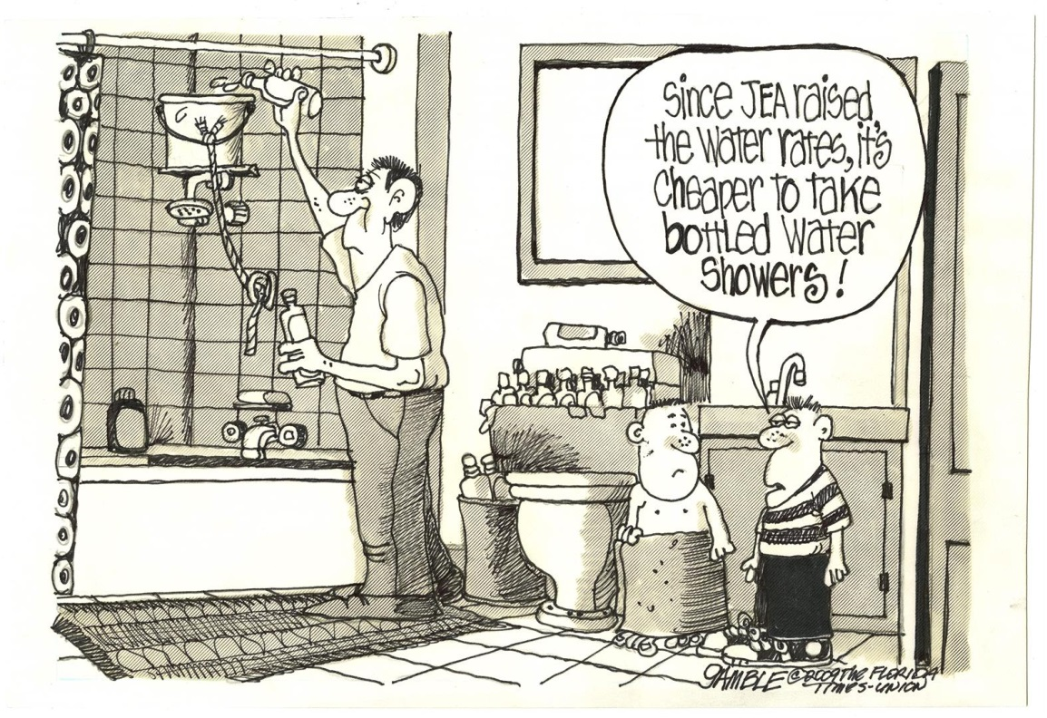
1) Tariffs I
Ultimately cost-covering water tariffs

Slide 8
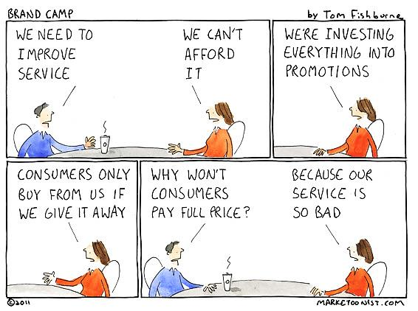
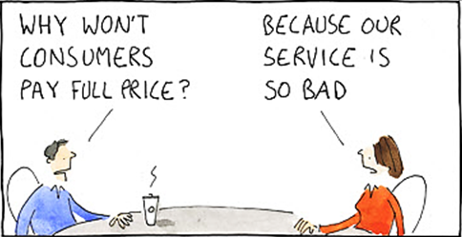
1) Tariffs II

Slide 9
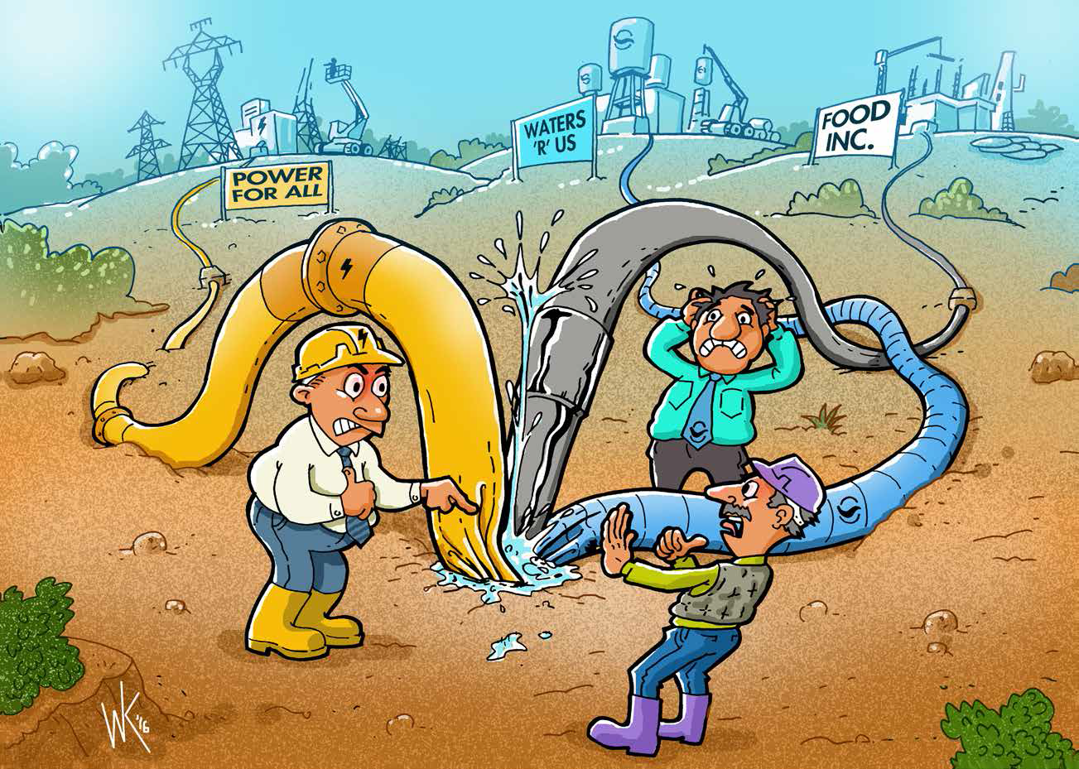
2) Taxes

Slide 10
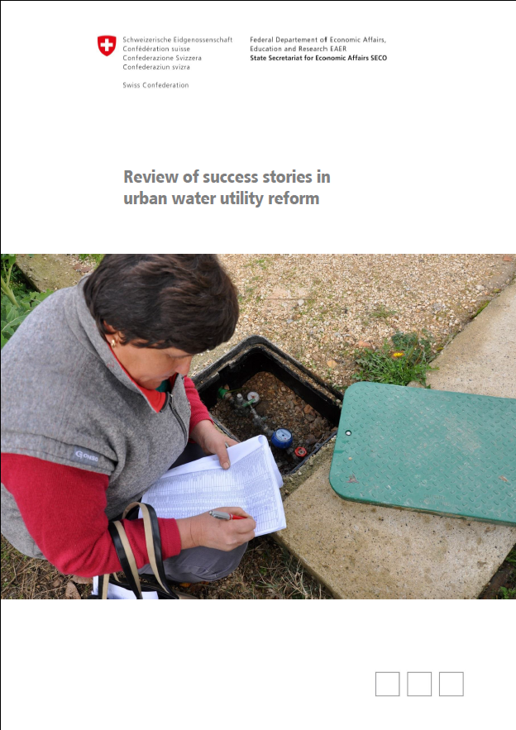
3) Transfers
Donor funds
“all utilities rehabilitated, renewed and expanded the intake, production and distribution infrastructure, which – ultimately – is also a critical ingredient of the success. These investments programs could not have been financed from the utilities’ own resources (directly or through a commercial bank) and probably neither from the local or central government’s budgets. The development agencies role as grant or loan financier was thus critical.”
Link to Review
Link to Tool

Slide 11
Making use of the sources of finances
Financial leeway is needed
Financing modalities:
3 Ts
(commercial and/or development) banks with loans
public private partnerships
Fiscal decentralisation
Varying combinations of efficiency improvements and tariff adjustments.

Slide 12
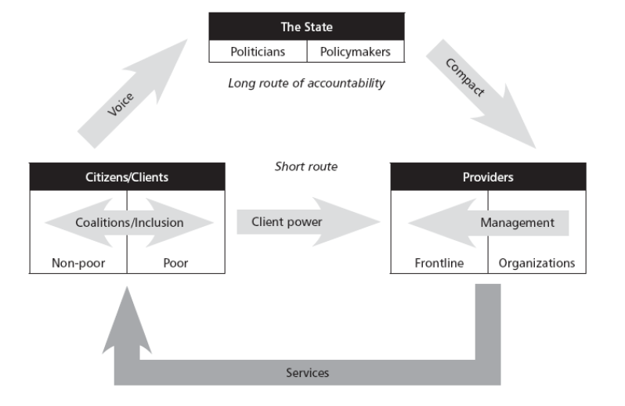
Win-Win-Win-Situation – e.g. tariffs
THE WINNER ☺
Commitment, Ownership, Willingness;
Clear Policies; Autonomy, Accountability,
Understands and accepts need for higher tariffs
Municipality
Praise PU
THE
WINNER ☺
THE
WINNER ☺
Customer Orientation - Services meet expectations

Slide 13
Thank you very much!

