Slide 1
Reform in the System for Water Supply, Collection and Treatment at Local Level EuropeAid/136063/IH/SER/MK Conditions for Effective and Productive Water Utility Business Planning
Danube Water Conference 2017, Vienna
Session on Business Planning, May 18
Mr. Ad Sannen (Eptisa)
This Project is funded
by the European Union

Slide 2
Topics
BP Internal conditions
BP External conditions
BP Focus on key utility processes
Tailored BP process
Anchoring BP in the annual planning cycle
BP Action orientation

Slide 3
Utility Business Plan (basic setup)
Vision and Mission
Where we want to be, ambitions
How we want to work, our values
Objectives and Strategies
Planned results, ways to achieve them
Key indicators of success
Financial Plan
Investments
Financial projection
Action Plans
Operations
Prices
Commercial
Staff and organization
System description
Existing situation
Operations, Finance, Organization
Main issues and bottlenecks

Slide 4
Utility Business Plan
Provides a road map for action, milestones, indicators of succes
Defines projects, investments and sources of funds
Defines improvement of internal business processes: better/more efficient ways to do the job
Creates awareness, ownership, shared vision, acceptance by stakeholders
Is anchored in internal routines for annual revision and updating
Is communicated internally & externally

Slide 5
BP Internal conditions
Management drive, ownership and leadership
Basic Business (commercial) awareness and orientation on internal processes
BP Team (taskforce), expertise, time & budget
Access to data
Performance Indicators, performance monitoring and reporting system
Sufficient critical mass (scale of operations)
Availability of internal supporting systems and procedures

Slide 6
BP External Conditions
Compliance with Regulatory Framework
Requirements of investors/financers
Coordination with asset owners
Local economic and spatial developments, political interests
Customer & community oriented
Tariff justification and affordability
Environmental stewardship (water resource protection)
Transparency on objectives, strategies and results

Slide 7
BP requires focus on key Utility Processes
Asset Management
Distribution network operation, NRW reduction
The commercial process (meter-to-cash cycle)
Internal information and data management

Slide 8
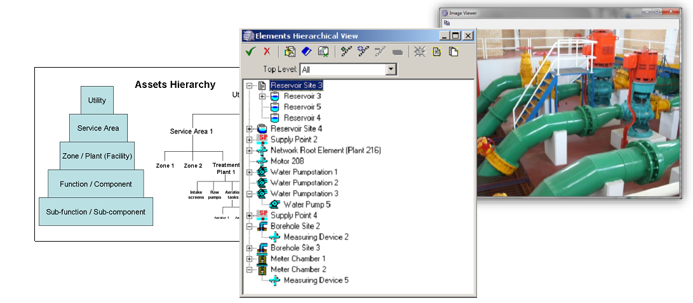
Asset Management System
Business impact:
Assets data and value
Investment Planning
Extension of assets life
Reduced assets failure

Slide 9
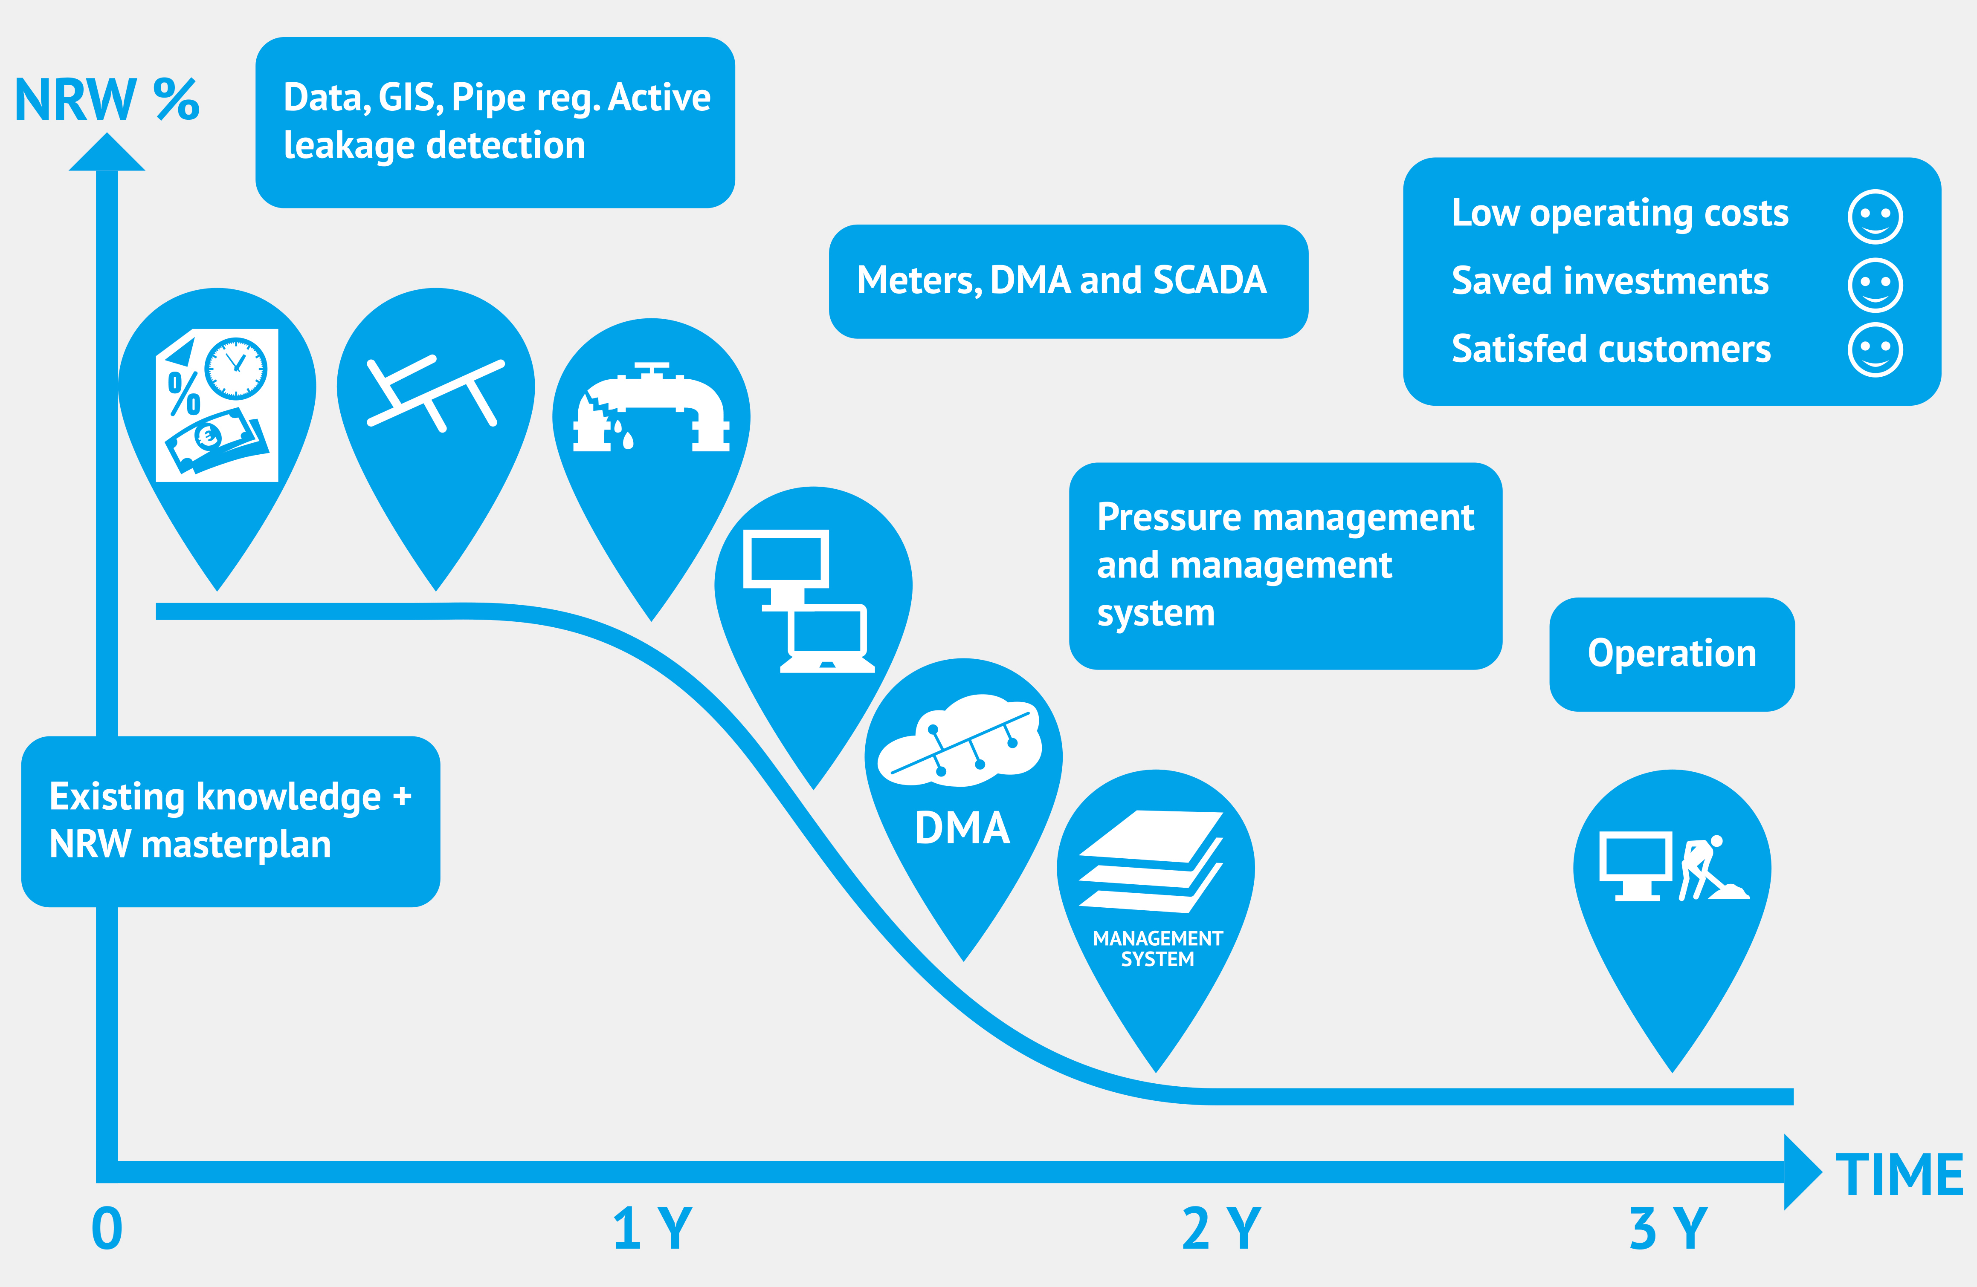
Reduction of NRW
Business impact:
Lower operating costs
Saved investments
Satisfied customers

Slide 10
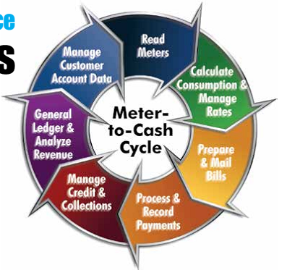
The Commercial Process
Business impact:
Customer knowledge
Increased Revenue
Reduced receivables
Better cashflow

Slide 11
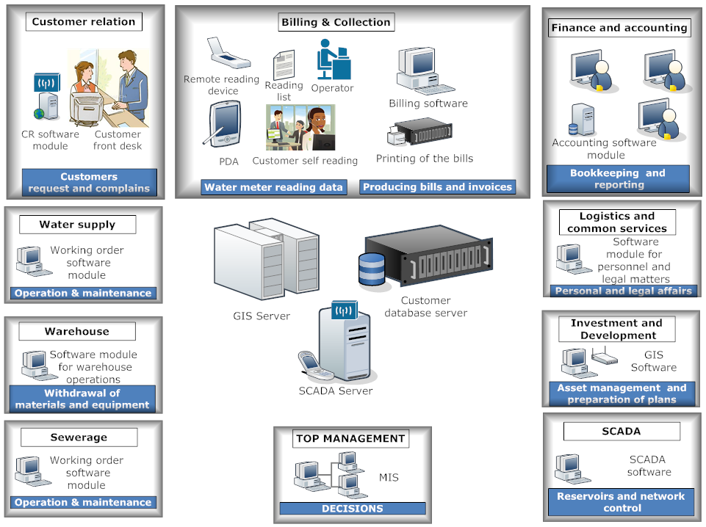
Data management
Finance and Accounting
Connecting and integrating business sectors

Slide 12
Business Planning Process
1. Current Performance Assessment
4. Strategic priorities and development needs
10. Tariff Projection
11. Organization and capacity development Plan
2. Mission & Vision
5. Objectives and targets
6. Demand / Services Forecast
12. Formalization
3. SWOT
7. Investment Programming
Implementation
8. Business Process Improvement Activity Plans
Monitoring performance
9. Financial Forecast

Slide 13
BP Tailored Approach
BP
Level 1
BP
Level 2
BP
Level 3
Fully independant and autonomous BP process (full scale BP)
Externally facilitated, Partly internally financed
Fully supported
Externally financed
as part of broader capacity development (simple BP)

Slide 14
Anchoring Business Planning in the Annual Planning cycle
General
Manager
Vision
Evaluation, review
Director
Operations
Director
Financial
Director
Projects
Strategic objectives
Distribution
Dept.
Revenue
dept
Contracts
dept
Operational objectives &
Performance indicators
Measuring performance
Pumping
Collection
Billing
New
Treatment
Action Plan, targets
& budget (resources)
Implementation

Slide 15
Lessons learned (1)
Business planning is not a stand-alone activity; it needs a basis of proper (audited) data, a dedicated team and inputs from stakeholders
Business Planning requires awareness on the importance of internal processes for utility performance improvement
Business Planning as an external legal/regulatory requirement can be an important accelerator for improvement of internal processes
The BP process works best when it is internalized and embedded in the Utility’s planning cycle. BP is a planning tool, not a report
The BP provides the justification for investments and the tariff forecast

Slide 16
Lessons learned (2)
The BP provides essential information and context for Technical Feasibility Studies of new investments
The BP should not necessarily be complicated: a simple format of 5 pages with key data in tables is sufficient for small utilities and for utilities making a BP for the first time
Ownership and management commitment to the BP process are key; external consultants should not take over
The BP needs follow up. Utilities need to setup project teams to implement investments and internal process improvements

Slide 17
Thank you
adsannen.id.as@gmail.com

