Slide 1
Financing WWT facilities and operation – sustainability and full cost recovery
Michael Jacobsen, Project Director - Water
Notes:
This is a presentation of work done by COWI and ValuAdd under a contract with the World Bank.
I served as Project Director and Philip Giantris as Team Leader.
The following presentation is a presentation of our work with a focus on the tool that we developed, but also giving a quick overview of the sector and the policy recommendations in our report.
It is a personal presentation, and I would like to emphasize that the findings and conclusions are those of the consultant and do not necessarily represent the views of neither the Government, the World Bank or the European Union whom I understand has co-financed the multi-donor grant facility from which this project is funded
The presentation has more slides and text than I can cover in 20 minutes so the handouts are intended for future reference. You will get those afterwards. Therefore, I may skip some information quickly in this presentation and we can discuss it during the discussion period.

Slide 2
Financing of WWT Facilities and Operation-
Sustainability and Cost Recovery
WHY?
  Legal Basis
  Sustainability, GDP and affordability?
What is the status?
  Wide variation in tariffs
  Tariffs as per SOS Danube
  Cohesion funds and sustainability
  How does lack of sustainability show?
Some steps towards improved sustainability

Slide 3
WFD – Does not require full cost recovery
Legal Basis
WFD Art. 9 Recovery of costs for water services
1. Member States shall take account of the principle of recovery of the costs of water services, including environmental and resource costs, having regard to the economic analysis conducted according to Annex III, and in accordance in particular with the polluter pays principle.
Member States shall ensure by 2010
- that water-pricing policies provide adequate incentives for users to use water resources efficiently, and thereby contribute to the environmental objectives of this Directive,
- an adequate contribution of the different water uses, disaggregated into at least industry, households and agriculture, to the recovery of the costs of water services, based on the economic analysis conducted according to Annex III and taking account of the polluter pays principle.
Member States may in so doing have regard to the social, environmental and economic effects of the recovery as well as the geographic and climatic conditions of the region or regions affected.

Slide 4
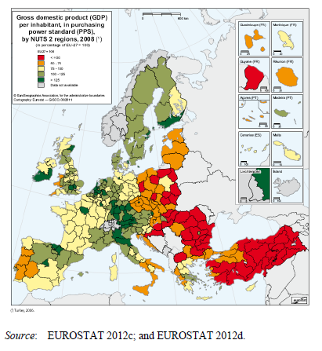
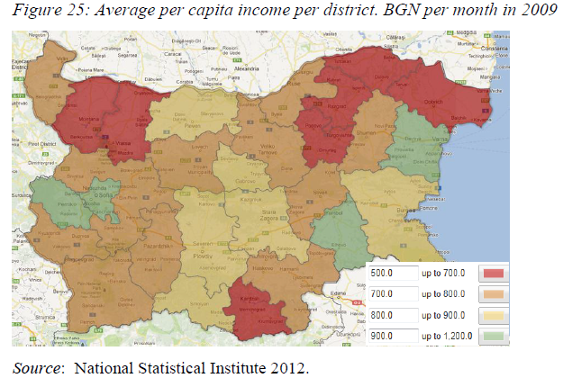
Is sustainability affordable?
Danube region poor by EU standards
Wide variation within countries eg Bulgaria

Slide 5
Cohesion Funds and Financial Sustainability
"The financial analysis in the 20 projects reviewed was generally found to be of reasonable quality and so providing a sound basis for financial sustainability"
"The seven operational projects studied all showed good financial performance and there was no indication that financial sustainability was going to be an issue"
  Source: Ex post evaluation of Cohesion Policy programmes 2007 – 2013 Environment. p.6

Slide 6
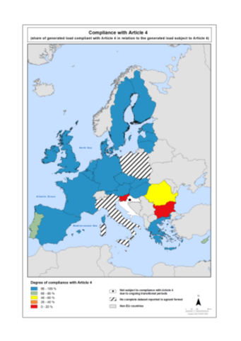
Compliance

Slide 7
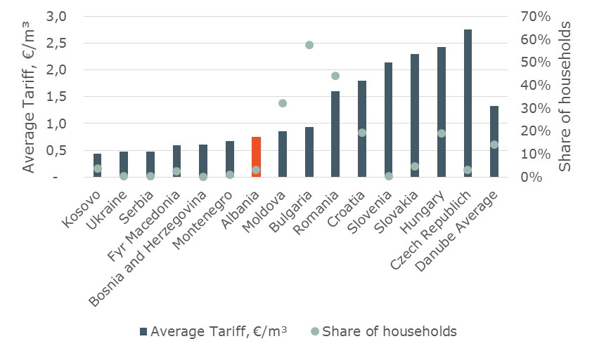
Regional comparison shows wide variation in tariffs and affordability
Affordability
Share of households that pay more than 3 per cent of their income for WSS
Source: State of the Sector, DANUBIS 2016

Slide 8
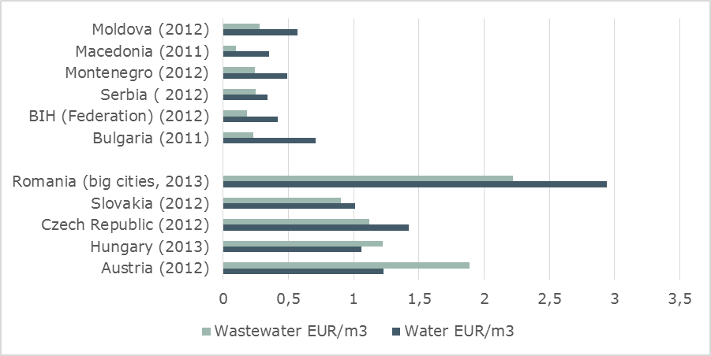
Tariff characteristics in WSS sector in Danube region**
Note the price of wastewater in EU versus non- EU countries
*
*Bulgaria is an EU member, but the tariff structure is as that for non-EU members
** Tariffs are for households /residential sector based on data provided to DANUBIS for State of the Sector report

Slide 9
Wastewater is more expensive than water –
But many consumers pay less for wastewater
Country /Year | Water EUR/m³ | Wastewater EUR/m³
Austria (2012) | 1.23 EUR/m³ | 1.89 EUR/m³
BIH (Federation) (2012) | 0.42 EUR/m³ | 0.18 EUR/m³
Bulgaria (2011) | 0.71 EUR/m³ | 0.23 EUR/m³
Czech Republic (2012) | 1.42 EUR/m³ | 1.12 EUR/m³
Hungary (2013) | 1.06 EUR/m³ | 1.22 EUR/m³
Macedonia (2011) | 0.35 EUR/m³ | 0.10 EUR/m³
Moldova (2012) | 0.57 EUR/m³ | 0.28 EUR/m³
Montenegro (2012) | 0.49 EUR/m³ | 0.24 EUR/m³
Romania (big cities, 2013) | 2.94 EUR/m³ | 2.22 EUR/m³
Serbia (Chamber of Commerce data 2012) | 0.34 EUR/m³ | 0.25 EUR/m³
Slovakia (2012) | 1.01 EUR/m³ | 0.90 EUR/m³
Source: SOS Danubis 2016, Bulgaria WSS Strategy 2014,
Note: Currency conversion by Author using xe.com

Slide 10
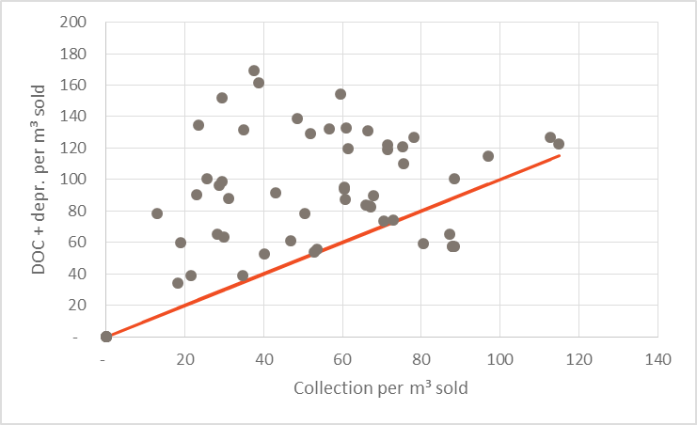
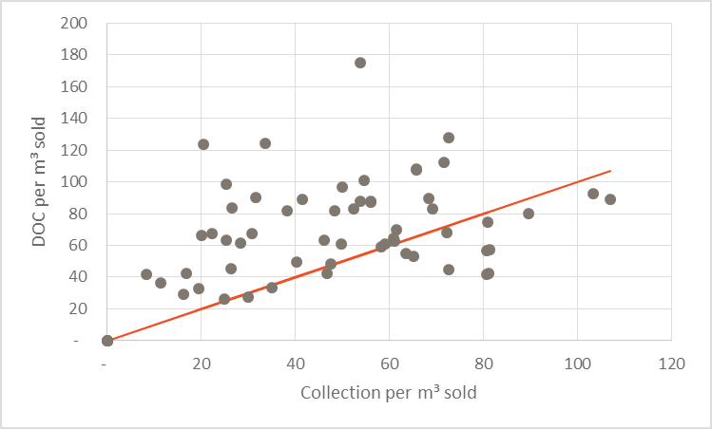
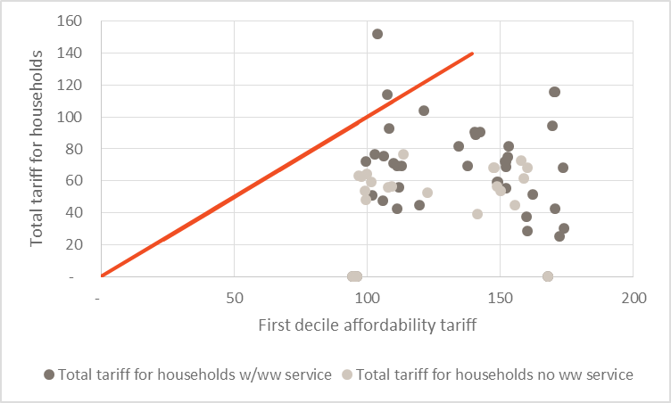
Cost cover ratios, sustainability and affordability
Albania 2015

Slide 11
Is cost coverage = sustainable utility operations
Water utilities rarely go bankrupt – They let their assets deteriorate
or
in worst cases, they do not pay their bills
  Debt to electricity company (and other suppliers)
  High levels of Non Revenue Water
  High levels of sewer infiltration (and inefficient operation of WWTPs
  Lack of capital retention funds (even in reach countries in Northern Europe)

Slide 12
Some steps towards sustainability
Tentative conclusions 1 of 2
  First things first
    Tariffs that cover at least operating & financing costs, proper maintenance & (most of) depreciation are necessary but not sufficient for sustainability
    Affordability is a real concern – but low tariffs is not the solution
  Asset management – Maintenance delayed is maintenance denied
    Asset management is key. Know your assets, make a maintenance and replacement plan.
    ISO 55000 a good place to start. Australian Public Sector – Good practice on a large scale

Slide 13
Some steps towards sustainability
Tentative conclusions 1 of 2
  First things first
    EU candidate countries – Avoid the traditional mistake to construct sewers in small agglomerations early
    EU member states – Implementation of WFD Article 9 is a good place to focus – Most often the key issues here are outside the municipal sector, but the negative impact is on municipal water supply
  Is there a need to strengthen the Regulator in your country?
    The regulator may be an important institution in support of sustainability in particular through:
    Tariff regulation
    Requiring asset management
    Regulating efficiency

