Slide 1
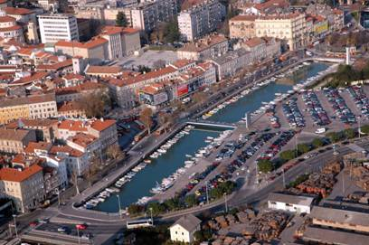
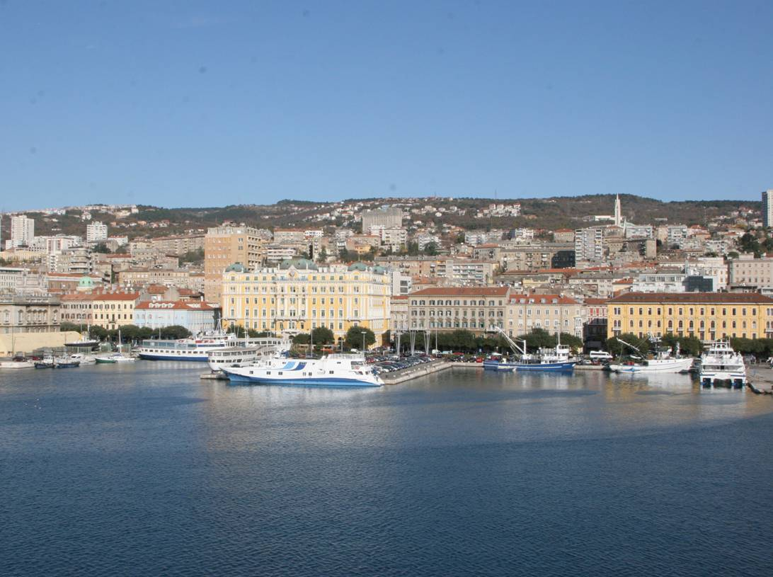
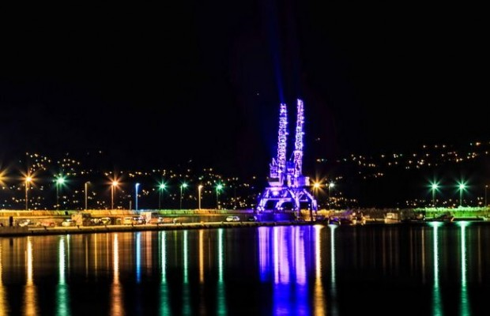
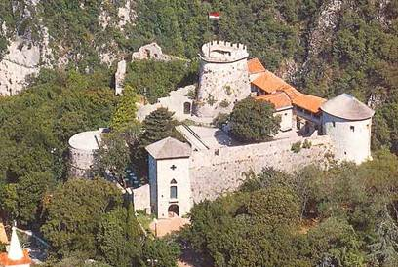
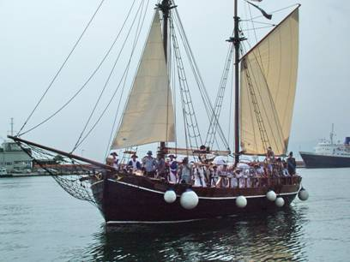
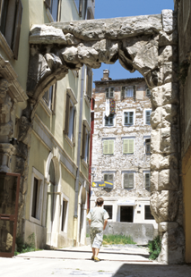
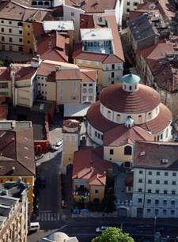
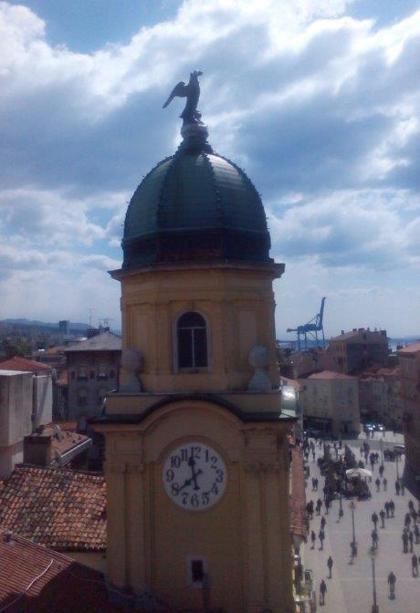
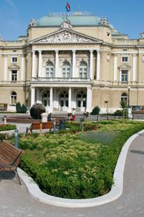
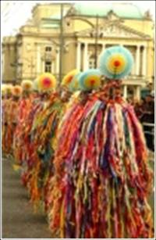
CITY OF RIJEKA
Mr. Miroslav Matešić, Deputy Mayor
Rijeka Municipality Bond Issue

Slide 2
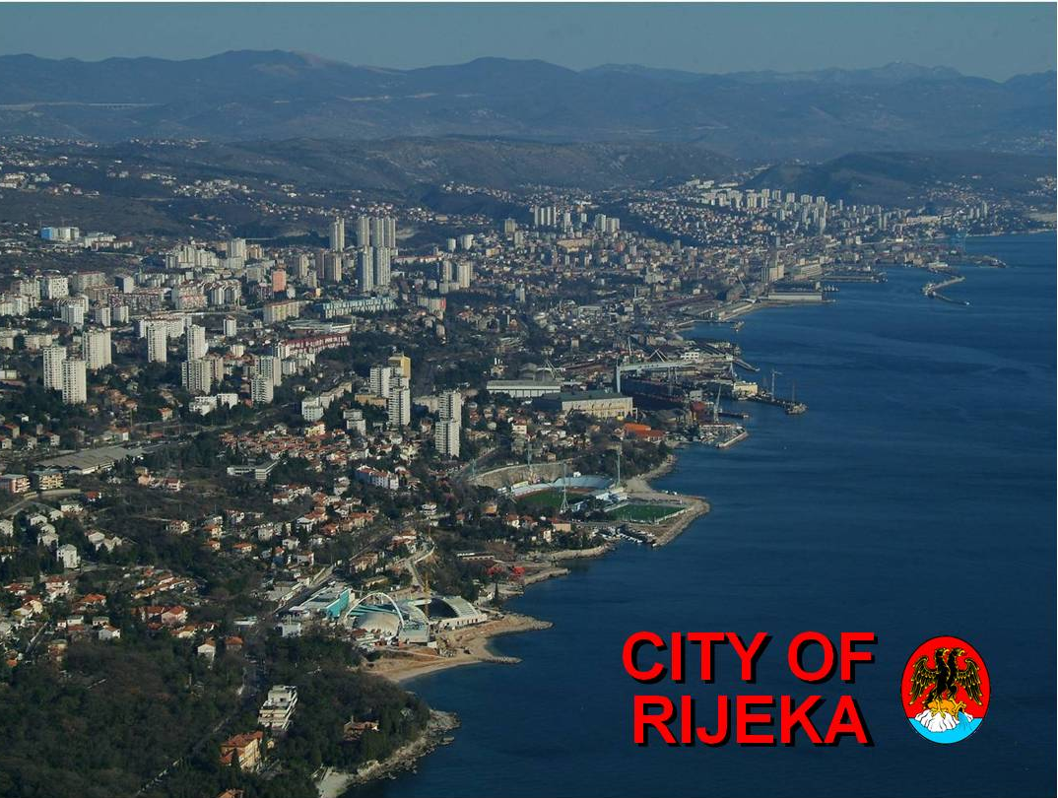

Slide 3
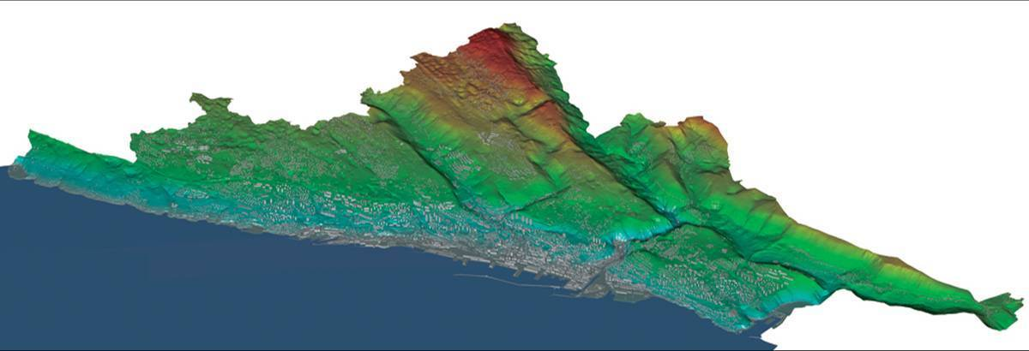
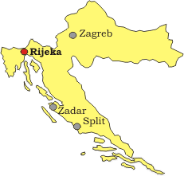
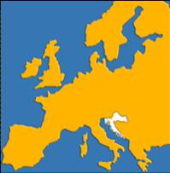
CITY OF RIJEKA
City of Rijeka:
Area: 44 km²
Population: 128.735
Rijeka urban agglomeration :
10 cities and municipalities
Area: 863 km²
Population: 216.649
Notes:
I wish to welcome you to the City of Rijeka and hope you have a pleasant stay in our city.

Slide 4
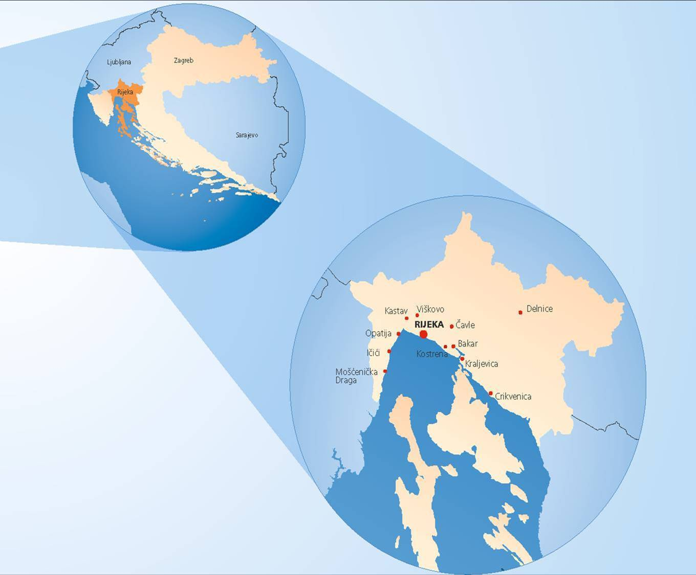
CITY OF
RIJEKA
Rijeka Gateway Project - project in cooperation with World Bank
City of Rijeka - the biggest issue of municipal bonds in Croatia

Slide 5
New models of city projects financing
EU funds
City Budget
Asset Management
Foundation
Bond Issue
Credit Rating
Project
Financing
CITY OF
RIJEKA
Loans
Asset Leasing
Rental
Securitization
Corporative Bonds
(City company)
PPP-Models
Guaranty
Debt Management
Factoring
Notes:
City of Rijeka have experience with alternative financing model, among others, with corporative bonds and private-public partnership.

Slide 6
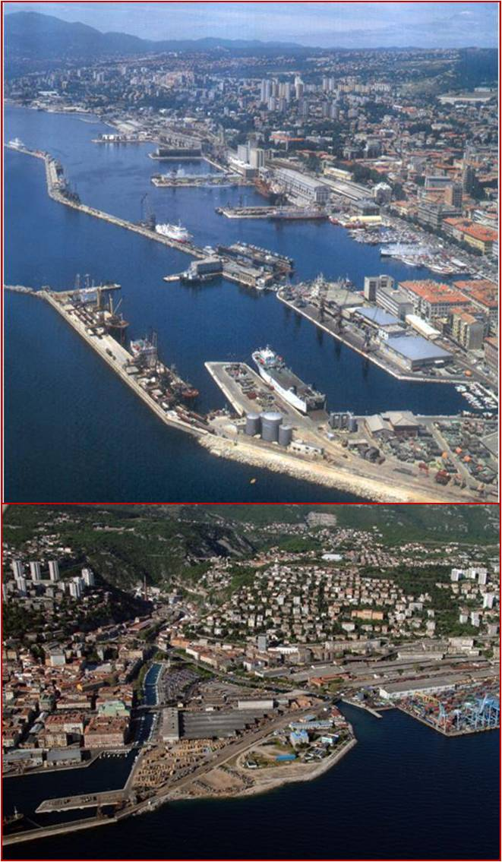
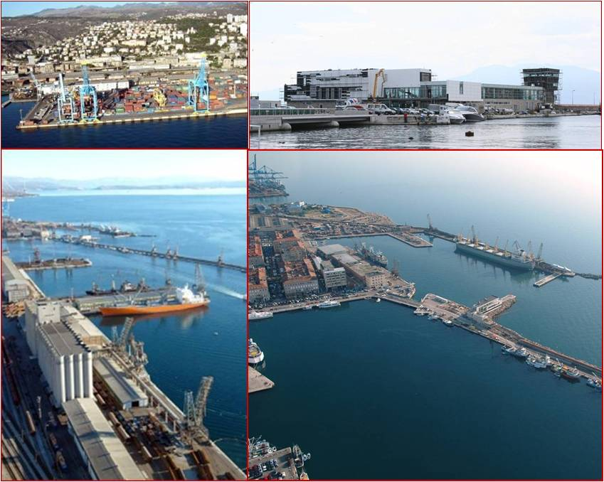
Rijeka Gateway
Project
1. Port modernization
2. Roads
3. Waterfront
Notes:
The most important project is Rijeka Gateway Project. This is a mega-project including three components:
Port modernization
Roads
Waterfront
Rijeka Gateway Project is the biggest project in the South East of Europe supported in preparation from the World Bank.
This is not just modernization of the port and other components but this is a project of increasing of competitivness of Croatian and regional economy connected with the modern Port and Road infrastructure.

Slide 7
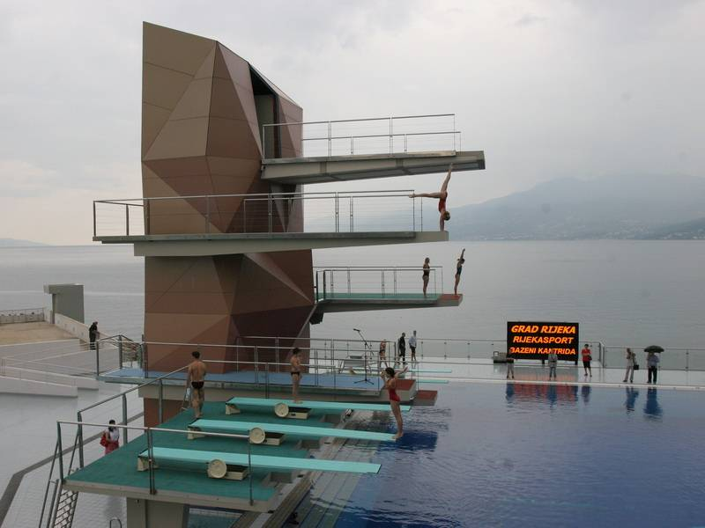
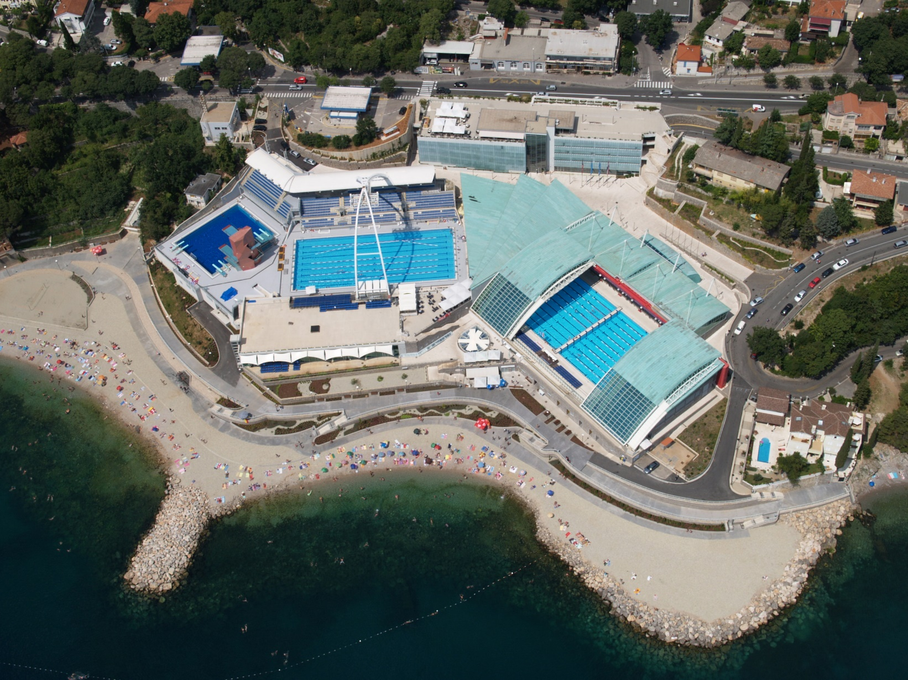
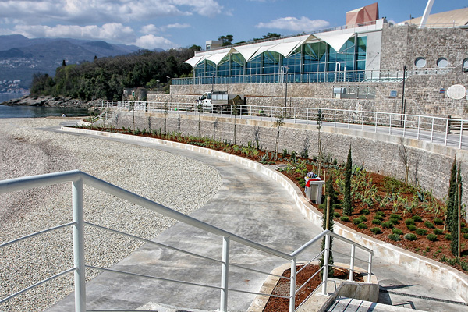
Rijeka’s first bonds for financing new Rijeka’s
swimming-pools
Notes:
City’s bonds was used finance complex of new Rijeka’s swimming-pools. Its opening was in December 2008 when also European championship in swimming were take place. That was 100th aniversary of sport swimming in our city.

Slide 8
Swimming-pool complex embraces:
5 separated swimming-pools
beach arrangement
sea promenade
garage business complex
new roads building
public pedestrian areas building
+ Resolving water supply problems at Kantrida and Turanj
D
F
A
A
A
F
A
A
E
C
B
Notes:
Just an expression “new swimming-pool”, which is frequently used while mentioning this complex project, cannot exactly describe all advantages that Rijeka is going to get with its construction completition.
Swimming-pool complex considers even five different and separated pools, from which the biggest one has removable roof. That is followed by beach and sea promenade arrangement, construction of garage and business complex, preparing all preconditions for ex shipyard revitalization, new roads construction, public pedestrian areas and resolving water supply problems at Kantrida and Turanj.

Slide 9
Final terms of City of Rijeka Bond Issue
Issuer: | City of Rijeka
Issue amount: | 24.574.513 EUR (in 3 tranches)
Issue date: | 18.07.2006 / 17.05.2007 / 01.04.2008
ISIN: | HRGDRIO167A4
Ticker: | GDRI-O-167A
Redemption: | amortizing
Principal repayment: | During the first six payments of semiannual coupon payments, principal will not be repaid; during next eight semiannual coupon payments 5% of principal will be repaid; during the last six semiannual coupon payments 10% of principal will be repaid.
Denomination: | EUR
Subscription currency: | HRK
Settlement currency: | HRK
Final maturity: | 18.07.2016
Interest rate: | 4,125%
Coupon payment: | semi-annual
Issue price (% of issue amount): | 94,965%
Yield to maturity: | 4,96%
Call option: | The Issuer may, under condition that such offer is equally available to all Bondholders, redeem part or all Bonds starting on 18 July 2010, once a year at the recall price as defined in the Prospectus
Insurance: | unsecured
Listing: | Official Market, Zagreb Stock Exchange
Issue Agent and Underwriter: | Privredna banka Zagreb d.d.
Payment agent: | Central Depositary & Clearing Company Inc.
Notes:
In this slide you can see Bonds issue conditions

Slide 10
Investors in Rijeka City Bonds
Structure of Investors in Rijeka City Bonds
Active sale of bonds to citizens
Rijeka City bonds were actively offered for sale to physical persons in all Rijeka branch offices of the Sponsor as well as in other branch offices of the PBZ Bank all over Croatia.
The bonds were bought by famous athletes, artists and businessmen
The bonds were bought by parents and grandparents for their children and grandchildren.
The citizens participated in the bonds sale for a symbolic price of 1 € up to several tens of thousands of Euro.
Institutional investors expressed a strong demand for Rijeka City bonds.
Notes:
Municipal bonds as a way of raising funds In order to secure funds for building the pool complex, the City of Rijeka issued municipal bonds. Among other investors, citizens of Rijeka also participated in buying bonds and in that way got involved in building the new complex and at the same time started a new way of saving money.

Slide 11
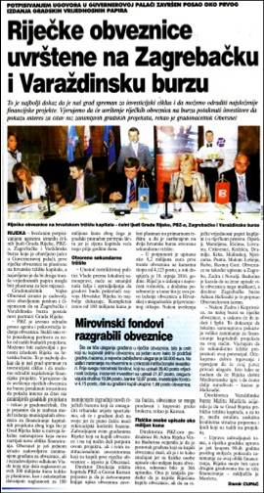
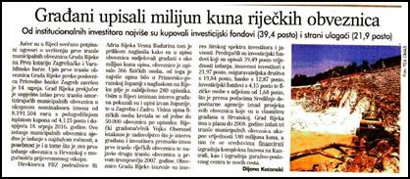
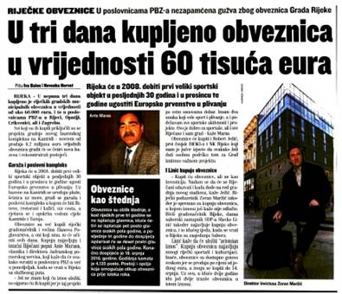
Active Marketing Campaign
Rijeka City bonds issuance was accompanied by an active marketing campaign.
An interview with the Mayor and the representatives of the PBZ Bank was broadcast on local and national TV and radio, and articles were published in all major newspapers.
A special agreement was achieved with local newspapers that acted as media sponsor of the event
TV contribution with Rijeka City Mayor and PBZ Bank Director for the Stock Exchange Report was broadcast 20 times in national TV prime time news.
Mayor’s chat with citizens, a leaflet and most significant pieces of information published on Rijeka City Internet pages.
Leaflets were printed for citizens, containing the advantages of all kinds of investments.
Citizens had the opportunity to get more information on Rijeka City Info Centre.
Within the road show and marketing campaign , press conferences for journalists were held in Rijeka and presentations for investors in Zagreb.

Slide 12
Rijeka’s first bonds – an impulse toward further development of the City of Rijeka
The Kantrida Swimming Complex in Rijeka was opened on the 24th July 2008. Since that time till the March 2017, a total of 2,414,794 users were recorded.
The Swimming Complex is used by all age groups, starting from the six months babies.
The sports users are sports clubs (domestic and foreign), various associations, institutions, companies, national sports teams (domestic and foreign) and individuals.
CITY OF RIJEKA
Notes:
It was special pleasure to greet you at this presentation at which we present all advantages of long expected Rijeka bonds.

Slide 13
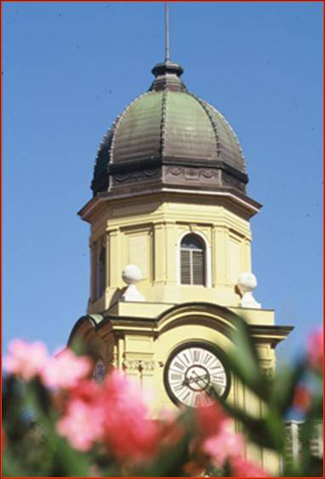
City of Rijeka
Sister City and Friendly City Relations
Kawasaki, Japan
Faenza, Italy
Neuss, Germany
Csepel, Hungary
Qindao, China
Ljubljana, Slovenia
Rostock, Germany
Genova, Italy
Este, Italy
Dalian, China
Burgas, Bulgaria
Bitola, Macedonia
Ningbo, China
Karlsruhe, Germany
Cetinje, Montenegro
Trieste, Italy
Roma, Italiy
Novi Sad, Serbia
Rijeka 2020
European
Capital of Culture
www.rijeka.hr

