Slide 1
Innovative financing solutions: Durban water recycling plant
Neil Macleod

Slide 2
Why build the plant?

Slide 4
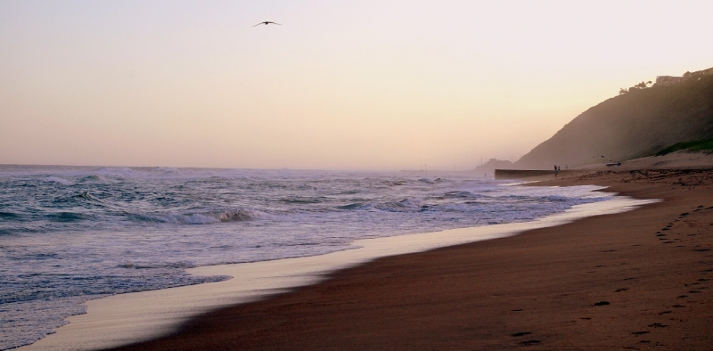

Slide 7
Why use a PPP as the vehicle to implement the facility?

Slide 8
The process we followed

Slide 9
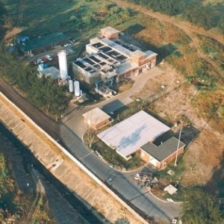

Slide 10
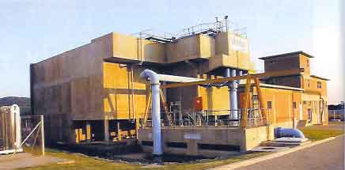

Slide 11
The end result

