Slide 1
Albania: Water Supply and Sewerage Financing Options
Government of Albania
Lindita Sotiri
WSS Financing Strategy Team
Michael Jacobsen – COWI
Anri Dajko – Valu Add Management Services
Notes:
This is a presentation of work done by COWI and ValuAdd under a contract with the World Bank.
I served as Project Director and Philip Giantris as Team Leader.
The following presentation is a presentation of our work with a focus on the tool that we developed, but also giving a quick overview of the sector and the policy recommendations in our report.
It is a personal presentation, and I would like to emphasize that the findings and conclusions are those of the consultant and do not necessarily represent the views of neither the Government, the World Bank or the European Union whom I understand has co-financed the multi-donor grant facility from which this project is funded
The presentation has more slides and text than I can cover in 20 minutes so the handouts are intended for future reference. You will get those afterwards. Therefore, I may skip some information quickly in this presentation and we can discuss it during the discussion period.

Slide 2
Albania Water Supply and Sewerage Financing Options
Rationale for and Organization of Study
2. Purpose and Structure of the Financial Analysis Tool
3. Scenario Analyses and Policy Observations and Recommendation

Slide 3
What Drove Us to Undertake the Study?
1. Rationale for and Organization of Study
We felt we knew our water supply and sewerage services objectives.
We has a strong feeling that we had a serious financing gap.
We lacked the harmonization of needs with wants and the real possibilities for going forward.
We had no clear methodology to understand and address the gap.
Notes:
This is in line with our TOR and an agreement between the World Bank and the Government last summer. We have linked to the work of the Water for People Working Group. We have also reached out to donors. GIZ has done much interesting work that we have tried to access and incorporate, not always successfully.

Slide 4
Purpose of Study
1. Rationale for and Organization of Study
To support the Government (Water for People working group) in developing a WSS financing vision
Show options for redesign of investment flows and instruments (efficiency, targeting of investments, links to performance)
Support improvement to the tariff setting (fixed and variable components, policies and practices of regulator)
Assess tariff level and affordability issues
Assess subsidy scheme and coping cost (outside the Financial Strategy Model)
Notes:
This is in line with our TOR and an agreement between the World Bank and the Government last summer. We have linked to the work of the Water for People Working Group. We have also reached out to donors. GIZ has done much interesting work that we have tried to access and incorporate, not always successfully.

Slide 5
Benefits of the Analytical Model
5. Policy Observations and Recommendation
Provides for informed decision making.
Allows for realistic considerations of scenarios.
Supports the development of a Concrete Road Map that accommodates integrated and harmonized interventions.

Slide 6
But There Are Risks to Consider!!!!
5. Policy Observations and Recommendation
New approach needs time and capacities.
Many stakeholders challenge to be in the same boat.
Requires political will and support and not populism.

Slide 7
Next Steps
5. Policy Observations and Recommendation
Raise awareness across Ministries and Institutions.
Implement the Road Map and monitor progress.
Train staff to maintain, update and apply the model.
Support the further application/replication of the model to the other three (3) thematic groups/sectors under the National Water Council.

Slide 8
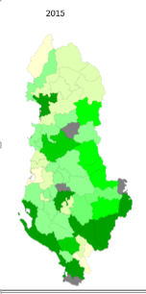
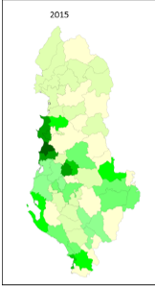
Room for improvement in water supply coverage
1. Brief overview of sector performance and funding
Coverage URBAN water supply
Coverage RURAL water supply
Performance Target | Measure | Base Year 2014
Water Service Coverage Urban | % of Population | 89
Water Service Coverage Rural | % of Population | 36
Sewerage Coverage Urban | % of Population | 63
Sewerage Coverage Rural | % of Population | 6
WWTP coverage Urban | % of Population | 12
WWTP coverage Rural | % of Population | 0
Non-Revenue Water | % of System Input | 67
Collection Efficiency | % of Current Bills | 91
Continuity of Service | Hours/Day | 13
Direct Operating Cost coverage | % | 98
Total Cost coverage | % | 73
Notes:
You will recognize that the numbers in the table to the left differs from those published by the Benchmarking Unit. This is because until 2015 the Benchmarking Unit published data for areas for which the utilities had the jurisdiction to supply water. This meant that areas outside jurisidiction, largely, but not only, rural areas were not included in the statistics.
We have used the Benchmarking Unit data available for areas within jurisdiction of utilities and for areas outside we have had access to a large sample collected under a project funded by the Government of Austria
Thus our data for coverage are lower than those published – in particular as refers to rural areas.

Slide 9
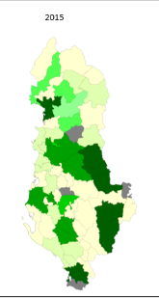
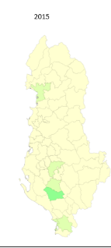
...... and even more so for sewerage and WWTP coverage
1. Brief overview of sector performance and funding
Coverage URBAN water sewerage
Coverage RURAL water sewerage
Performance Target | Measure | Base Year 2014
Water Service Coverage Urban | % of Population | 89
Water Service Coverage Rural | % of Population | 36
Sewerage Coverage Urban | % of Population | 63
Sewerage Coverage Rural | % of Population | 6
WWTP coverage Urban | % of Population | 12
WWTP coverage Rural | % of Population | 0
Non-Revenue Water | % of System Input | 67
Collection Efficiency | % of Current Bills | 91
Continuity of Service | Hours/Day | 13
Direct Operating Cost coverage | % | 98
Total Cost coverage | % | 73
Notes:
The lower numbers are particularly visible for sewerage, of which there is very little outside the jurisdiction of the utilities. The WWTP data are from 2015

Slide 10
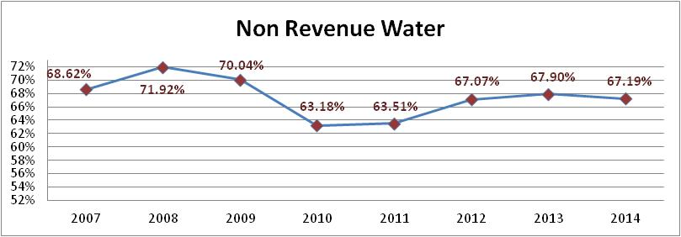
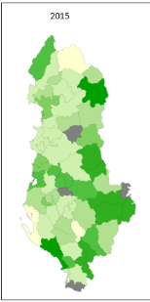
No visible improvement in non-revenue water over time Very large differences between utilities / municipalities
1. Brief overview of sector performance and funding
Notes:
Data are from the benchmarking unit data base.
Self-reported,
NRW in % is not a very good measure as we know –
But the picture is still clear

Slide 11
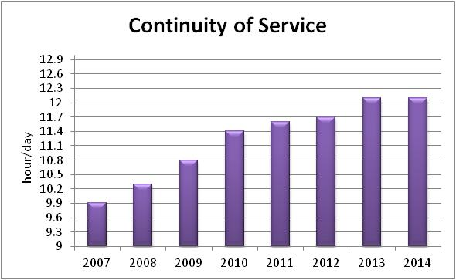
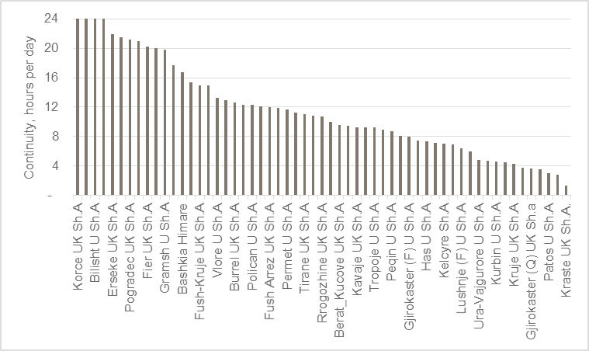
Continuity of Service – still not achieved Only four utilities report 24/7 supply Consumers report even less 24/7 supply
1. Brief overview of sector performance and funding
REPORTED BY CONSUMERS | Per cent | Cumulative per cent
0-6 hours | 84.5 | 84.5
6-12 hours | 12.0 | 96.5
12-18 hours | 2.5 | 99.0
18-24 hours | 1.0 | 100.0
Notes:
Note the slow improvement in recent years. These data are self-reported as are our data (Benchmarking)
The following utilities report 24 hours supply in all their zones:
Bilisht UK Sh A
Korce UK Sh A
Rubik UK Sh A
Librazdh UK Sh A
Porgadec, Skhoder, Fier and Erseke are above 20 hours supply on average for their zones as they provide 24 hours to most consumers
Note how reporting by consumers in the Living Standards Measurement Survey gives much lower figures!

Slide 12
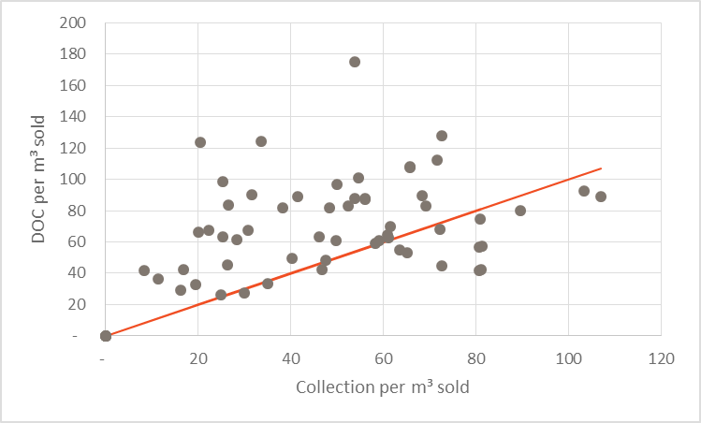
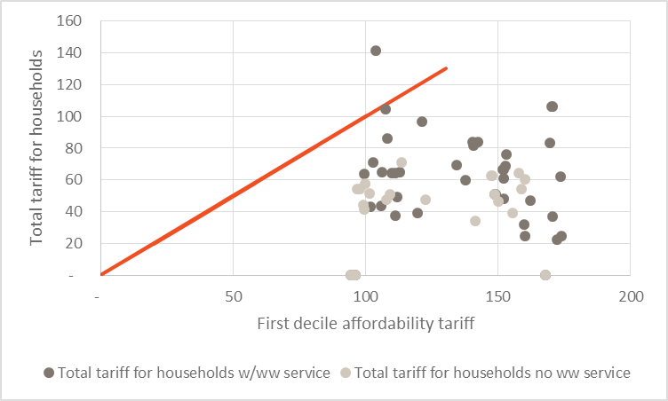
Collected revenues are insufficient to cover operations and minimal maintenance Tariff increases would be affordable in most municipalities even for the poor
1. Brief overview of sector and funding
Direct Operating Costs (DOC) include maintenance of less than 0.01 EUR per m3 water produced
Notes:
Explain the scatter diagram
DOC based on self-reporting. Note the implied very low cost for maintenance. Note how an average of tariffs`= DOC hides the fact that more than half of the utilities charge too little to cover their DOC (which is why they build up energy debt year after year)
Tariffs – one tariff for consumers with ww and consumers without. We have constructed artificial average tariffs on this basis – but we have the underlying data and use them here
Affordability based on LSMS. Note how surprisingly that there is affordability in Albania. This largely reflects current very low tariffs (no tariff is higher than 1 EUR/m3 and many are less than 0.2 EUR per m3)
Note to self: The tariff shown in the tariffs versus affordability chart is the tariff for customers with and without WW services separately, while the tariffs shown in the tariffs versus DOC chart are a weighted average of tariffs in that municipality. Therefore the max. actual tariff is lower here (as it includes a share of customers who do not have access to WW and therefore have been assumed to not pay for it)

Slide 13
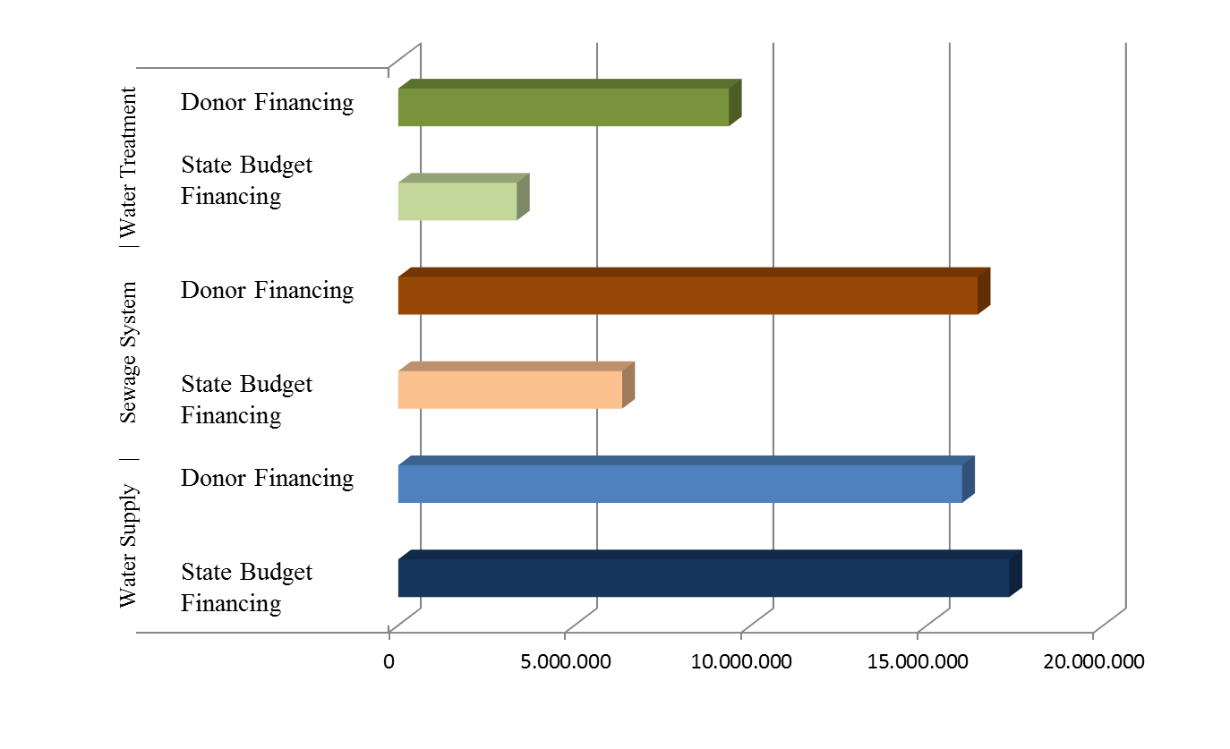
Donors dominate investments in wastewater – better balance in investments in water supply
1. Brief overview of sector and funding
Year | Source |  |  | Use per Service
 | International Transfer | National Transfer | Total | Water Supply | Wastewater Collection | Wastewater Treatment | Total
2005 | 32,376 | 18,200 | 50,596 | 42,148 | 8,333 | 115 | 50,596
2006 | 32,829 | 21,538 | 54,366 | 38,132 | 7,427 | 8,807 | 54,366
2007 | 23,136 | 20,125 | 43,260 | 26,291 | 11,687 | 5,282 | 43,260
2008 | 36,831 | 25,487 | 62,318 | 37,528 | 17,651 | 7,140 | 62,318
2009 | 32,460 | 20,821 | 53,281 | 28,850 | 12,285 | 12,141 | 53,281
2010 | 25,136 | 29,900 | 55,036 | 24,341 | 14,587 | 16,108 | 55.036
2011 | 30,202 | 19,329 | 49.531 | 16,124 | 21,457 | 11,951 | 49,531
2012 | 29,130 | 13,762 | 42,892 | 13,071 | 27,699 | 2,123 | 42,892
2013 | 21,180 | 18,909 | 40,089 | 17,340 | 18,381 | 4,368 | 40,089
Avg. 2005-13 | 29,253 | 19,519 | 48,772 | 23,903 | 15,501 | 7,559 | 48,772
2014 | 52,513 | 16,933 | 69,445 | 13,672 | 29,468 | 26,306 | 69,445
2015 | 51,253 | 28,214 | 79,466 | 20,407 | 41,606 | 17,454 | 79,466
Avg. 2014-15 | 51,883 | 22,574 | 74,457 | 17,040 | 35,537 | 21,880 | 74,457
Avg. % Increase | 77.4% | 15.6% | 52.7% | -28.7% | 129.3% | 189.5% | 52.7%
Notes:
Note how donors dominate financing of sewers and wastewater treatment
Combined with the inadequate tariffs charged for wastewater this raises a warning
An the warning seems justified in light of the mixed experience operating recently build WWTPs.

Slide 14
Purpose of the Financial Strategy Tool
3. Purpose and Structure of the Financial Strategy Tool
Financial model in Excel developed for Albania to support the analysis of various financing options in the WSS sector.
Tariff affordability analysis to assess level of tariff and impact on the “poorest of the poor”.
Scenarios of measurable improvements in WSS services defined with Government
Calculation of associated financing needs for these scenarios.
Excel-based model ensures internal consistency between policy targets, expenditure needs, and available financing. When there is inconsistency, the tool shows a financing gap.
"The purpose of computing is insights not numbers"
Hamming, R.W. (1962) in Numerical Methods for Scientists and Engineers. McGraw-Hill

Slide 15
Structure of the Financial Analysis Model
3. Purpose and Structure of the Financial Strategy Tool
Four Distinct Groups: Each with Modules and Segments
First Group are the policy-oriented (Cockpit, Scenarios and Assumptions) sheets. Policy-maker enters the desired targets for the water sector. These targets may be entered at national level and /or at local government level.
Second Group is the input data sheet. These are partly factual data on the water sector and partly projections for the future such as population projections, projections of income growth, price responsiveness of demand etc. These data are entered at the local government level and for each water utility
Third Group is the calculation sheet. Here, all calculations are done in the model.
Fourth Group is the summary statistics and outputs sheet. Here, calculated results are presented at the various geographical levels (national, municipal and rural versus urban) and presented in tables and figures
Notes:
A few notes on how we have built the model. It is an Excel model with no proprietary features – everything is open to the skilled user.
0) The policy oriented sheets have been constructed to be user friendly and address the most relevant policy questions
The input data sheet are from Benchmarking Unit database as far as possible. As you know these data are supplied by utilities. The database provides the data used both by the Ministry of Transport and Communications for policy development and by the Regulator for its regulation. Thus the database is the most authoritative source of information on utility data
We have complemented those data with data on areas outside Jurisdiction since the database only covers the (old) utility data within Jurisdiction
Our data are based on 2014 data since those were the ones available when the project started in November 2015. Can be updated (although if the structure of the variables has changed this will require changes in the structure of the Excel file as well)
As explained in an Annex to the report, we have constructed 61 utilities, one for each municipality based on existing data. These are "virtual" in the sense that most of these do not exist exactly as they have been presented – but the user can follow the transformation from the benchmarking data (plus added date for out of jurisdiction areas) to the 61 Municipalities
Calculations can be done for a specific utility or for a "typical" (=weighted average) Albanian utility. This allows us to address policy consequences both at national level and at the level of the municipal utility. Unit costs have been taken from the Master Plan. Thus fully consistent with Master Plan
Reporting is available for a specific utility and for a typical. Supported by graphs

Slide 16
Nature and Structure of the Financial Analysis Model
First Group (Cockpit) contains three modules where the policy-maker or model user specifies the following:
Policy objectives or targets to be achieved in the water sector as a stated value.
If the policy-objectives are not fulfilled, the policy maker/user have to specify a higher level of ambitions for the different policy-measures, which typically trigger higher investment costs.
Proposed tariff/tariffs that policy-maker feels can be supported both through public perception and social means.
Similar to case for investments, the model foresees an iterative process whereby the policy maker/user suggests a set of tariffs, evaluates the outcome in terms of affordability and cost coverage for utilities, and revises the tariff suggested as appropriate.
Proposed financing assumptions for the investment needs generated, based on the sector objectives.

Slide 17
Tariff Affordability Analysis
Affordability assessed using International “rule of thumb” criteria:
Monthly consumption of 3 m³ water per person (100 liters/person/day)
Affordability level of 4% of total household income
Model presents calculations respectively for the 1st and 3rd deciles and the average monthly income.
Policy maker can review affordability depending on how much attention is to be given to income distribution and poverty in determining the maximum affordable level for tariffs.
Affordable price per m³ of tap water is calculated using the formula:
Total Average Monthly Household Income
Affordable Price (Lek/m3)= Household size X 3m³
Average for Albania = 246 lek/m3 (range 170 lek to 323 Lek)

Slide 18
Three of the Scenarios Analyzed with Government
4. Scenario Analysis
Scenario 1: Government objectives as originally expressed by “Water for People” Working Group and specified in Steering Committee meeting in November 2015.
Scenario 2: Similar, but with the rate of investment lowered / coverage expansion slower so that it is not as heavily loaded in the early years.
Scenario 3: A realistic alternative specifically intended to meet the policy vision of the “Water for People” Working Group and the performance objectives of the Government, while providing a clear path towards EU compliance.
A realistic mix of expansion of coverage, tariff increases and changes in structure, efficiency improvements in energy, staff etc. and enhanced maintenance

Slide 19
Scenario 1
4. Scenario Analysis
Performance Target | Measure | Base Year 2014 | 2020 | 2027 | 2040
Water Service Coverage | % of Population | 62
Urban | % of Population | 89 | 95 | 97 | 99
Rural | % of Population | 36 | 75 | 80 | 90
Sewerage Coverage | % of Population | 36
Urban | % of Population | 63 | 95 | 97 | 99
Rural | % of Population | 6 | 25 | 40 | 75
Wastewater Treatment Coverage
Urban | % of Population | 12 | 50 | 97 | 99
Rural | % of Population | 0 | 0 | 40 | 75
Non-Revenue Water | % of System Input | 67 | 45 | 30 | 25
Collection Efficiency | % of Current Bills | 91 | 93 | 96 | 98
Continuity of Service | Hours/Day | 13 | 18 | 20 | 24
Cost Coverage-Collections
Direct Operating Cost | % | 98 | 110 | 120 | 130
Total Cost | % | 73 | 80 | 90 | 100
Applied assumptions:
Tariffs are increased to covers all operating costs in 2020 (approx. 130 lek/m³ for water supply plus the fixed connection fee, plus wastewater if applicable starting from 52 lek per m³ for water supply in 2014).
Investment funding from national and international sources are retained at the average level of the past 10 years (approximately 50 million EUR annually).
Results:
Financing needs of all utilities in Albania is highly negative in the first five years, and stays negative in every single year.
Not Feasible.

Slide 20
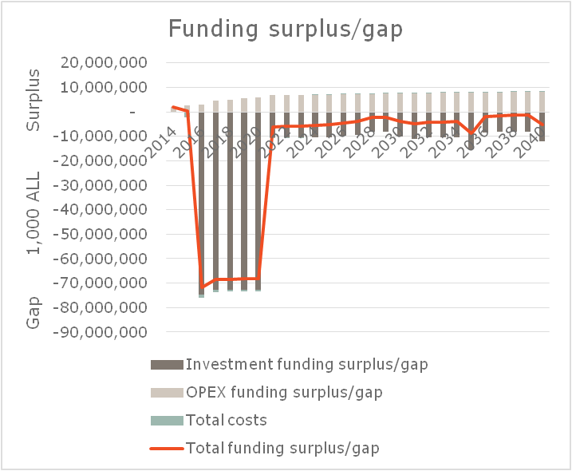
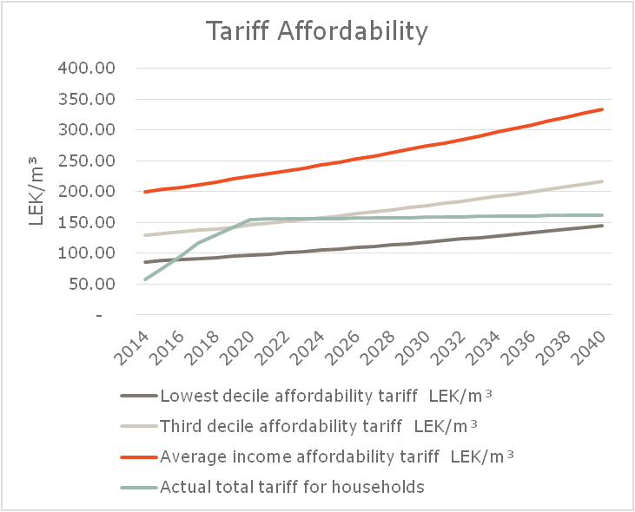
Scenario 1: Funding Gap & Tariff Affordability

Slide 21
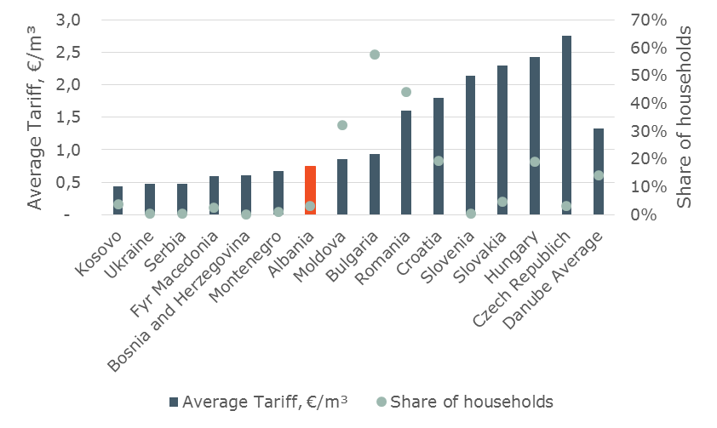
Regional comparison shows that tariffs in Albania are low and affordable
1. Brief overview of sector and funding
Share of households that pay more than 3 per cent of their income for WSS

Slide 22
Scenario 2
4. Scenario Analysis
Performance Target | Measure | Base Year 2014 | 2020 | 2027 | 2040
Water Service Coverage | % of Population | 62
Urban | % of Population | 89 | 92 | 97 | 99
Rural | % of Population | 36 | 50 | 75 | 90
Sewerage Coverage | % of Population | 36
Urban | % of Population | 63 | 78 | 80 | 99
Rural | % of Population | 6 | 20 | 35 | 75
Wastewater Treatment Coverage
Urban | % of Population | 12 | 47 | 80 | 99
Rural | % of Population | 0 | 16 | 41 | 75
Non-Revenue Water | % of System Input | 67 | 45 | 30 | 25
Collection Efficiency | % of Current Bills | 91 | 93 | 96 | 98
Continuity of Service | Hours/Day | 13 | 18 | 20 | 24
Cost Coverage-Collections
Direct Operating Cost | % | 98 | 110 | 120 | 130
Total Cost | % | 73 | 80 | 90 | 100
Applied assumptions:
Water supply service in rural areas is expanded more slowly, and, in particular, provision of urban wastewater collection and treatment is slower than in Scenario 1.
With no overall change in cash flow, this scenario only lessens the annual financial shortfall in the early years.
Results:
Scenario 2 demonstrates that unless investments are combined with both very substantial increases in both grants and loans for the initial financing as well as very substantial increases in tariffs it is not possible to arrive at a feasible scenario.
Not Feasible.

Slide 23
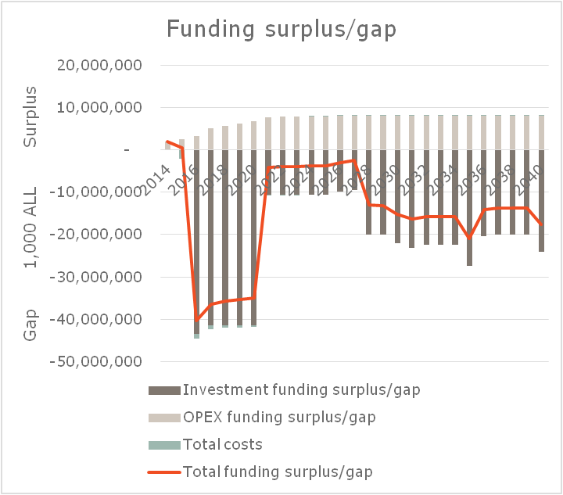
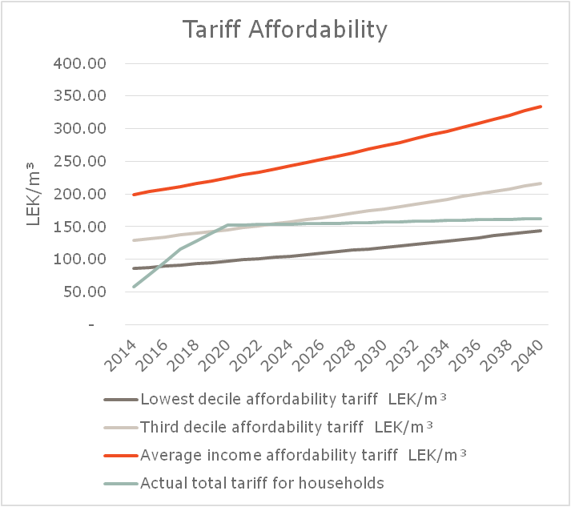
Scenario 2: Funding Gap & Tariff Affordability

Slide 24
Scenario 3 “Water for People Affordable Policy Package”
Performance Target | Measure | Base Year 2014 | 2020 | 2027 | 2040
Water Service Coverage | % of Population | 62
Urban | % of Population | 89 | 92 | 97 | 99
Rural | % of Population | 36 | 40 | 65 | 80
Sewerage Coverage | % of Population | 36
Urban | % of Population | 63 | 65 | 70 | 80
Rural | % of Population | 6 | 15 | 25 | 50
Wastewater Treatment Coverage
Urban | % of Population | 12 | 50 | 70 | 80
Rural | % of Population | 0 | 15 | 25 | 50
Non-Revenue Water | % of System Input | 67 | 59 | 47 | 38
Collection Efficiency | % of Current Bills | 91 | 94 | 96 | 98
Continuity of Service | Hours/Day | 13 | 14 | 18 | 22
Cost Coverage-Collections
Direct Operating Cost | % | 98 | >150 | >200 | >230
Total Cost | % | 73 | 89 | 94 | 92
Significant increase in sewerage coverage, both urban and rural, but less than originally envisaged
Significant increase in rural water coverage, but less than originally envisaged
Efficiency improvements
Enhanced maintenance (1% of assets p.a.)
Tariff increases no more than 10 per cent per year, keep affordable. Total tariff lower than in Scenarios 1 and 2!

Slide 25
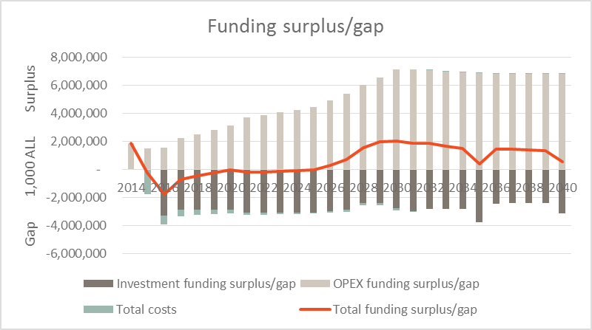
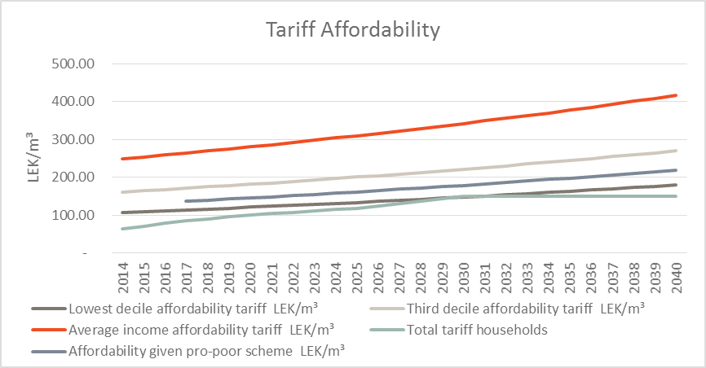
Scenario 3: Funding Surplus Gap & Tariff Affordability
Notes:
Note how this combination gives a feasible and affordable scenario
Note how we do not increase tariffs beyond 2030. But it could be done and more ambitious targets reached later in the period
note how we have included a pro poor subsidy scheme
Tariff increases have been kept below 10 % p.a. as advised by Regulator
National Contribution has been increased realistically as advised by Ministry of Finance – IFI contributions are linked to national contribution. Grants also although we have been a little optimistic on the composition of loans and grants

Slide 26
A vision for a funded WSS strategy
5. Policy Observations and Recommendation
For Albania to implement its water sector reforms, the “Policy Package” must include:
Investments leading to service level improvements
Policy measures to enhance efficiency in operations
Substantial tariff increases
Requests to IFI’s and the Ministry of Finance for increases in funding
The "Water for People Policy Package" that is shown combines Government targets with what is doable
A corollary: Unless there is a political will on tariffs and to significantly increase the Albanian Government’s budget support to meet the sector’s investment needs; then it will be next to impossible to achieve “EU similar” service levels, even by 2040

Slide 27
Components of the policy package
5. Policy Observations and Recommendation
Government capital investment spending would be at current levels through 2019 and increase to 30 – 35 million Euro per year thereafter
IFI capital investment spending would be at current levels through 2019 and increase to 75 million Euro per year thereafter
Average Combined Tariff for water supply and sewerage services would increase at the rate of 5% per year through 2030, and then no more increase. In 2014 tariff is 65 lek/m3 increasing to 95 lek in 2020; 130 lek in 2027; and 150 lek in 2040
Sewerage Coverage and WWTP in urban areas reach 80 % by 2040
Sewerage Coverage and WWTP in rural areas reach 40 % by 2040
Significant improvements in efficiency, partly due to EE investments

