Slide 1
Data collection from utilities, their need and use for producing Performance Indicators (Study Case Kosovo)
Presented by: Sami Hasani, WSRA, Kosovo Head, Tariff and Finance Regulation Department
Vienna, 17th May 2017

Slide 2
Outline of Presentation
Legal basis for reporting data from utilities to WSRA
WSRAs legal obligation to collect data and to monitory utilities performance
WSRAs legal actions to fulfill its obligation
Processing the data reflected in the OFCR report
Reports published from WSRA
Functioning of reporting system and reliability of KPI
Penalties for non-reporting and incorrect reporting
Usage of published data and KPI
Performances Annual Report

Slide 3
Legal basis for reporting data from utilities to WSRA
Utilities are legally obliged to report to WSRA
Utilities has appointed persons responsible for reporting and communicating with WSRA
Utilities reports their data on monthly and yearly basis
Utilities report about almost 150 data monthly and we extract 40 PI, and from them 14th KPI
The reported data are;
a.) Operative, b.) Financial, c.) Customer service, and d.) Other data that may be required from WSRA

Slide 4
WSRAs legal obligation to collect data and monitory utilities performance
WSRA and utilities communicate closely
Utilities has to report all requested data
Collected data always are checked for regularity
We evaluate different aspects of utilities performance
Each indicator has its own definition
Monitoring standards of services is ongoing process,
The utilities performance is determined from extracted KPI
We rank best utility
We publicly recognize best performing utility
We give award.

Slide 5
WSRAs legal actions to fulfil its obligation
We have created a unique reporting regime in EXCEL and Access called Operational, Financial and Customer Reporting format (OFCR), and took this actions;
selected the data to be reported from utilities
selected KPI
issued written manual for use OFCR format
trained utilities staff to use it
The data are directly upload from utilities authorized person
Data past in OFCR format becomes WSRA property
We analyze reported data and produce indicators

Slide 6
Processing the data reflected in the OFCR report
We analyze, evaluate, process and produce KPI
We compare KPI with set targets from regulatory tariff process
By comparing utilities KPI with set targets we determine degree of fulfillment of objectives set year by year
Targets are set in close communication
Targets are determined from setting tariffs
Set targets are contractual obligations between utilities and WSRA
Because of that we monitory them regularly

Slide 7
Reports published from WSRA
Before we publish any report or financial statements we communicate closely with utilities
We continually verify data and indicators
WSRA once a year audits data and financial statements
Prepares 2 types of reports;
4 Assessment report on the degree of fulfilment of 14 KPI, and
Annual Performance report with 34 KPI
Assessment report are published in 4 edition (3 periodically and 1 annually)

Slide 8
Functioning of reporting system and reliability of KPI
WSRA performs its legal obligations institutionally with the utilities
Reporting now is stabilized and well functioning
Communication is now collegial
We verify data in each stage of work,
Once yearly we audit reported data
Extracted indicators are reliable,
WSRA is open to accept utilities good suggestions

Slide 9
Penalties for non-reporting and incorrect reporting
Utilities can be penalized from WSRA for this behaviors;
if they give incorrect, or inaccurate, or dis-oriented data,
provides services without a license,
not respects license terms,
supplies non-quality water;
cut water services without any serious reasons etc.

Slide 10
Usage of published data and KPI
Data published by WSRA are used by all interested parties for them, like;
utilities,
shareholders as supervison body,
local and international institutions (EC bodies),
doners -external and internal, and
other interested parties for them etc.

Slide 11
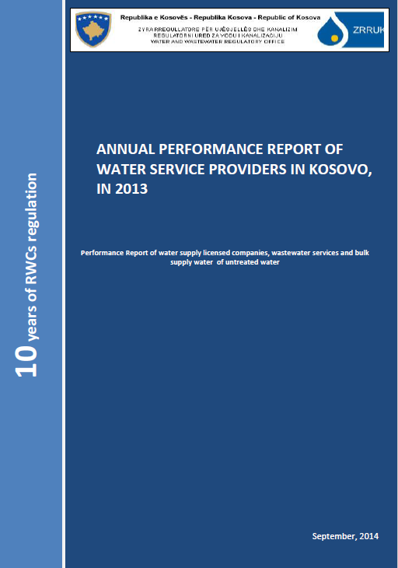
Performances Annual Report
concise, easy readable and understandable
diagrams clearly reflects;
results,
professionalism,
easy discussions results
independent and transparent findings etc.

Slide 12
Thank you for your attention !

