Slide 1
Ministry of Regional Development and Public Works
Water and Sewerage Sector in Bulgaria
Challenges and Vision
Vienna
May 2016

Slide 2
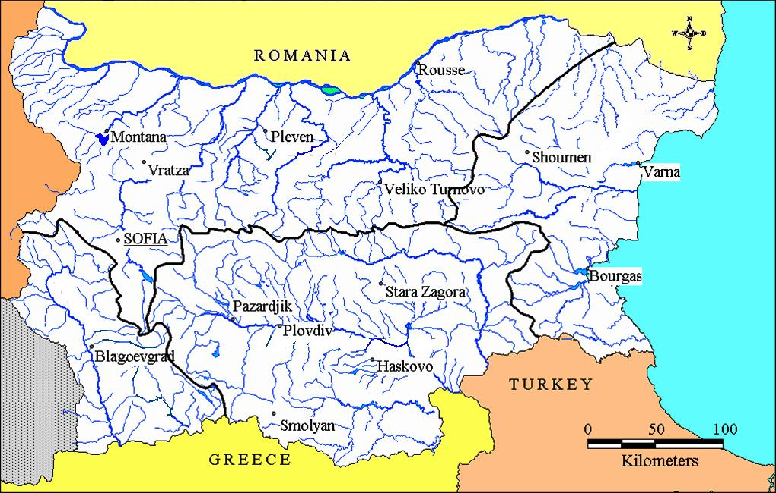
Ministry of Regional Development and Public Works
Map of Bulgaria
Water Catchments

Slide 3
Ministry of Regional Development and Public Works
Institutional Framework
Management of the Water Sector in Bulgaria
Ministry of Environment and Waters:
The national management of the water resources
Ministry of Regional Development and Public Works
The national policy in the water supply and sewerage sector

Slide 4
Ministry of Regional Development and Public Works
Functional framework
Owners of the infrastructure – the state and the municipalities
WSS Associations – representatives of the owners
WSS Operators – sign a contract with the owners of the infrastructure for management, maintenance, operation and provision of services
    Water Regulator (SEWRC)- Quality of service and Price of water
WSS Associations
WSS Operators
  State
Client
  Municipalities
SEWRC

Slide 5
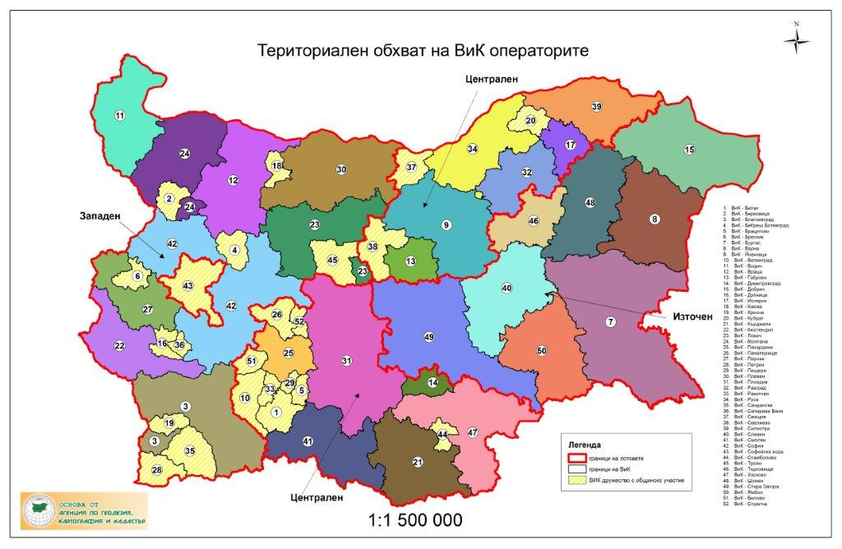
Ministry of Regional Development and Public Works
WSS operators
Management, maintenance and operation of the WSS assets and provision of WSS services
29 companies - 100% state or mixed 51% state / 49% municipal ownership
22 companies - 100 % municipal ownership
1 Concession - Sofia municipality

Slide 6
Ministry of Regional Development and Public Works
What we have done?
Public ownership of the water supply and sewage infrastructure – WSS assets - municipal or state owned on a functional principle.
Concluding contracts for Management, maintenance and operation of the WSS assets and provision of WSS services between the water supply and sewage association as representative bodies of the owners and WSS companies.
Introducing and application of regional approach in planning the development of the WSS infrastructure trough Regional Water and Waste Water Master plans and Regional Feasibility Studies.
The Water reform as initiated in 2009 has three pillars:

Slide 7
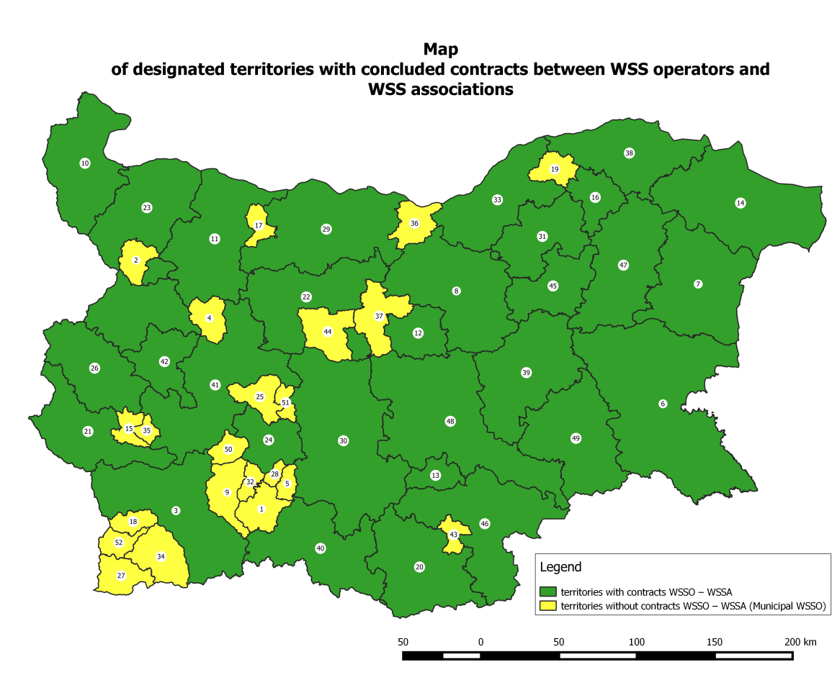
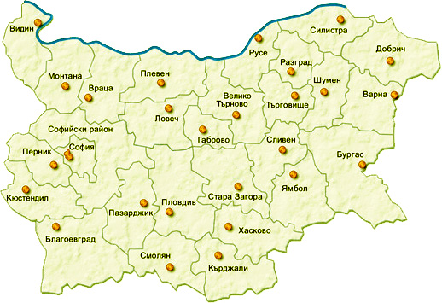
Ministry of Regional Development and Public Works
The Challenges and Future activities

Slide 8
Ministry of Regional Development and Public Works
Strategy for development and management of the water supply and sewage in Republic of Bulgaria
The Strategy was elaborated and adopted in 2014 with the support of the World bank together with an Action plan for its implementation
It sets four strategic objectives:
Compliance - WSS infrastructure meets the requirements of the EU directives and Accession Treaty obligations;
Sustainability - WSS services are environmentally, technically and financially viable;
Affordability - WSS services are affordable for all consumers;
Value for money - The service quality performance and efficiency are equivalent to good European practice.
The investment needs as defined comprise 6 billion EUR for achieving compliance, effectiveness and sustainability of the sector.

Slide 9
Ministry of Regional Development and Public Works
Regional Feasibility Studies for 14 areas
4 Contracts for 20 ml. EUR were signed in March 2016
Technical and economical documentation for project application under Operational programme “Environment 2014-2020”
The measures should ensure achieving compliance with EU directives and effectiveness of the WSS infrastructure
The feasibility studies (technical documentation) will be ready by the Spring of 2017 and application forms later in the autumn of 2017.

Slide 10


Ministry of Regional Development and Public Works
Two projects of the MRDPW under OPE 2014-2020
Activities aiming at compliance and effectiveness, management and enhancing capacity in the WSS sector:
Elaboration of the Regional Feasibility Studies for 14 areas
Elaboration of Information Systems for the WSS infrastructure and services
Trainings, seminars, demonstration of good practices etc. for the stakeholders in the sector
Revaluating the WSS public assets
Consultancy services from the World bank particularly intended to implement the Action plan to the WSS Strategy, to improve WSS services and optimize capital and operating costs, to continue enhancing the regulatory capacity to improve service delivery in the sector.
Others
Notes:
Процедурата стартира през септември 2015 г. и беше координирана с инициативата JASPERS и Европейската комисия
Участваха 45 предложения от 33 консорциума с българско и международно участие
Четирите договора ще бъдат подписани и изпълнявани едновременно
По досегашните данни РПИП ще се изготвят за 183 агломерации, 57 от тях над 10 хил. е.ж.

Slide 11
Ministry of Regional Development and Public Works
Thank you for your attention!
www.mrrb.government.bg
Nevena Ivanova
N.Ivanova@mrrb.government.bg

