Slide 1
Addressing the double challenge EU accession process, an opportunity to address water sector challenges
2016 Danube Water Conference
12 May 2016, Vienna
Marianne WENNING
Director
DG Environment, European Commission

Slide 2
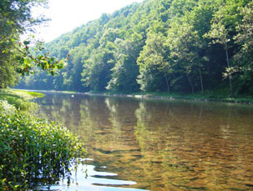
EU Water Policy
The WFD objective: Good water status by 2015
All fresh, ground, transitional and coastal waters in the EU
Status considers ecological (including hydromorphology), chemical and quantitative aspects
River basin-based management / coordination at regional & international level
River Basin Management Plans in 6-year cycles (2010-2015, 2016-2021, 2022-2027)
Programmes of Measures to achieve good status
Use of economic instruments and need for necessary investments

Slide 3
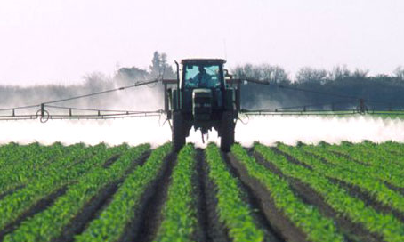
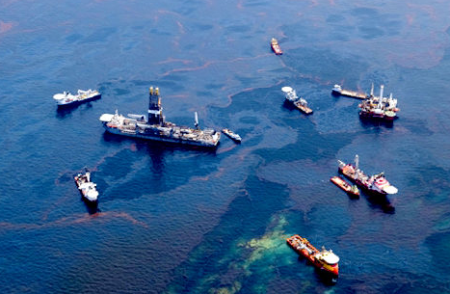
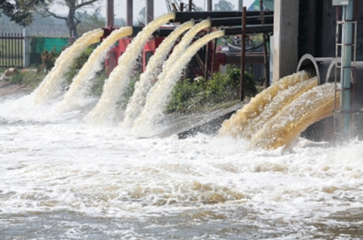
Main pressures
Diffuse pollution
Agriculture - nutrients and pesticides
Flow regulation and morphological alterations
Hydropower
Navigation
Floods management
Abstraction
Energy production
Agriculture
Point sources
Urban Waster Water
Urban untreated storm overflow and run off
Industrial wastewater

Slide 4
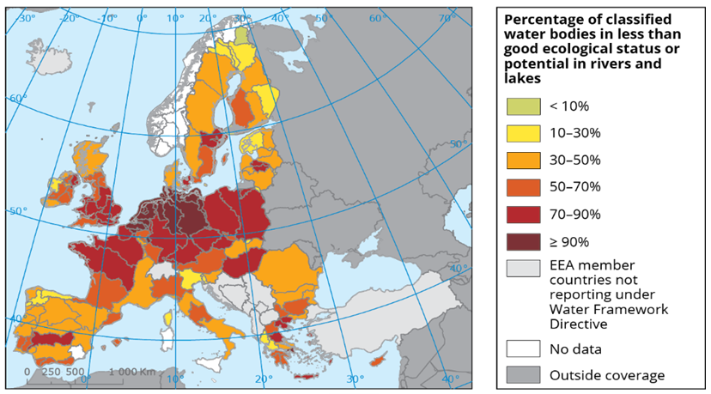
Challenges: Less than Good Status

Slide 5
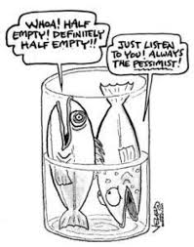
RBMPs 2010-2015
Often insufficient monitoring and deficient analysis of pressures
Frequent and non-transparent use of exemptions
Programmes of measures rarely address the gap
Insufficient investment and financing of measures
Only partial application of cost recovery

Slide 6
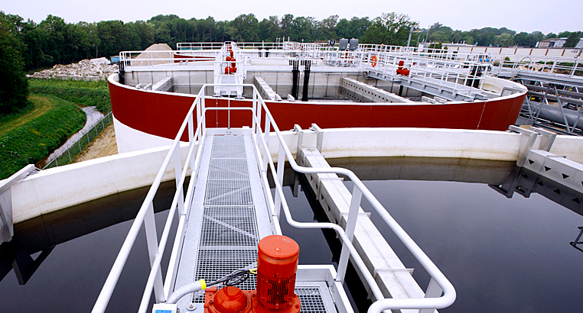
Investment
Investment needs:
Implementation of the Water Framework Directive, 1st cycle 2009-2015: €300 billion (spent 1/3 = ca. €15 billion/Y)
Construction, renewal and maintenance of urban water infrastructure: €90 billion /y
R&D: €7 billion / Y (spent only €4 billion / Y)

Slide 7
Several funds at EU Level:
Financial
instruments
Structural & Cohesion Funds: ESIF – European Structural and Investments Funds (regional, agricultural, social and maritime specific)
European Fund for Strategic Investment (EFSI)
Horizon 2020 > InnovFin – Eu Finance for Innovators > specific Water Innovation Facility is under discussion
Development of a Water Investment Platform

Slide 8
4 Funding mechanism for non-EU countries:
Financial
instruments
IPA – Instrument for Pre-accession Assistance
TAIEX – Technical Assistance and Information Exchange Instrument
Twinning – Institutional cooperation between public administrations
ECRAN – Environment and Climate Regional Accession Network

Slide 9
Conclusions
The Water sector has high importance
For achieving our environmental objectives
As creator of jobs and economic growth
Water management in large basins such as the Danube Region is a true challenge
Coordination
Integrated approach
Realistic planning
Finding funds needed
Timely execution of the plans
Capacity building and absorption capacity

Slide 10
Thank you for your attention

