Slide 1
Addressing the Double Challenge…times three
Danube Water Conference 2016
Jennifer Sara, Director
April 4, 2016
Notes:
We have just heard an interesting presentation on the EU environmental acquis, and I have been asked to speak more specifically about the broader sector context in the Danube region, ín light of the Conference Title: addressing the Double Challenges and building on the analytical work completed last year and presented in the State of the Sector report referenced by David.

Slide 2
Addressing the Double Challenges… times 3
Addressing respective sector shortcomings and also meeting the EU accession goals
Transitioning from MDGs to SDGs as a major paradigm shift in the water sector
Climate change and new water security challenges with major implications for the region and its utilities
Notes:
I wish it were all that simple to take forward the discussion where you left off last year …..however, since we met here last year, there have been two events of global importance where countries have made commitments that will have major impact on how WSS sector achievements are met and measured. Today, in addition to reminding us of the findings from the State of the Sector report from 2015, I would also like to explore two additional challenges: (a) what it means to move from the Millennium Development Goals to the Sustainable Development Goals, and (b) the implications of the Paris agreements of CoP 21 and the historic endorsement just last month in NY by 65 Heads of State the National Determined Contributions (NDCs) representing individual country commitments on CC.

Slide 3
1. Challenges existing in the sector State of the Sector Report - May 2015
Service Access: 22.5M w/out piped water, 28M w/out flush toilets
Performance of service providers: improving but still below international standards
Financing: need to increase financing, tariffs
Institutions: role clarification and strengthening needed
Notes:
Based on survey on 340 utilities

Slide 4
Sector Challenges Differ by Country
Notes:
Non EU countries having greater challenges on almost all service sustainability indicators compared to EU memebers or candiddates – but interestingly smaller gaps in collection ratio and affordability

Slide 5
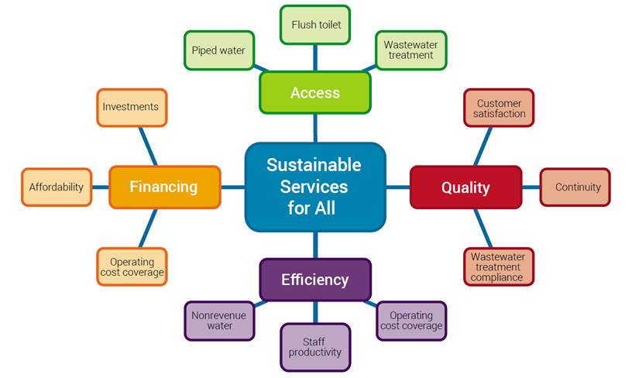
Challenge: Utility Performance versus Access
Notes:
A huge challenge that we face at the Bank when advising our client countries, especially those with low coverage rates is to find the appropriate balance between improving the financial performance of the utility measured by its ability to deliver services at the required quality to customers while maintaining a financial equilibrium, vs focusing on expanding services to the unserved – and usually required more expensive solutions and lower customer payment capacity. A similar issue presents itself with the Danube utilities, not only in terms of some countries still needing to meet the service needs of the more than 20 million people without services (1/6 of population), but also to meet the more stringent wasterwater treatment needs required of the the EU

Slide 6
Some general principles…
Clear national policies and programs setting access targets and quality standards
Sector financing strategies incentivizing performance improvement, promoting cost recovery and ensuring mechanism for extending services to all (cross-subsidy, social safety net, etc)
Sustain efforts on development of clear regulatory and accountability frameworks for service providers and local governments
Bank experience worldwide: there is no “best” model for sector governance, regulation, financing, service provision
Models are successful if they are adapted to local objectives, challenges and constraints
Notes:
Back to basics

Slide 7
Ensure availability and sustainable management of water and sanitation for all
2. Adding a new double challenge
SDG6 beyond access
Goal 6
6.3 Water quality
6.4 Water-use Efficiency
6.5 Water resource management
6.6 Eco-systems
6.2 Sanitation and Hygiene
6.1 Drinking Water
Means of Implementation
6.A International cooperation and capacity development
6.B Local participation
Source: UNICEF
Notes:
However, as we move from MDGS to SDGs, the first big change is that all countries have now signed onto to meeting the SDG gpals
Not only is there a dedicated goal for Water – SDG 6 – Water is also required to meet 15/17 other goals …water for energy, agriculuture, health, education etc.
Also in addition to goals 6.2 and 6.2 on service delivery, there are 4 additonal goals and means of implementation that are required these include
6.3 Improve water quality; 6.4 Increase water-use efficiency across all sectors and ensure sustainable withdrawals and supply of freshwater; 6.5 Integrated water resources management; 6.6 Protect and restore water-related ecosystems

Slide 8
SDG 6.1 and 6.2 set a new standard for WASH access…
Target 6.1: By 2030, achieve universal and equitable access to safe and affordable drinking water for ALL
Target 6.2: By 2030, achieve access to adequate and equitable sanitation and hygiene for ALL, and end open defecation, paying special attention to the needs of women and girls and those in vulnerable situations
Notes:
The SDGs include a goal on water and sanitation which includes ambitious targets for universal access to drinking water, sanitation and hygiene by 2030.
SDG targets were carefully negotiated by member states using very specific language (universal, safe and affordable drinking water for all, adequate and equitable sanitation and hygiene for all) with special emphasis on ending open defecation, needs of women and girls and those in vulnerable situations
These targets have been agreed by all countries and are applicable to all countries (low, middle and high income).

Slide 9
…representing a quantum leap from MDG 7
 | Service ladder | Progressive realization
SDG 6.1 | Safely managed drinking water | Improved facility located on premises, available when needed, and free from contamination
MDG 7.8 continuity | Basic water | Improved facility within 30 minutes round trip collection time
 | Unimproved water | Unimproved facility does not protect against contamination
 | No service | Surface water
Developing Developed
Source: UNICEF
Notes:
The proposed indicator for SDG target 6.1 is ‘Proportion of population using safely managed drinking water services’
This represents a higher service threshold and a new ‘rung’ at the top of the drinking water service ladder used by JMP during the MDGs
The ladder aims to capture progressive improvements from no service at all (surface water) and use of unimproved water sources (no protection against contamination), to using an improved water source (helps protect against contamination) which was the old MDG standard. If you have an improved facility close to home (within 30 minutes) this is now classed as a basic level of service (accessibility, quality, quantity) but the SDGs aim higher. In order to be classed as safely managed the improved facility should firstly be located on premises (accessibility), secondly water should be available when needed (available), and thirdly it should be free from contamination (quality)
It is also a monitoring ladder, increasing sophistication of monitoring allows countries to track higher levels of service – these often happen in tandem.

Slide 10
EU and most countries are not yet set to tackle, the broader water security challenges
Somewhat
aligned
6.3 Water quality
6.4 Water-use Efficiency
6.5 Water resource management
6.6 Eco-systems
6.2 Sanitation and Hygiene
6.1 Drinking Water
Goal 6
Limited alignment between SDG6 indicators and EU SD Indicators framework
But progressive alignment at national level:
1 country has aligned its national development strategy with SDGs (Slovenia)
4 have started the alignment process (Austria, Czech Republic, Montenegro, Ukraine)
No alignment
Water Framework Directive
2011 Resource Efficiency Roadmap of EU 2020 Strategy
Strongly aligned
ESDN Quarterly Report N°35

Slide 11
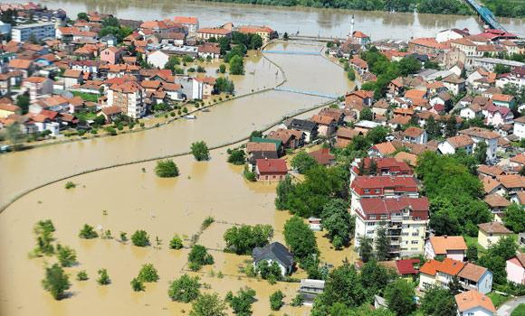
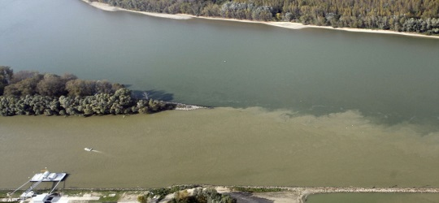
And the 3rd Double Challenge Climate Change as it expresses itself through Water
Droughts & water scarcity
Floods
6% of Moldova GDP lost due to 2012 drought
15% (BiH) and 5% (Serbia) of GDP lost due to 2014 floods
Ecosystem
degradation & pollution
Risks not monetized, but pressing problems in the region
Notes:
What are some of the problems?
Unpredictable nature of climate change requires utilities that are resilient and can adapt
There will be trends (increased water stress in parts of Central Asia, excess water/floods in Europe… see slide of global freshwater per capita)
There will be extreme events (shocks)
How to maintain uninterrupted services?
What are some solutions?
Need to identify climate resilient water sector assets
Need to address management practices (monitoring protocols with other actors, not just utility performance but water availability and demand in the basin, i.e. need to work with others…IUWM approach is helpful)
Need to develop improved technology (for water re-use, for WWTP and WTP processes that emit less GHGs, waste-to-energy, more efficient household water appliances)
Need to address behaviors of customers (demand management, Perth Australia as a leader for reducing water use)

Slide 12
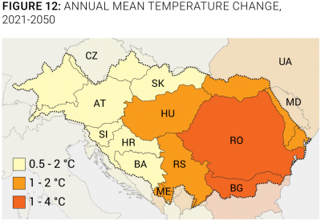
Expected climate change patterns in the region
Annual mean temperature change 2012-2050
major seasonal precipitation changes
seasonal runoff pattern changes
droughts, low flow situations, and water scarcity may become longer, more intense, and more frequent
increase in air and water temperature and increased pressures on water quality
Summer precipitation differences between (1961-1990) and (2070-2100)
LMU 2012, Climate Change Adaptation study
UNEP, ENVSEC 2011, Climate Change Adaptation in South Eastern Europe

Slide 13
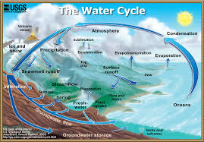
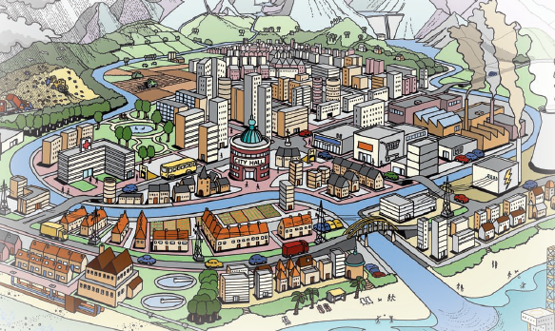
Water Extreme express themselves in cities and water systems
I n t e r s e c t i o n

Slide 14
Urban Water Management under extremes
Socio-political drivers
Water Supply Access and Security
Public Health Protection
Flood Protection
Social Amenity, Environmental Protection
Limits on Natural Resources
Intergenera-tional equity, Resilience to CC
Water Supply City
Sewered
City
Drained
City
Water-Ways
City
Water Cycle City
Water Sensitive City
Adaptive multi-functional infrastructure & urban design reinforcing water sensitive behaviours
Supply Hydraulics
Separate Sewerage Schemes
Drainage, Channelisation
Point and Diffuse Source Pollution Mgmt
Diverse fit-for-sources & conserva-tion, waterway protection
Service Delivery Functions
Source: Transition to Water Sensitive Cities (Rachel Brown, Nina Keath and Tony Wong)

Slide 15
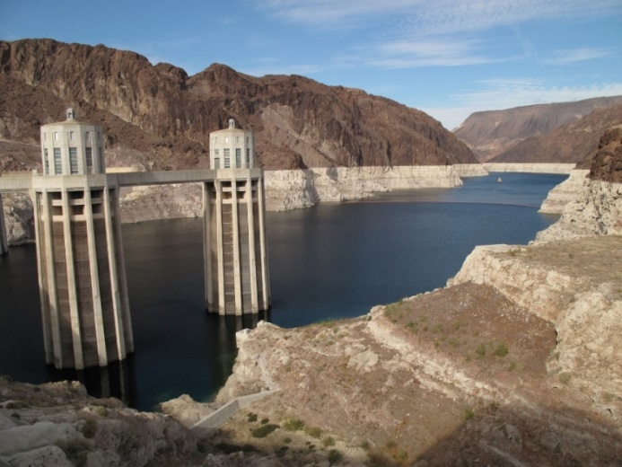
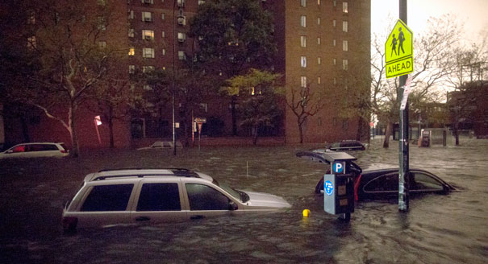
Designing under climate uncertain can be very challenging
Climate model projections often disagree with each other…
… and depend on hypothetic future climate policies and socio-economic trends…
There might be less water than we expect
http://commons.wikimedia.org/wiki/File:Lake_mead_july_2009.jpg
Or there might be more
http://www.politico.com/news/stories/1012/83043.html
→ Do not try to guess what the future conditions will be, try to be robust and flexible.

Slide 16
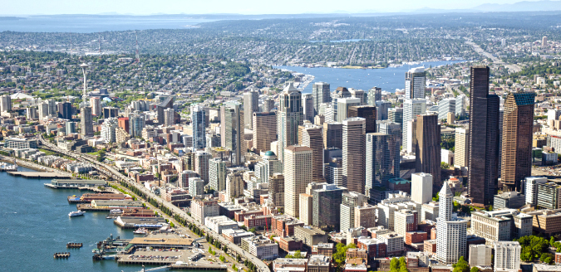
Example from Seattle Public Utilities
Notes:
Fastest growing large city in the U.S. Multiple responsibilities – 1.4 million people, flows in perpetuity
Like a lot of water utilities, Seattle PU has a strong engineering legacy and culture but one that is evolving to put greater emphasis on the role of science and economics.
drinking water, storm/wastewater, solid waste
surface water from highly protected forested watersheds
long history of “demand side management”
$900 million annual budget
dedicated staff focused on climate change
SPU - $900 million annual budget, 1400 employees
Investments, operations driven by water cycle
Surface water – protected watersheds – filtered, UV/ozone

Slide 17
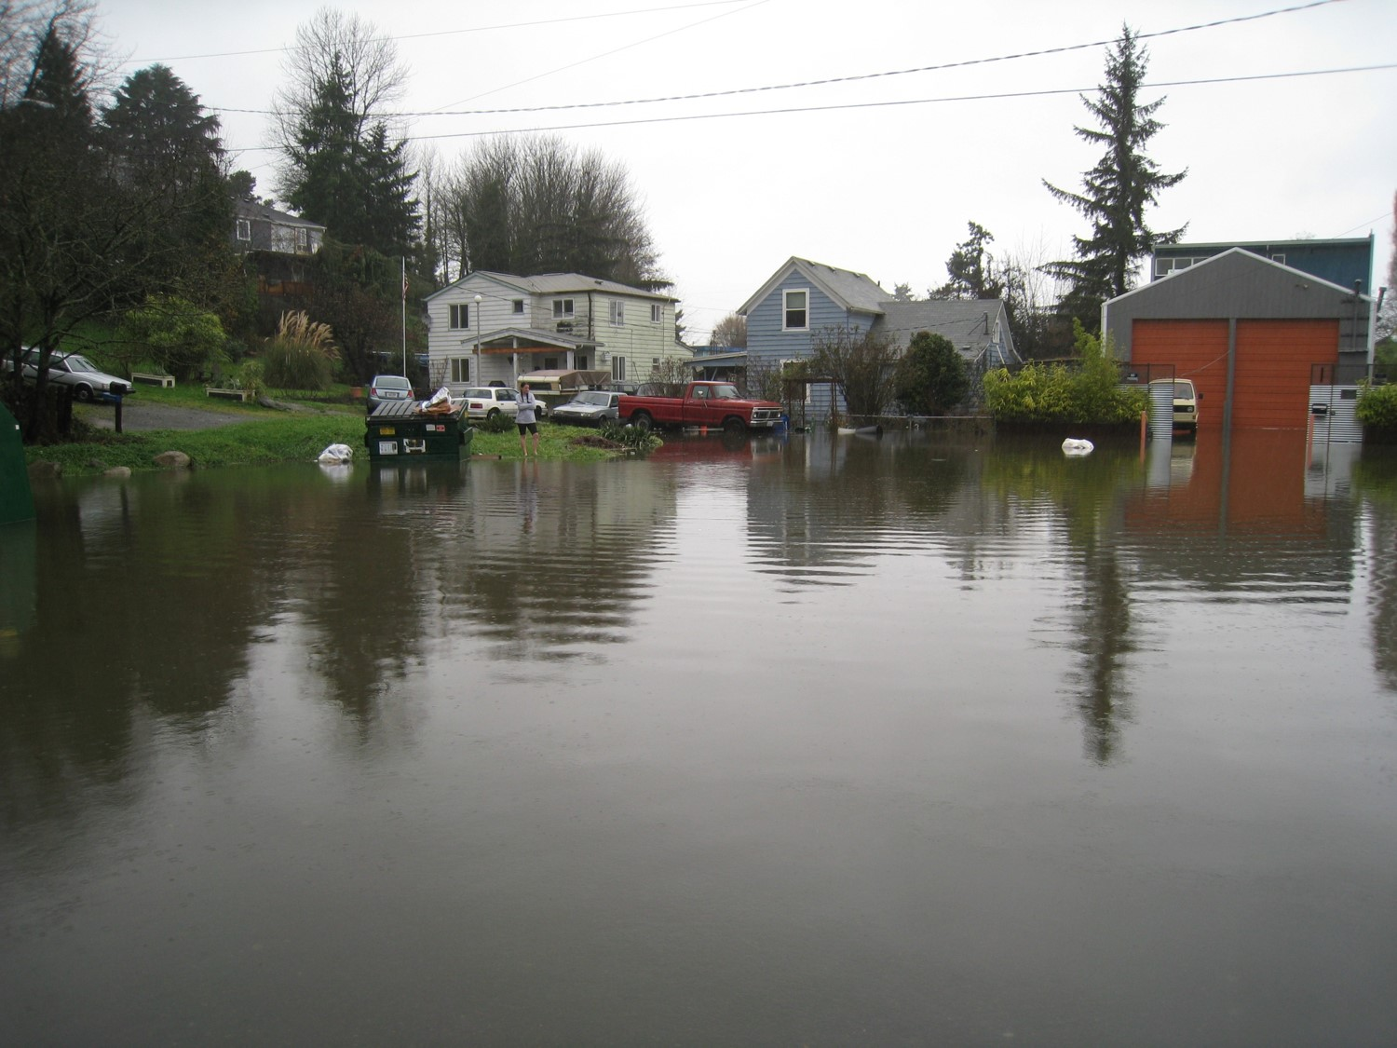
Urban Drainage
Notes:
Strong social and environmental values:
Stormwater mngt, wastewater conveyance in urban area.
Water quality, life/property protection objetives, = quality of life
City defined by water and hills as well – 41% of the area of the city is water, seven hills that affect hydrology
System is still being built out
Challenge and opp – how to design system given uncertainty of precipitation, opp to more fully integrate water cycle, pursue dual functions for urban infrastructure (syndicate stormwater mngt)
Also opp to move towards more real time, dynamic mngt like water supply

Slide 18
Climate program objectives
Approach
enhance knowledge
engage science
build collaborative networks
embed what we learn in what we do
And some lessons
strengthen institutions and people
build enduring adaptive capacity and collaborative partnerships
adaptation as a continuous process, not an end state
leverage what we learn, embed in what we do
Notes:
We know that changes in water cycle due to climate change will affect our supplies and infrastructure
These changes and effects, however, cascade into other utility functions
We need to step back and look at climate comprehensively to chart our course for how to respond
One of our principal challenges: how do we ensure our substantial investments in infrastructure provide guaranteed returns given climate change?
In Seattle, we have an asset management program called Stage Gates that we use to rationalize the expenditures on CIP & O&M for the life of a project
We’ve used this platform to better ensure we’re making investments that reflect our values in social equity
Have also created footholds to embed climate considerations into this process

Slide 19
Importance of Partnerships and Networks
Seattle
Public Utilities
wucaonline.org
Portland
Water Bureau
San Francisco
Public Utilities
Commission
Southern Nevada
Water Authority
(Chair)
New York City
Department of Environmental Protection
Denver
Water
(Vice Chair)
Metropolitan
Water
District of
So. California
Central Arizona
Project
San Diego
County Water Authority
Tampa Bay
Water
Mission: The Water Utility Climate Alliances provides leadership in assessing and adapting to the potential effects of climate change through collaborative action. We seek to enhance the usefulness of climate science for the adaptation community and improve water management decision-making in the face of climate uncertainty.
Notes:
Working together to share experiences and knowledge..opportunity available to IAWD
(Cover image from WUCA’s latest paper on decision support – Embracing Uncertainty)
As a sector, we need to get more comfortable with uncertainty at the strategic level, but also figure out how to mainstream this into what we do
How do we reflect uncertainty around precipitation projections and the notion of planning for multiple futures into engineering design standards?
How do we better incorporate climate considerations into our asset management programs?

Slide 20
Robust Decision Making (RDM) methods ask: What are the limitations of our plans and investments and how can we improve them?
“Predict Then Act”
What will the
future be?
What is the best near-term decision?
What is the future?
What is the best decision based on our forecast/scenario?
How sensitive is our decision to our predictions?
To what extend the decision depends on our forecast/scenario?
Robust Decision Making (RDM)
What options we have?
What are the vulnerabilities of our plan/investment?
How can we reduce the vulnerabilities?
Notes:
RDM:
Start with a proposed strategy
Use multiple model runs to identify conditions that best distinguish futures where strategy does and does not meet its goals
Identify steps that can be taken so strategy may succeed over wider range of futures
RDM tools being developed to subject investment decisions to climate stress test

Slide 21
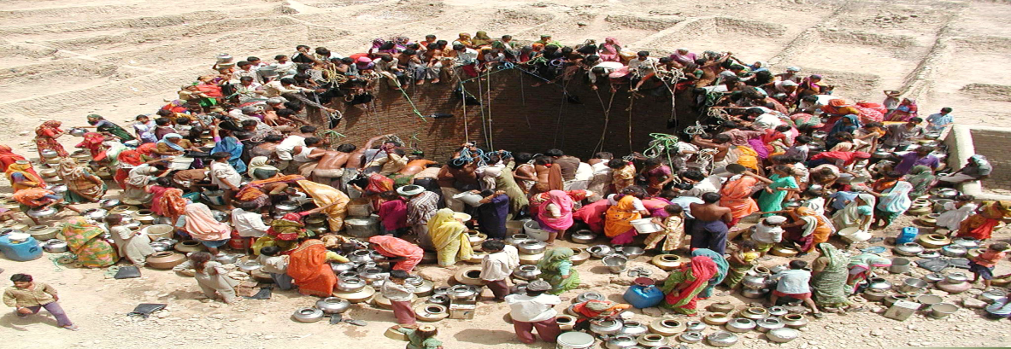
What does this mean for Danube utilities?
Further efforts on climate change mitigation
Reduction of GHGs through improved wastewater treatment and disposal – included in EU countries INDC
Need to build climate resilience:
Incorporate climate uncertainty in infrastructure designs
Develop utilities emergency preparedness plans
Increase awareness of competing water use and engage in water allocation, IWRM mechanisms

Slide 22
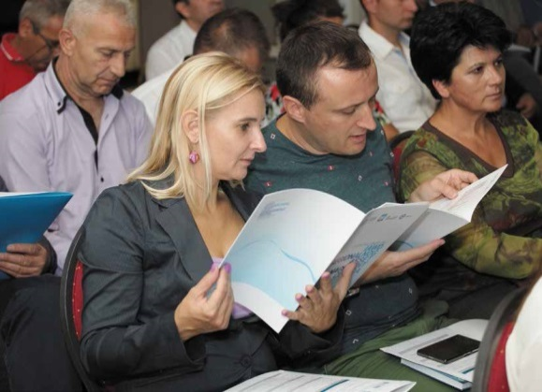
…and some even more critical principles
More important than models: people who design and run them
Wealth of ideas to be discussed during the conference, gathered and brought back home…
Share your problems, challenges, mistakes, so they can be discussed and learned from
We are here to help…

Slide 23
Double Challenges… times 3 Conclusions
With the SDGs, a quantum leap in ambitions and a focus broadened to water security issues
Under climate uncertainty, resilience of services is the next great challenge for utilities
No one model, but every time a tailored solution to a unique set of sector challenges

Slide 24
Thank You

