Slide 1
Capacity Building for NRW in SEE
Does the Effort Pay Off?
Dipl.-Ing. Andreas Lutschounig
Vienna, 13th May 2016

Slide 2
Capacity Building for NRW in SEE
Does the Effort Pay Off?
Dipl.-Ing. Andreas Lutschounig
Vienna, 13th May 2016

Slide 3
NRW CAUSES
TASKS
CAPACITY BUILDING
ACHIEVEMENTS
CONCLUSION
SETEC ENGINEERING
Topics

Slide 4
NRW CAUSES
TASKS
CAPACITY BUILDING
ACHIEVEMENTS
CONCLUSION
SETEC ENGINEERING
Topics

Slide 5
NRW CAUSES
TASKS
CAPACITY BUILDING
ACHIEVEMENTS
CONCLUSION
SETEC ENGINEERING
Topics

Slide 6
SETEC Engineering
Established 1999 (successor of SEBA Messtechnik, est. 1966)
Ownership: GAUFF, Germany (100% subsidiary)
Head office: Klagenfurt, Austria
Turnover: 6,5 million Euro (2015), 85% international
Permanent employees: 35 (April 2016)
Field of business (consulting):
Water supply system optimisation (NRW reduction, energy efficiency, hydraulic modelling, leak detection, pipe tracing, GIS)
Project management (conducting studies, design, tendering, contracting, supervision, handing-over and financial control)
Capacity building (technical trainings, tariff calculations, legal support, asset management)
Managing Directors: K. Birkenmeier, F. Morgenstern, G. Zimmerl

Slide 7
SETEC Engineering
Established 1999 (successor of SEBA Messtechnik, est. 1966)
Ownership: GAUFF, Germany (100% subsidiary)
Head office: Klagenfurt, Austria
Turnover: 6,5 million Euro (2015), 85% international
Permanent employees: 35 (April 2016)
Field of business (consulting):
Water supply system optimisation (NRW reduction, energy efficiency, hydraulic modelling, leak detection, pipe tracing, GIS)
Project management (conducting studies, design, tendering, contracting, supervision, handing-over and financial control)
Capacity building (technical trainings, tariff calculations, legal support, asset management)
Managing Directors: K. Birkenmeier, F. Morgenstern, G. Zimmerl

Slide 8
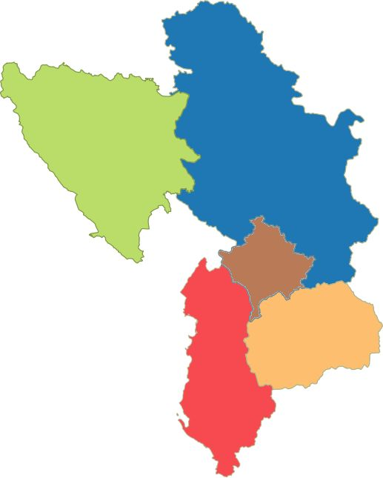
SETEC Engineering in SEE
Albania (since 1992)
Bosnia and Herzegovina (since 1995)
Serbia (since 2001)
Macedonia (since 2006)
Kosovo (since 2008)
BOSNIA
and
HERZEGOVINA
SERBIA
KOSOVO
MACEDONIA
ALBANIA

Slide 9
SETEC Engineering in SEE
Albania (since 1992)
Bosnia and Herzegovina (since 1995)
Serbia (since 2001)
Macedonia (since 2006)
Kosovo (since 2008)
BOSNIA
and
HERZEGOVINA
SERBIA
KOSOVO
MACEDONIA
ALBANIA

Slide 10
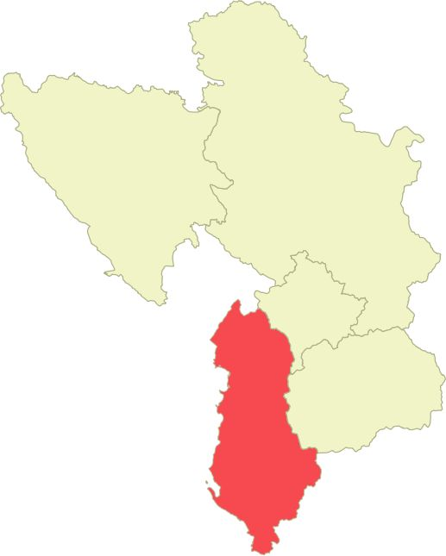
Albania
2016 – 2020
2013 – 2017
2013 – 2015
2012 – 2016
2012 – 2014
2010 – 2012
2009 – 2010
2007
Municipal Infrastructure IV
(Delvina, Gjirokastra, Kamza and Lushnia)
Municipal Infrastructure II
(Berat, Kamza, Kucova and Lushnia)
Technical Assistance to the Water Supply and Sanitation Sector
Municipal Infrastructure I
(Fier, Gjirokastra, Lezhe and Saranda)
Integrated Coastal Zone Management and Clean-up Project
Pogradec Water Supply Project
Water Supply and Environmental Protection Lake Shkodra
NRW Reduction Strategies training, Pogradec
ALBANIA

Slide 11
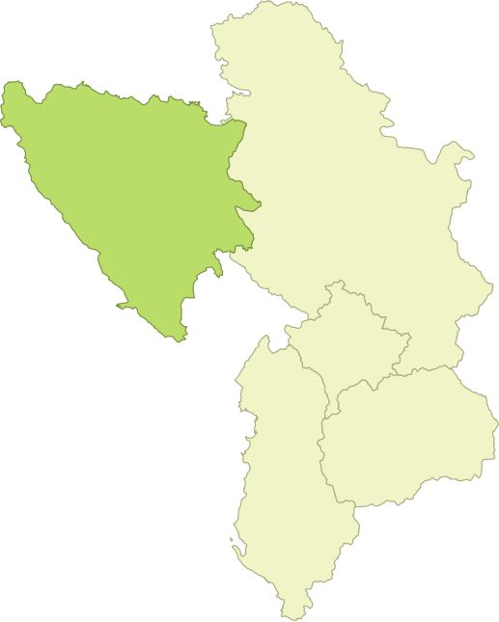
Bosnia and Herzegovina
2015 – 2016
2014
2009
2007
2004 – 2007
Reduction of NRW in South East Europe
(E. Sarajevo, Gorazde and V. Kladusa)
NRW reduction training, Cazin
Prijedor Water Supply Project
Rehabilitation of Urban Water Supply Una-Sana
Region, Bihac
Water Supply Kakanj
BOSNIA
and
HERZEGOVINA

Slide 12
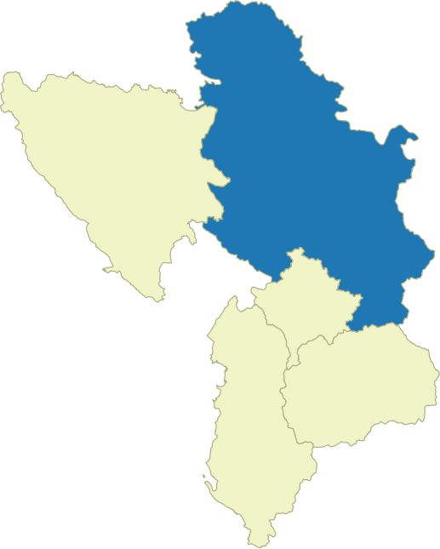
Serbia
2014 – 2016
2013 – 2016
2010 – 2017
2008 – 2017
2006 – 2009
Water and Sewerage Programme in Medium-Sized Municipalities –
Programme V, Phase 1 (Arandjelovac, Kikinda, Knjazevac,
Paracin, Prokuplje, Stara Pazova, Valjevo and Vrbas)
Morava Regional Water Supply (Velika Plana, Smederevska Palanka)
Water and Sewerage Programme in Medium-Sized Municipalities –
Programme II, Phase 1+2 (Aleksinac, Jagodina, Kraljevo, Leskovac,
Pirot and Vranje)
Water and Sewerage Programme in Medium-Sized Municipalities –
Programme I, Phase 1+2 (Kraljevo, Loznica, Pancevo, Sabac,
Smederevo, Sombor, Sremska Mitrovica and Vrsac)
Rehabilitation of Urban Water Supply and Sewage Systems in Novi Sad,
Niš, Kragujevac and Belgrade – Phase 3
SERBIA

Slide 13
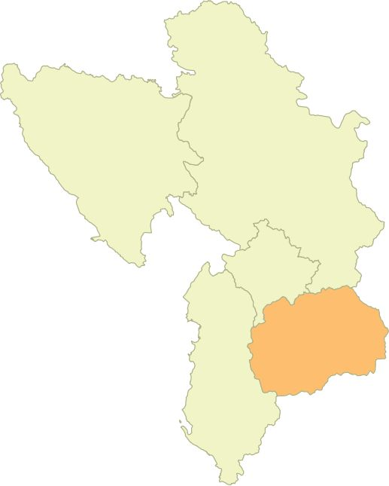
Macedonia
2015 – 2016
2015 – 2016
2006 – 2010
2003
Reform in the System for Water Supply, Collection and
Treatment at Local Level
(Berovo, Bitola, Debar, Gostivar, Kavadarci, Kichevo,
Kumanovo, Radovish, Skopje, Strumitsa and Tetovo)
Reduction of NRW in South East Europe
(Kocani, Gevgelija and Vinica)
Water Supply Prilep
Sewage and Water Supply in Tetovo
MACEDONIA

Slide 14
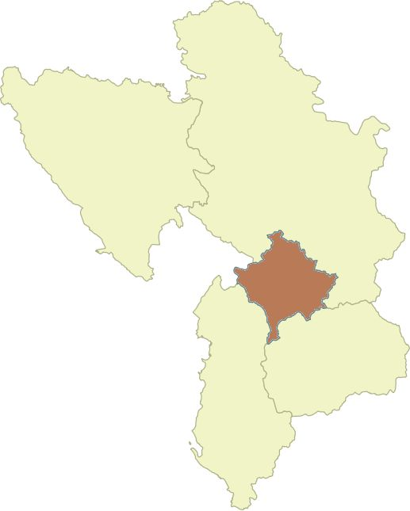
Kosovo
2015 – 2016
2014 – 2016
2010 – 2014
2009 – 2013
2009 – 2013
Reduction of NRW in South East Europe (Lipjan, Podujevo and Pristina)
Engineering Consulting Services for the Mitrovica Regional Water Company – Phase 2
Institutional and Technical Support for the Water Supply System, Mitrovica
Water Supply and Waste Water Programme South-West Kosovo VI – Phase 2
(Gjakova, Peja, Prizren, Rahovec)
Urban Water Supply Rehabilitation Programme V – Phase 2
(Klina, Istog, Peja, Unik)
KOSOVO

Slide 15
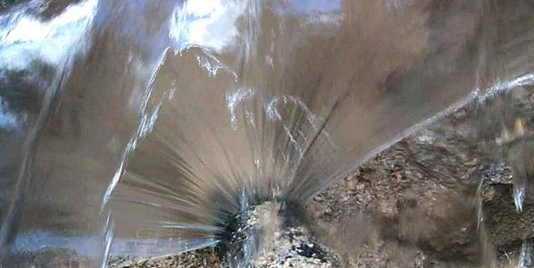
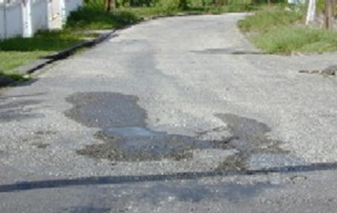
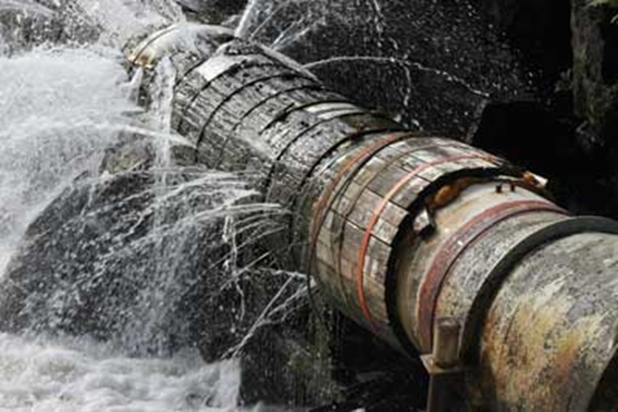
NRW CAUSES
TASKS
CAPACITY BUILDING
ACHIEVEMENTS
CONCLUSION
SETEC ENGINEERING

Slide 16
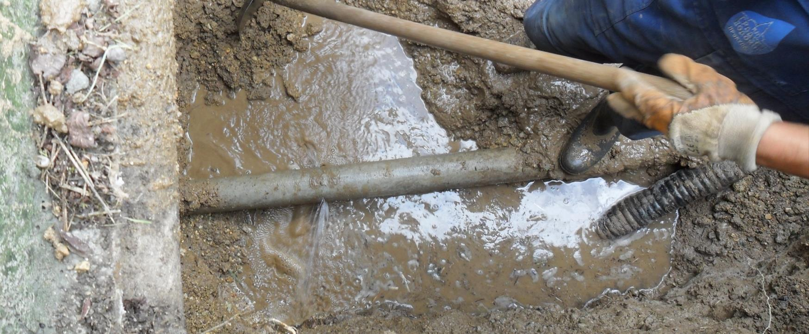
CAUSES FOR HIGH NRW
TECHNICAL
INSTITUTIONAL
No pressure management
Use of material and works of bad quality
No network infrastructure replacement programme
No active leakage control
No adequate tools and spare parts for repairs
No water meter replacement and calibration programme
No efficient documentation of activities in the field
No accurate network drawings
No, incomplete and/or inaccurate production metering
Lack of skilled staff (low salaries, politics)
Lack of motivation (low salaries)
Fraud meter readings (corruption)
Illegal connections/unregistered customers (corruption)
Lack of funds for quality repair materials and tools
Unmetered consumption – no calibrated water meters installed
No adequate organisational procedures
No adequate reporting to the management
No comprehensive service level agreement (municipality)
No detailed customer service level agreement

Slide 17
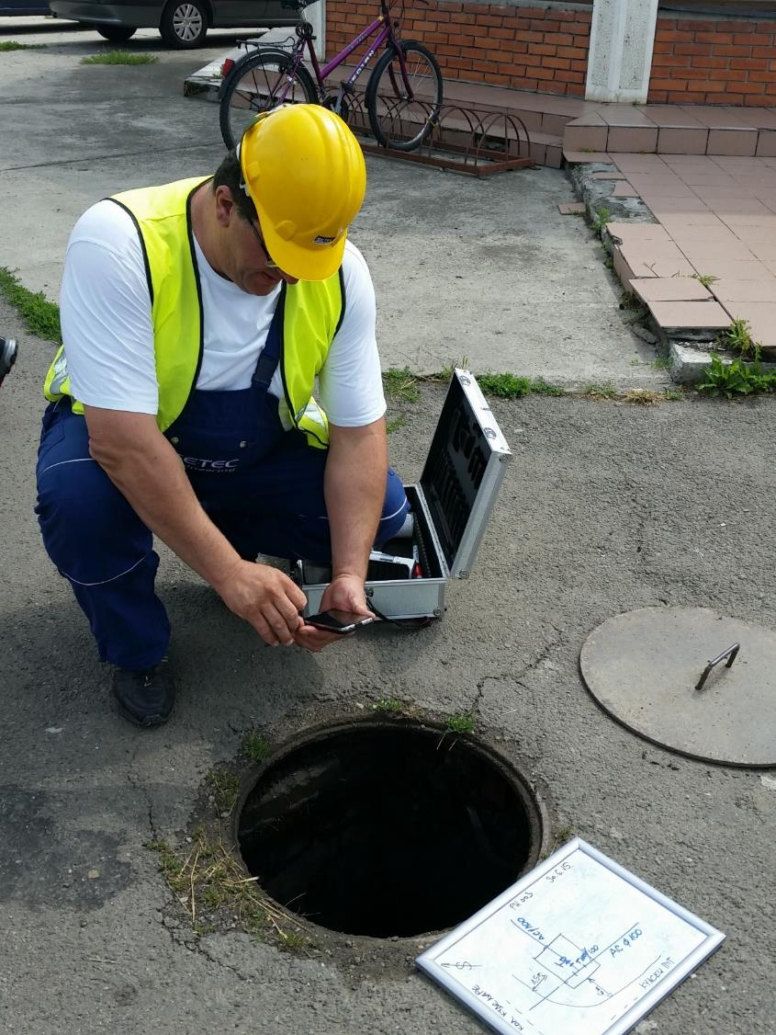
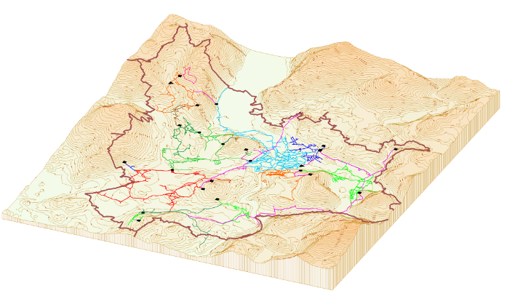
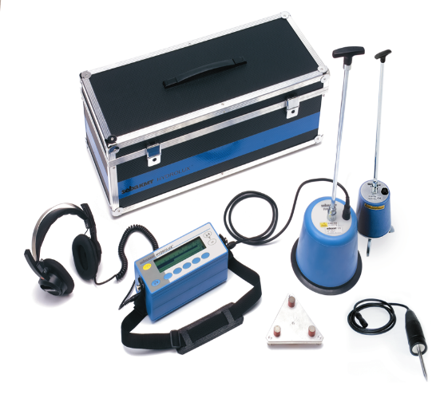
NRW CAUSES
TASKS
CAPACITY BUILDING
ACHIEVEMENTS
CONCLUSION
SETEC ENGINEERING

Slide 18
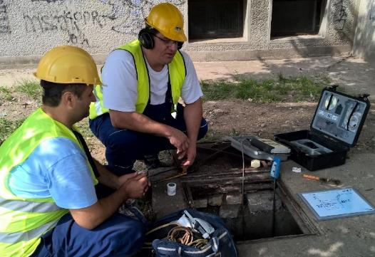
TASKS
TECHNICAL
INSTITUTIONAL
Mapping, GIS
Sectorisation (DMAs)
NRW assessment
Hydraulic modelling
Energy efficiency
O&M concept
Leak detection training
Procurement of leak detection equipment
Action plan for NRW reduction
Implementation of investment measures
Improvement of commercial procedures
Tariff adjustment plan
Asset valuation and cost accounting
Management information system (MIS)
Public awareness and customer relationship
Organisational and human resources management
Legal assistance (SLA)
Performance monitoring (benchmarking)
Borrowing capacity / loan repayment strategy
Know-how transfer – horizontal learning

Slide 19
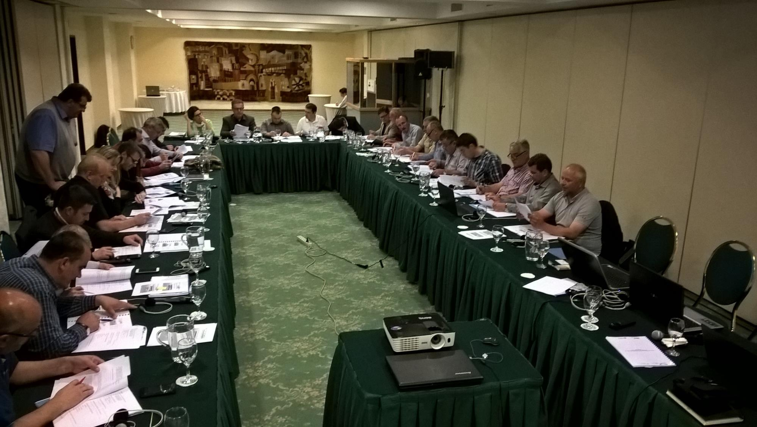
NRW CAUSES
TASKS
CAPACITY BUILDING
ACHIEVEMENTS
CONCLUSION
SETEC ENGINEERING

Slide 20
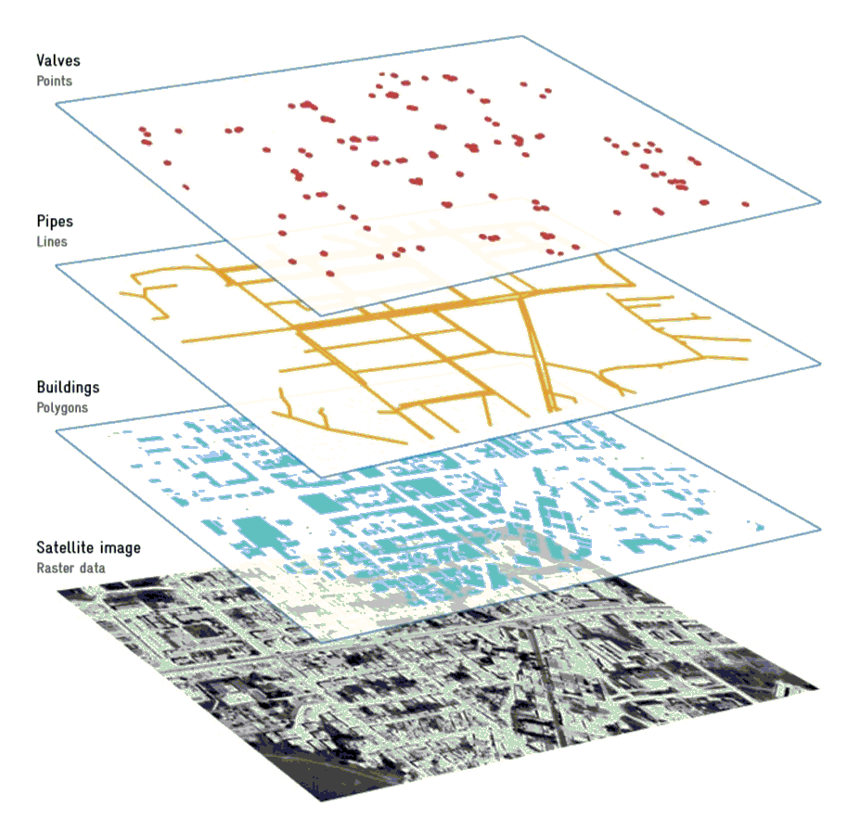
CAPACITY BUILDING
 | TECHNICAL | INSTITUTIONAL
Analysis | Mapping, NRW, hydraulic modelling | Asset valuation, organisation chart, job descriptions, borrowing capacity
Concepts | O&M, NRW | Tariffs, commercial procedures, loan repayment, cost accounting
Trainings | Leak Detection (LD), NRW, GIS | Human resources management, public awareness and customer relationship,
Support | NRW, O&M, GIS, design, tendering, contracting, construction supervision, | Legal aspects (SLA), tariffs, organisation chart, job descriptions, asset valuation
Procurements | LD equipment, GIS and hydraulic modelling hard- and software | Billing, accounting, MIS and benchmarking hard- and software

Slide 21
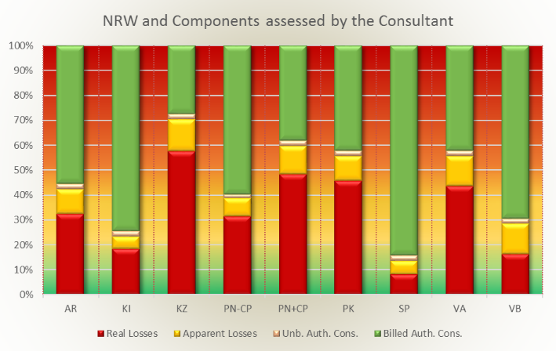
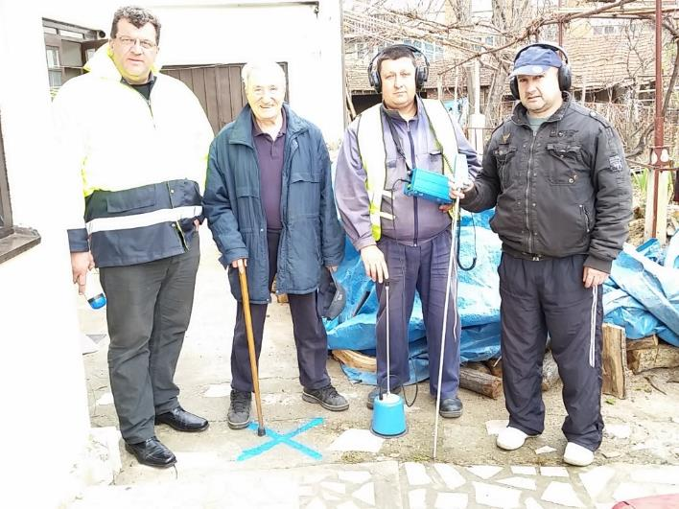
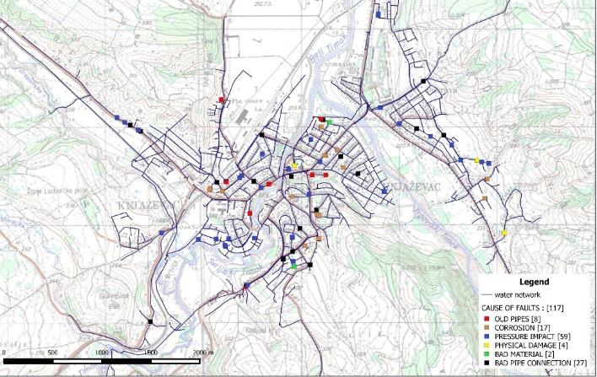
NRW CAUSES
TASKS
CAPACITY BUILDING
ACHIEVEMENTS
CONCLUSION
SETEC ENGINEERING

Slide 22
ACHIEVEMENTS
TECHNICAL
INSTITUTIONAL
More accurate network maps
DMAs to locate areas with high NRW
Current and future hydraulic situation and needs
Proposals for energy savings
Improved procedures for O&M
Sustainable NRW actions
Improved water supply infrastructure
Asset register (ownership), values depreciation
Service Level Agreements
Rising cost coverage through tariff increases
Adequate organisation charts and job descriptions
Improved cost accounting
Improved commercial procedures
MIS installed and in use
Performance monitoring (benchmarking)
Increased Budget for maintenance and loan repayment
REDUCED NON-REVENUE WATER LEVEL

Slide 23
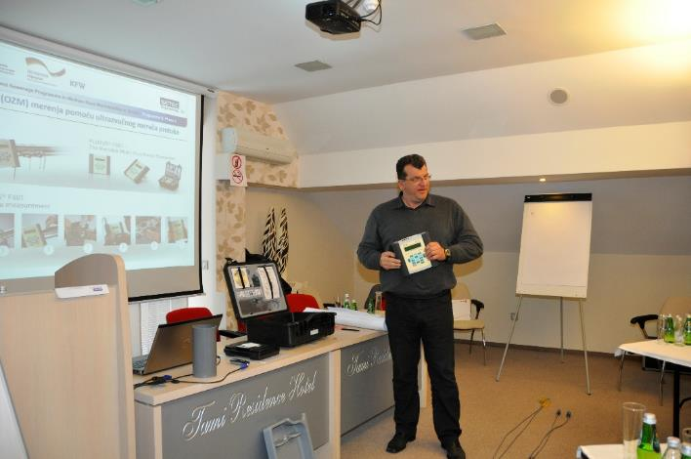
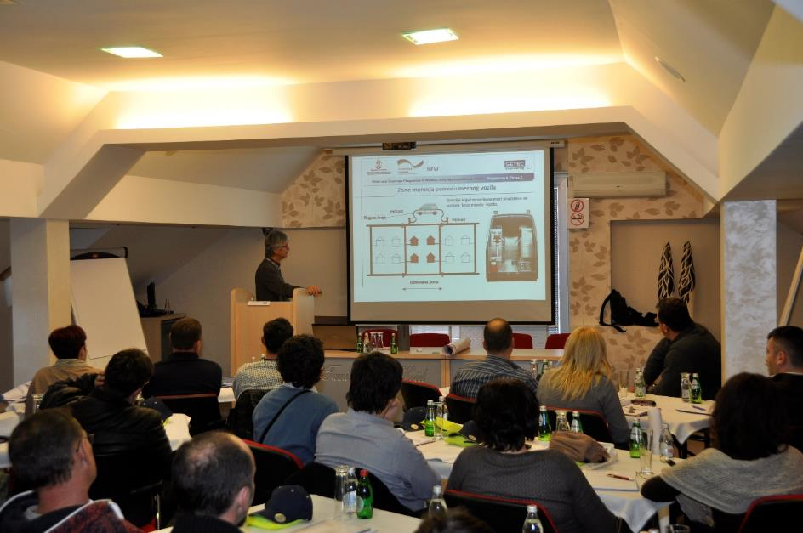
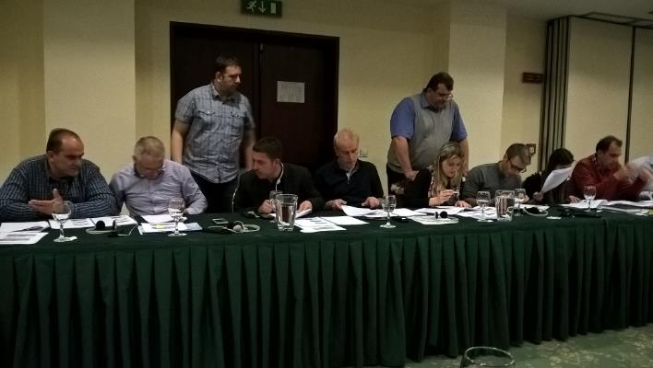
NRW CAUSES
TASKS
CAPACITY BUILDING
ACHIEVEMENTS
CONCLUSION
SETEC ENGINEERING

Slide 24
CONCLUSION
Does the Effort pay off?
YES,
but…

Slide 25
you will need…
AWARENESS
COMMITMENT
INDICATORS
INCENTIVES
MONITORING

