Slide 1
Performance Based NRW Reduction Contracts
The case of HoChiMinh City
Bill Kingdom
Vienna, May 2016

Slide 2
Why is NRW reduction so important?
Reducing NRW delivers multiple benefits:
Improves customer service levels – higher pressures and/or better continuity and/or expanded coverage
Enhances asset lives and utility management – if NRW reduction leads to 24/7
Improves utility financial performance (and/or reduces local government subsidies) by reducing costs and increasing revenues
Makes cities more competitive when accompanied by service improvement
Improves climate resilience by reducing demand on scarce water resources
Reduces emission of GHGs – less energy/m3 delivered
This is not a “win win” (W²) - it is a “win win win win win win” (W⁶)

Slide 3
Context of HoChiMinh City (HCMC)
HCMC is the largest city in Vietnam with over 6 million inhabitants (2004).
HCMC water supply corporation (SAWACO) is largest water supply company in the country. The network is hydraulically divided into 6 zones. Many urban areas have no access to piped water due to lack of water sources.
The total production capacity is 1,250,000m3/day (2004) and losses (NRW) are rather high (about 35% in 2004 –equal to 365,000m3/day). 90% of losses are at service network and house connections.
SAWACO sets a target to reduce NRW ratio from 35% in 2004 to 26% in 2010.

Slide 4
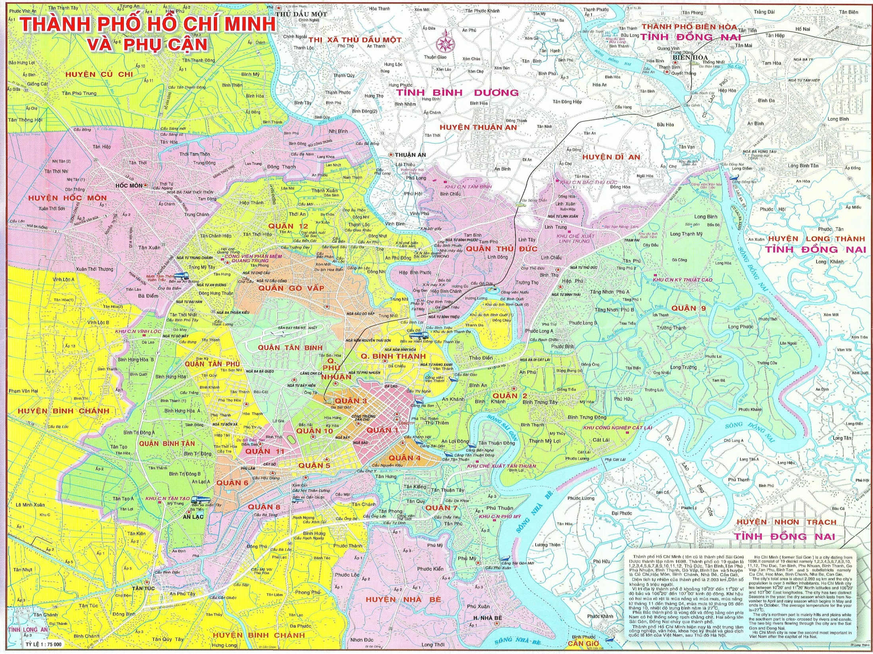
NRW Management Project
DỰ ÁN GIẢM THẤT THOÁT NƯỚC
Traditional model contracts
:
ZONE 3
ZONE 4
ZONE 2
ZONE 1
ZONE 6
Performance Based
Contract Zone
ZONE 5
3

Slide 5
NRW PBC Contract Objectives
Make use of an outside contractor to reduce leakage
Stimulate competition between contractor and Water Supply Company
Get a better understanding of the cost/benefit ratio of giving the work to an outside company
Find out to what level leakage can realistically be reduced and subsequently maintained
Build local capacity that can later be utilised

Slide 6
Contract Characteristics (1)
Type of contract:
output-based: design, build, operate contract with strong performance element
Payment:
fixed fee
'Priced Activity Schedule' for DMA establishment (lump sum price per DMA established)
performance fee per m3 leakage reduction
BoQ (supply and installation) for unforeseen works and works to connect new customers

Slide 7
Contract Characteristics (2)
Contract duration:
4 years + 1 year maintenance period
Selection process: in two stages
strict qualification process
final selection based on two envelope financial and technical bids.
technical assessment pass/fail
Winner is lowest price from technical pass

Slide 8
Contract Characteristics (3)
Performance Indicator:
Reduction in physical losses (m3/day)
but with a provision for adjustments driven by changes in pressure
Monitoring:
HCMC Water Supply Company supported by a specialist consultant

Slide 9
Scope of the Contract (1)
DMA establishment:
detailed investigations and updating of network drawings
review of DMA plan and submission of recommended changes to WSC (for approval)
preparation of detailed design for DMA establishment
establishment of DMAs including all construction works and installation of meters and pressure reducing valves (incl. supply of materials)
Miscellaneous (supply and installation) for unforeseen works and works to connect new customers

Slide 10
Scope of the Contract (2)
Leak detection and repair:
execution of leakage surveys
repair of leaks on mains
replacement of leaking service connections (complete, including the pipe saddle)
repair or replacement of leaking valves, hydrants, ....
repetition of leakage surveys until acceptable levels of leakage are achieved

Slide 11
Leakage Reduction Target
Volume (m3/d) quoted in the BoQ for the performance fee is indicative only – based on field work during document preparation
Contractor has to use his own experience and judgement to analyse this figure
Important for the contractor's calculation of the performance fee
Leakage reduction volume is neither a contractual target nor a minimum or maximum amount - it is simply an estimate used to compute the bid price

Slide 12
Performance Monitoring Process
Baselining as soon as a DMA is established (bulk inflow less metered consumption over 7 days)
Measurement to be repeated after leak detection and repair has been carried out
Establishment of minimum night flow
Afterwards: Continuous monitoring of minimum night flow

Slide 13
Ensuring sustainability
Minimum night flow (MNF) best indicator to see rise of leakage
Contractor to reduce losses again when MNF has risen by 5 l/conn/hour (so if DMA has 1,000 connections this would be 5 m3/h)
Contractor has natural interest to keep losses low as final payment will depend on the situation at the end of the contract
Year 5: 'leakage level maintenance period'

Slide 14
Creating Incentives: Fixed Fee not to exceed 30% of Performance Fee (1)
Figures used are only an example!!
Indicative leakage reduction volume as per the BoQ: 20,000 m3/d
Performance Fee quoted by the bidder: 300 XY currency/m3/d
Total amount of Performance Fee used for bid evaluation: 20,000 x 300 = 6,000,000 XY currency

Slide 15
Creating Incentives: Fixed Fee not to exceed 30% of Performance Fee (2)
Maximum allowable fixed fee: 30% of 6,000,000 = 1,800,000 XY
Maximum quarterly fixed-fee: 1,800,000 / 4 (years) / 4 (quarters) = 112,500 XY
The contractor is of course free to quote a much lower fixed fee and increase the rate for the performance fee instead.

Slide 16
Creating Incentives: Maintaining focus on leakage
Bid price for all non-NRW reduction activities not to exceed bid price for leakage reduction activities
This is not a construction contract.

Slide 17
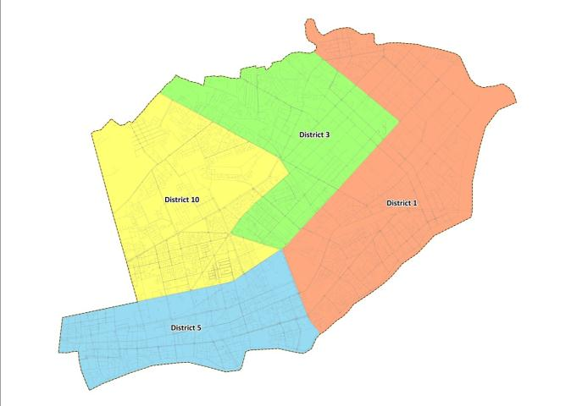
Overview of Zone 1
Zone 1 Profile:
No. of Districts : 4
Land Area (sq.km) : 23
Water Service Connections: 139,836
Proposed DMAs: 119
Target Minimum Recoverable Volume (cu.m/day): 37,500

Slide 18
Key Project Results
Project quarter number | 4 (Aug 2009) | 8 (Aug 2010) | 12 (Aug 2011) | 16 (Aug 2012) | 20 (Aug 2013)
Cumulative number of operational DMAs (no) – achieved/contracted | 1/10 | 4/45 | 29/95 | 93/119 | 110/119
Minimum volume of NRW reduced (m3/day) – achieved/contracted | 0/2,000 | 3,000/ 10,000 | 39,300/ 20,000 | 85,185/37,500 | 91,726/37,500

Slide 19
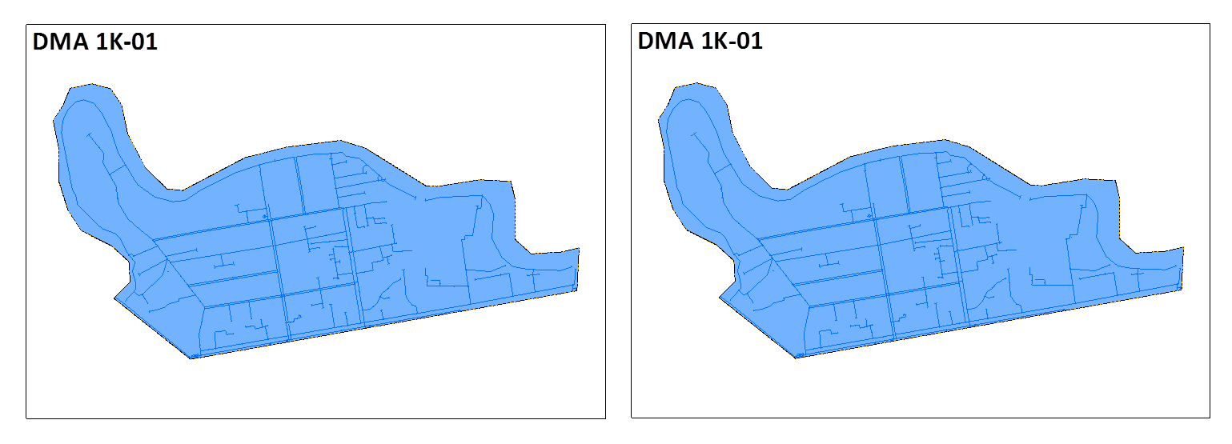
Benefits of Leakage Reduction
0m
7.0m
2m
6.5m
0m
7.5m
2m
9m
6m
10m
Pressure Before
Pressure After
BEFORE (August 2010)
Supply (cu.m/day) | 13,049
Consumption (cu.m/day) | 3,637
Average Pressure (m) | 2
NRW Volume (cu.m/day) | 9,412
NRW % | 72%
NRW Reduction
AFTER (October 2011)
Supply (cu.m/day) | 6,432
Consumption (cu.m/day) | 3,533
Average Pressure (m) | 8
NRW Volume (cu.m/day) | 2,899
NRW % | 45%
6,513 cu.m/day

Slide 20
Performance Based Leakage Contract - Some Results - HCMC
What:
Service population of ~ 1 million people
Number of connections 140,811
Length of distribution system 662,063m
Result:
Volume of water saved = 92,000 m3/d (final amount ~100,000m3/d)
Almost half the pre-project amount of leakage
Saved water could serve 500,000 people in HCMC
Saved power (23,000 kwh/d) could serve 2,500 HH in HCMC
How:
Number of DMAs created: 114
<1% of distribution system replaced (3422m/662063m)
8535 connections replaced = 6%
12,000 leaks fixed in 662km of pipe = one every 50m
Performance based payment – fixed + variable per m3/d saved

Slide 21
Forward Look for NRW PBCs
Degree of risk appetite:
Fixed versus performance fees
Bundled versus unbundled contracts
Leakage reduction versus NRW reduction
Challenges of intermittent supply and low pressure
Ensuring long term sustainability of low leakage levels
Building strong incentives when reducing risk transfer to contractor
Streamlining project preparation and facilitating rapid scale up
Leakage reduction versus delivering 24/7 contracts
Mobilizing private finance (ESCO model)

Slide 22
THANK YOU

