Slide 1

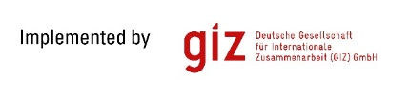




Case study of Velika Kladusha (B&H), Lipjan (Kosovo) and Kochani (Macedonia)
Vienna, 13 May 2016

Slide 2
Common findings
________________________________________________
In general, there are not adequate strategy and procedures for reduction of NRW in the project countries.
There are no separately established and trained leak detection teams among the evaluated operation units (although RWC Prishtina has already a well equipped leak detection team).
In general, the old network over 30-40 years-the weakest point for the high level of NRW (particularly concerns the secondary network that cumulatively cause the increased percentage of leakages in the system);
Most of the water supply systems have no DMA and PMA already established;
Lack of relevant and accurate data on performance of water utilities;
There is no up to date water supply cadaster system as a basis for quality management of the water supply system.
The water utilities in the region operate on the edge of profitability

Slide 3
The current NRW level in 3 utilities
2014, 2013, 2012, 2011, 2010 | Macedonia | Bosnia & Hercegovina | Kosovo
Non Revenue Water (%) | 61,36 | 60,46 | 58,88
Non Revenue Water (m³/km/day) | 74,73 | N/A | 69,24
Source: Danubis
Benchmark:
Less than 20 m³/km/day
Less than 20%

Slide 4
Selected DMA’s in 3 utilities
________________________________________________
Velika Kladusha (BiH)
Consumers: 1320 (10,14% of total nb. of consumers)
Kochani (Macedonia)
Consumers:
493 (4,2% of total of. of consumers)
Population:2000 (4.29 % of total population)
Lipjan
(Kosovo)
Length of water network (km): 12,6
(8,45% of total network)
Population:4500 (9,2 % of total population)
Length of water network (km): 54 (9,84% of total network)
Approx. level of leakage: 73%
Approx. level of leakage: 63%
Approx. level of leakage: 78,5%
Length of water network (km): 12,40 (8,1% of total network)
Population:3850 (8,31% of total population)
Consumers: 1127 (14,08% of total nb. of consumers

Slide 5
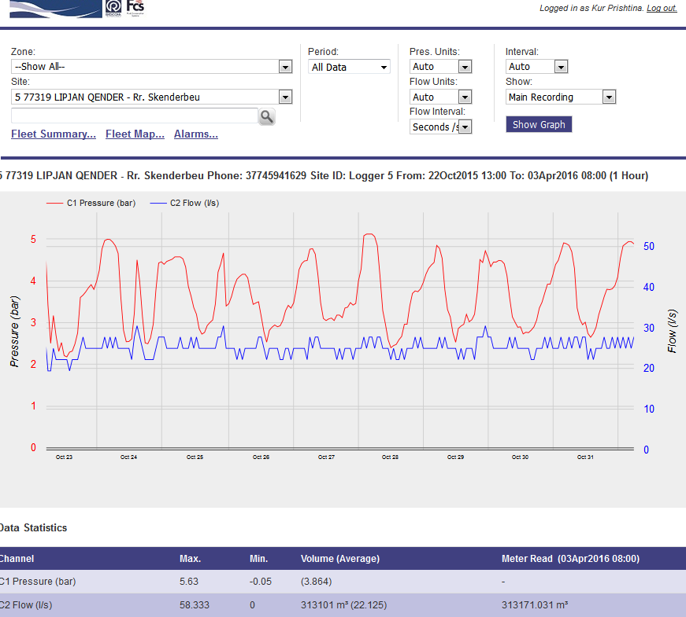
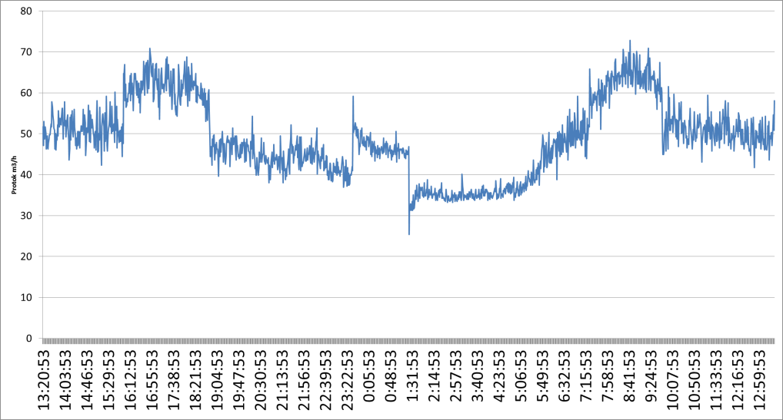
Initial MNF at the selected DMA’s
________________________________________________
Lipjan
Kochani
MNF Q= 22.22 l/sec
Velika Kladusha
MNF 9,7 l/s

Slide 6

Approach and methodology
________________________________________________
Transfer of knowledge:
  Simple – „step-by-step“
  Learning through work with practical examples
  Building own capacities
  Peer-to-peer learning
  Interactive with exchange of opinion, knowledge and good practice examples
  Connecting technical aspect with financial and socio-economic aspects
  Continuous promotion of importance of NRW reduction with increasing cooperation amongst different sectors

Slide 7
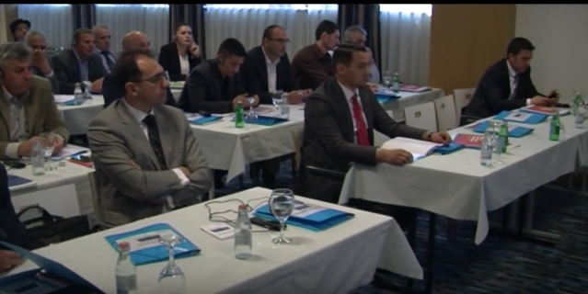
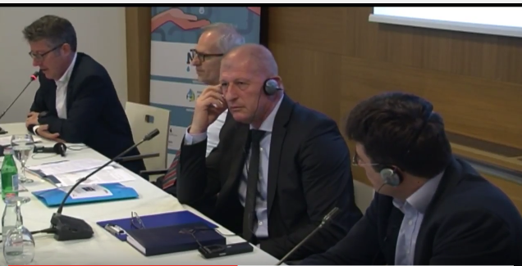
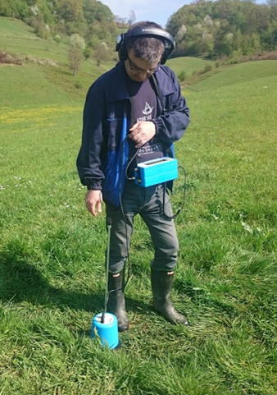
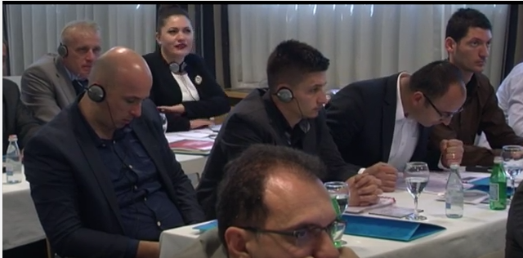
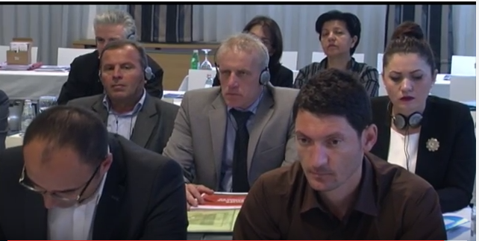
Activities carried out
________________________________________________
Conduction of a detailed assessment of PUCs
Collection of GIS data and data on water supply network infrastructure and consumers in the pilot DMA zone
Development of a water balance for the DMA zone as well as for the entire system for 2014
Development of a hydraulic calibrated model for the pilot DMA zone
Development of capacities at several levels:
- development of individual capacities
- development of PUC organizational capacities
- development of institutional capacities
Checking out accuracy of water meters in a certified laboratories
Supply of leak detection equipment
Step test
Continuous measuring of flow and pressure and leak detection by the NRW reduction management and leak removal team

Slide 8
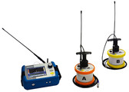
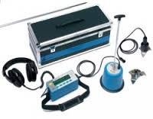
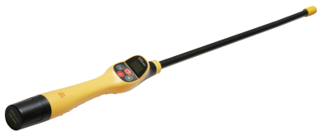
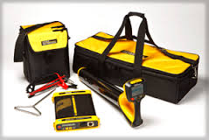
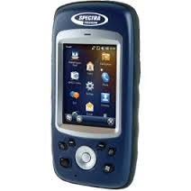
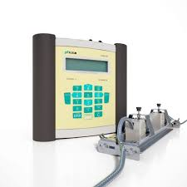
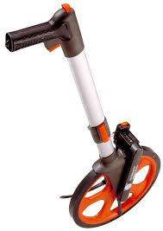
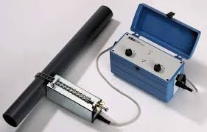
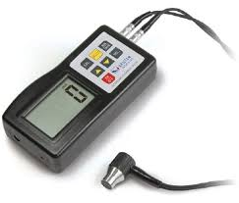
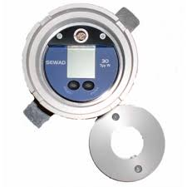
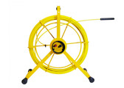

SUPPLYED EQUIPMENT
_____________________________________________
Ferromagnetic locator VM 880
Qty.1
GPS device MobilMapper 20
Qty.1
Ground Microphone
Hydrolux HL 5000 pro
Qty.1
Correlator Correlux C-3 standard Qty.1
Pipe tracer vloc pro 2 Qty.1
Locating Non metallic pipes GOK 50-R Qty.1
Locating Non metallic pipes RSP 3 Qty.1
Wall thickness
gauge Qty.1
Measuring wheel 703112
Qty.1
Pressure data logger SEWAD 30
Qty.4
Mobile ultrasonic flow
meter F 601

Slide 9
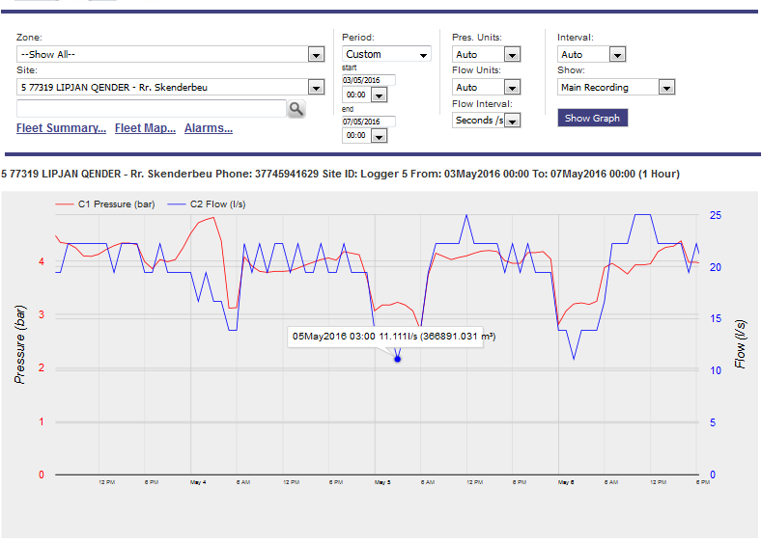
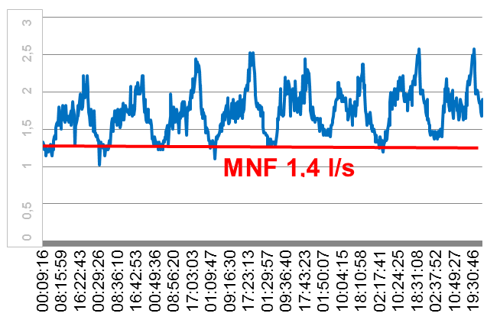
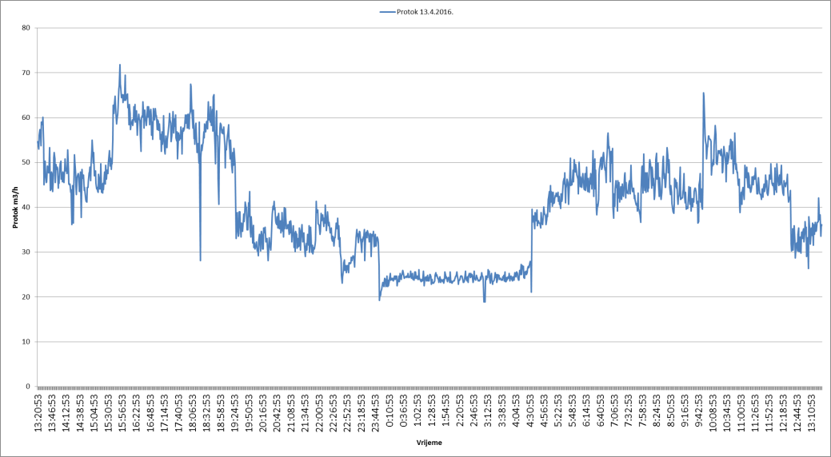
The last measured MNF at the selected DMA’s
________________________________________________
Lipjan
Kochani
MNF 11,11 l/s
Velika Kladusha
MNF 6,7 l/s

Slide 10
Achieved savings (yearly)
________________________________________________
Velika Kladusha (BiH)
Kochani (Macedonia)
MNF: 3 l/s (9,84% of total network)
m³: 94.608
Euro: 68.118 avg. sales price
Euro: 6.000 prod. cost of w.
Total savings for all 3 pilots
MNF: 16,44 l/s
m³: 549.042
Euro: 323.086 avg. sales price
Euro: 61.850 prod. cost of water
MNF: 3.3 l/s (8,45% of total network)
m³: 104.069
Euro: 72.848 avg. sales price
Euro: 20.814 prod. cost of w.
Lipjan (Kosovo)
MNF: 11.11 l/s (8,1% of total network)
m³: 350.365
Euro: 182.120 avg. sales price
Euro: 35.036 prod. cost of w.

Slide 11
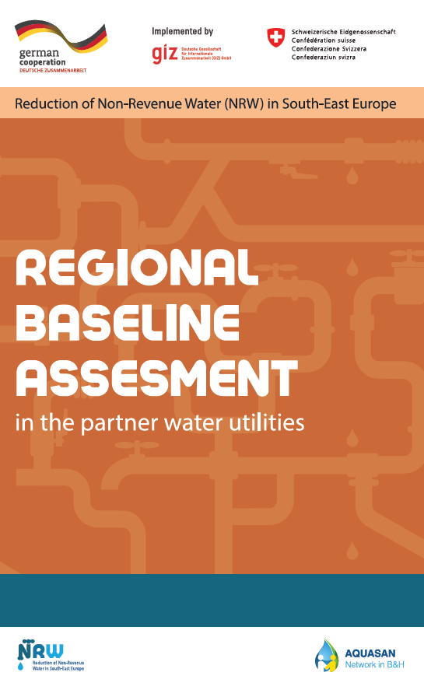



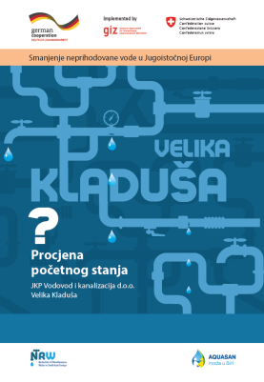
Prepared and disseminated materials
________________________________________________

Slide 12
Conclusions and recommendations
________________________________________________
Conclusions:
  Lack of financial resources is often mentioned as one of major reasons for high NRW – this project shows this is partially true – sufficient savings could be achieved with limited financial resources
  NRW management is not a one-off activity or activity that concerns technical department only.
Recommendations:
Continue with the activities on other DMA’s
- First priority - address the visual leaks and apparent losses.
- Define priority activities for NRW reduction – Assessing Real or Apparent losses
- Performance database needs to be developed as well as expanded and improved
continuously.
- The ultimate focus should be on integration of all applications, software and systems such
as the accounting and billing software, GIS, SCADA, HM

Slide 13
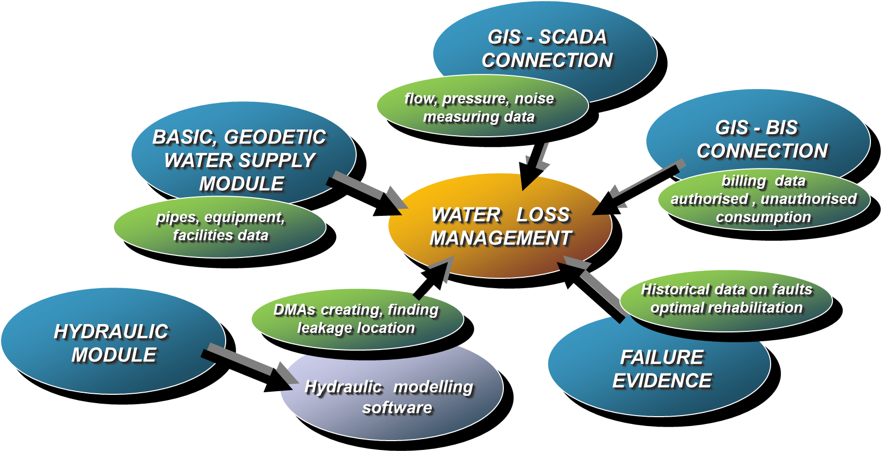
Technical Information System
______________________________________________

Slide 14
Thank you for your attention!
Bojan Ristovski
Regional NRW Expert for Macedonia and Kosovo
„Reduction of Non Revenue Water in Southeast Europe”
E-mail:bojan@aquasave.mk; Mob: +389 70 30 20 60

