Slide 1
Non-Revenue Water:
The cornerstone in delivering efficient and effective water services
by
Bambos Charalambous
Past Chair of the IWA WLSG
Chair of the IWA IWS TG
Fellow of IWA
HydroControl Ltd / J2C Water Ltd

Slide 2
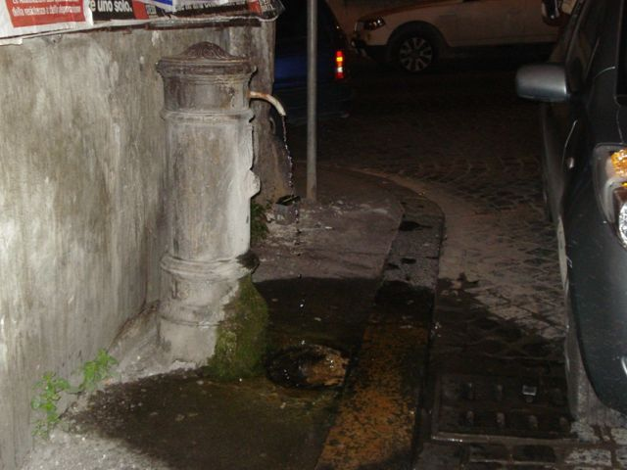
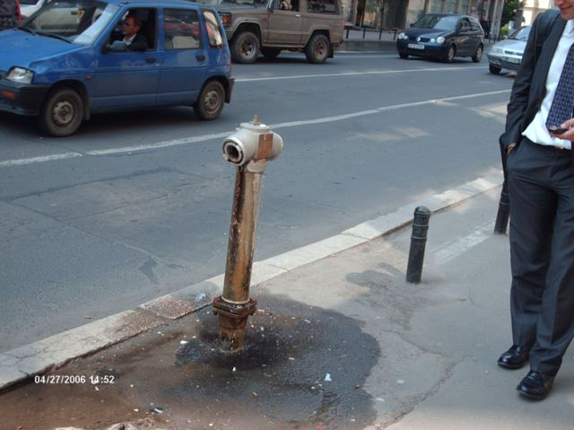
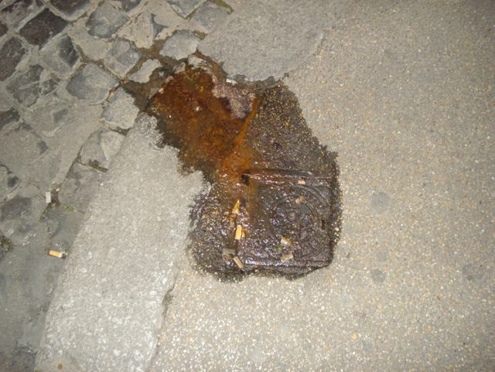
“Business as Usual”

Slide 3
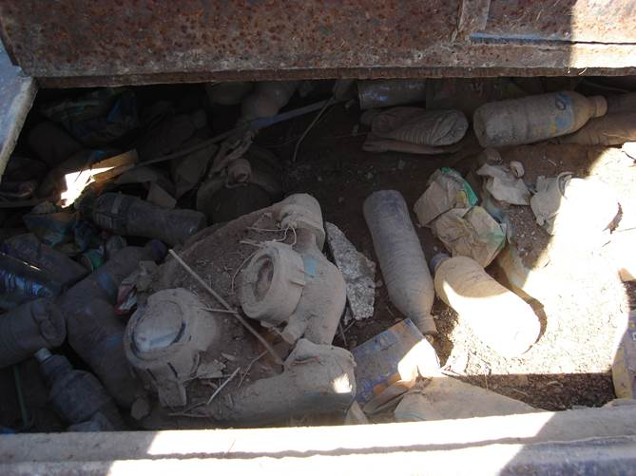
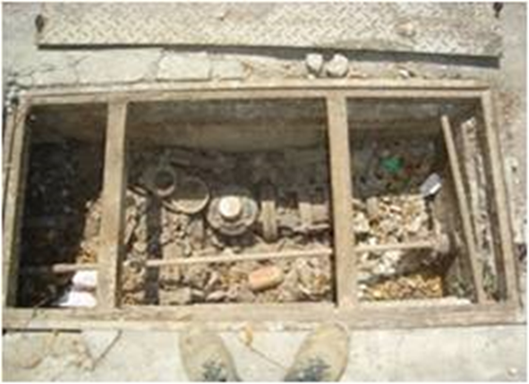
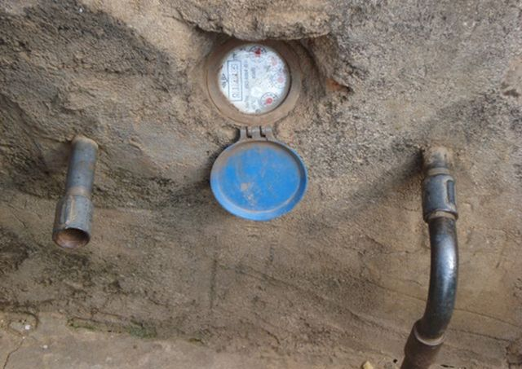
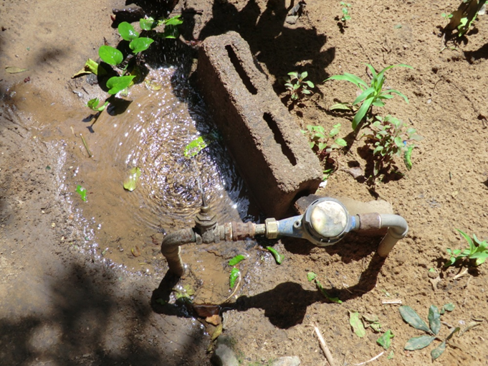
“Business as Usual”

Slide 4
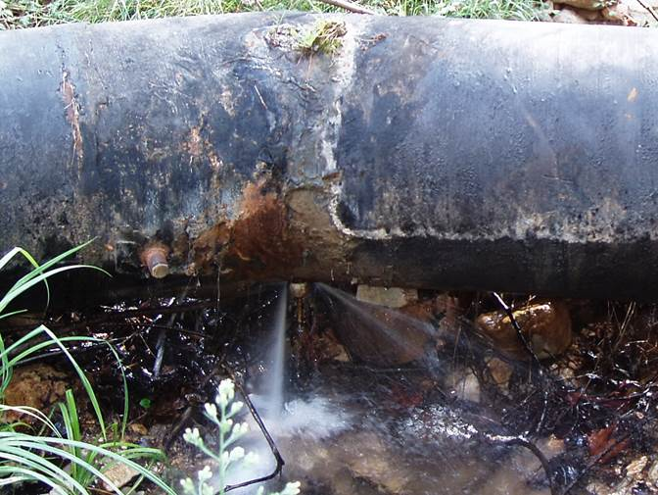
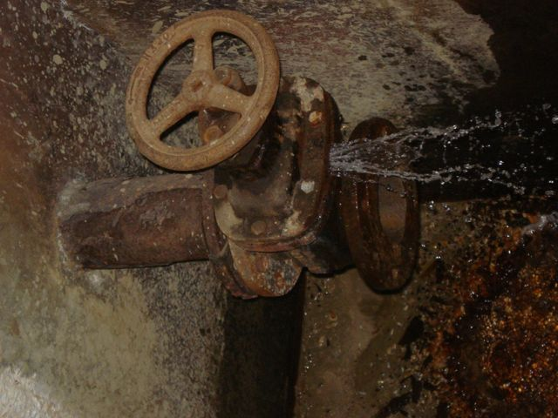
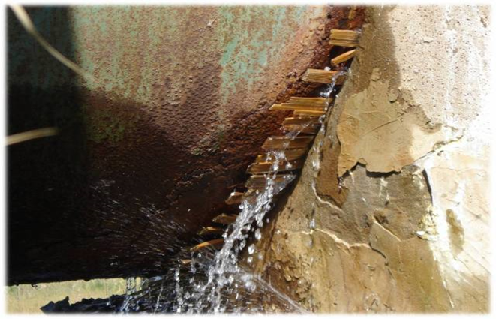
“Business as Usual”

Slide 5
Result of “Business as Usual”
High
N R W
“Passive Approach”
NRW Increases with Time
NRW=
Water which is supplied in to a system but
does not produce revenue
Low
0
TIME - Years
0
Notes:
Result in
Contribute to
Create

Slide 6
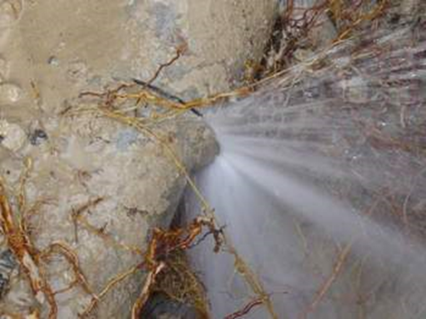
A Vicious NRW Cycle
Inefficient Operations
Poor service
Low Investments
Poor Skills Development
NRW Increases
Low Willingness to Pay
Customer Dissatisfaction
Notes:
Result in
Contribute to
Create

Slide 7
The Virtuous NRW Cycle
Water Utility
invests in NRW
Reduction
Water Utility
has increased revenue
& financial capacity
Water Utility
invests in NRW
Reduction
Water Utility
has increased revenue
& financial capacity
Water Utility
invests in NRW
Reduction
Water Utility
has increased revenue
& financial capacity
Water Utility
invests in NRW
Reduction
NRW REDUCES
NRW REDUCES
NRW REDUCES
NRW REDUCES
The Challenge:
How to turn the vicious cycle into virtuous cycle

Slide 8
Moving away from “Business as Usual”
NRW Increases with Time
Passive Approach – “Business as Usual”
High
N R W
NON-REVENUE WATER MANAGEMENT
LONG TERM STRATEGIC ACTION PLAN
HIGH NRW
Low
LOW NRW
ECONOMIC NRW
24/7/365
0
TIME - Years
0

Slide 9
The Centrality of Water Loss (NRW) in Good Water Utility Management

Slide 10
NRW Constituent Components
System Input Volume | Authorized Consumption | Billed Authorized Consumption | Revenue Water
 |  | Unbilled Authorized Consumption | Non Revenue Water
 | Water Losses | Commercial Losses
 |  | Physical Losses

Slide 11
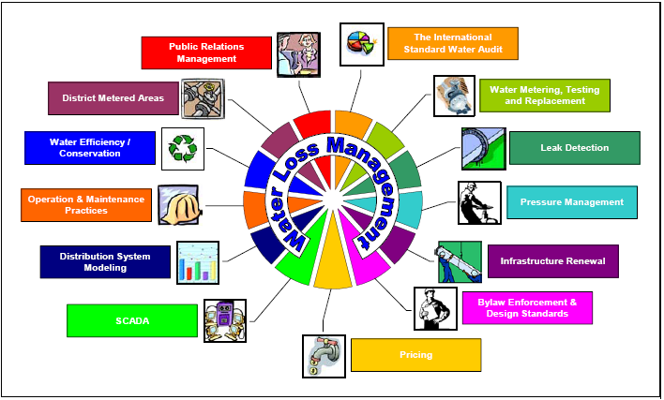
The Centrality of Water Loss Management
Source: McCormack, 2005

Slide 12
Non Revenue Water – Key Message
REDUCTION IN:
Unbilled Authorized Consumption will generate more revenues
Commercial Losses will generate more revenues
Physical Losses will:
  result in more water being available for consumption or reduction in operating costs
  delay the need for investments in source development

Slide 13
Key Challenges – Way Forward

Slide 14
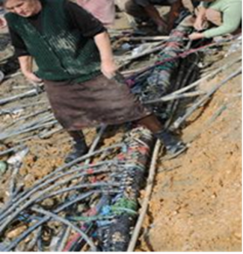
Main Challenges in the Danube Region
High NRW attributed both to Physical and Commercial Losses, more than 60% of System Input Volume
Lack of proper maintenance – Poor pipe network condition - Major replacement needed
Poor metering and inadequate metering policies
Data handling inaccuracies
Unsatisfactory bill collection
Inaccurate network data
Low water tariffs
Insufficient income
Lack of finances for CAPEX

Slide 15
Move from Passive to Active Mode
Three successive levels of improvement:
First, doing the obvious (simple and cheap):
-Pick the low hanging fruit, quick wins
Second level of action:
  -Drive the system into an improved performance
Third, the long-term and sustainable stage:
  -Fine tune and sustain gains

Slide 16
Driving Change
Management must:
  understand and accept challenge
  take ownership
  show commitment and leadership
Supporting elements/conditions:
  enabling environment
  employees, customers on board
  mandate, empowerment, capacity
  objectives, targets
  organization and administration
  financial resources, budget
  communication inside and outside of the utility

Slide 17


Thank you
Thank you
Bambos Charalambous
HydroControl Ltd / J2C Water Ltd
Tel.: +357 99 612 109
Email: bcharalambous@cytanet.com.cy

