Slide 1
Data and information for Municipal Officials and Public Transparency
Presenter:
Dr. Petros Kolovopoulos
Notes:
Hello!

Slide 2

WATER SERVICE DATA COLLECTION AND MANAGEMENT: WHAT FOR?
MAIN ISSUES DETERMINING DATA COLLECTION
  Objective
  Methodology
  Data Availability
  Data Accuracy, Reliability
  Raw vs Processed data
  Data Validation & Modeling

Slide 3
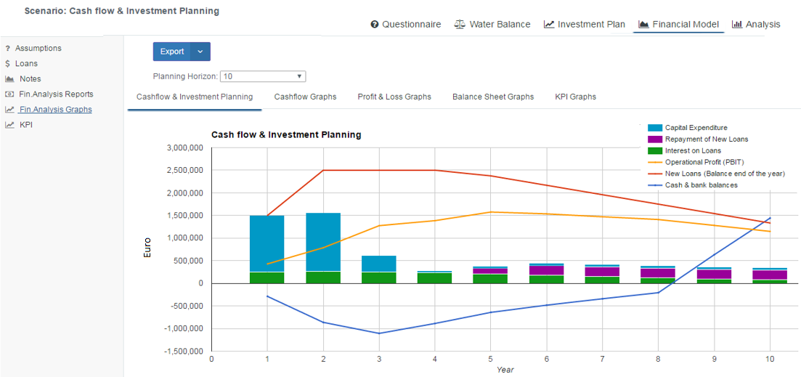
Example: NALAS AM-Business Planning Model
  The objective of the implementation of the Business Planning Model, is to assess the performance and sustainability of the Utility based on its current condition and the effect of various interventions to be carried out through a proposed Investment Plan.

Slide 4
Implementation Methodology

Slide 5
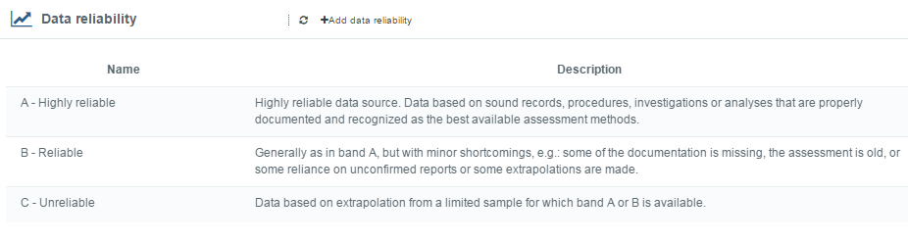
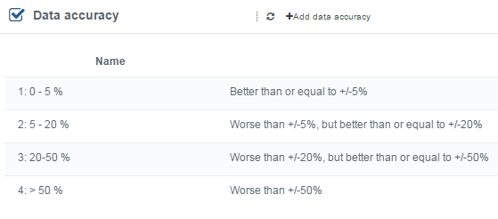
Implementation of AM-BPΜ
Data Accuracy & Reliability

Slide 6
Implementation of AM-BPΜ
Phase I: Questionnaire – Data Collection
Commercial / Operational / Financial / Technical Information

Slide 7
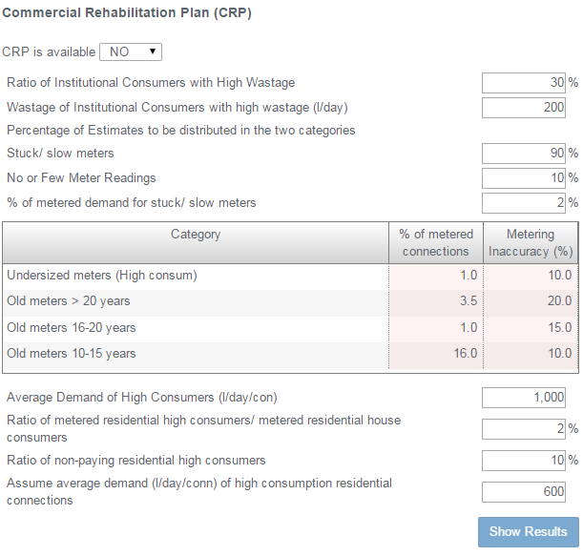
Implementation of AM-BPΜ
Raw vs Processed data

Slide 8
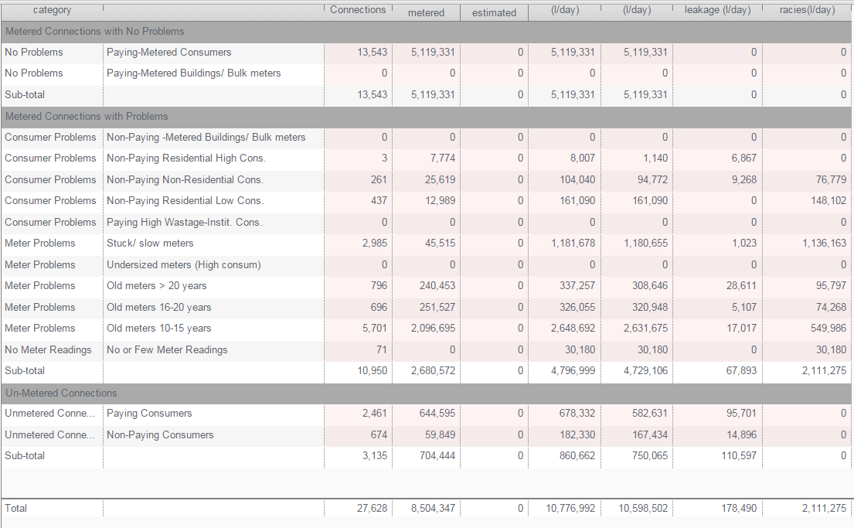
Implementation of AM-BPΜ
Raw vs Processed data

Slide 9
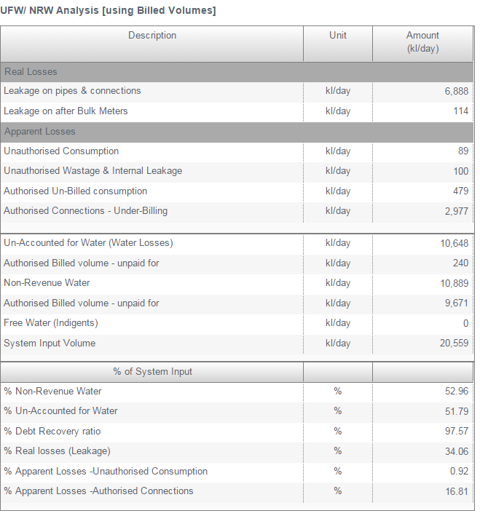
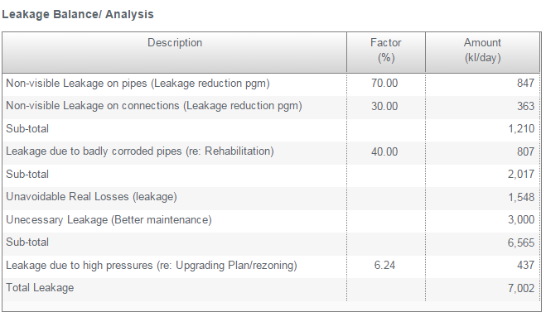
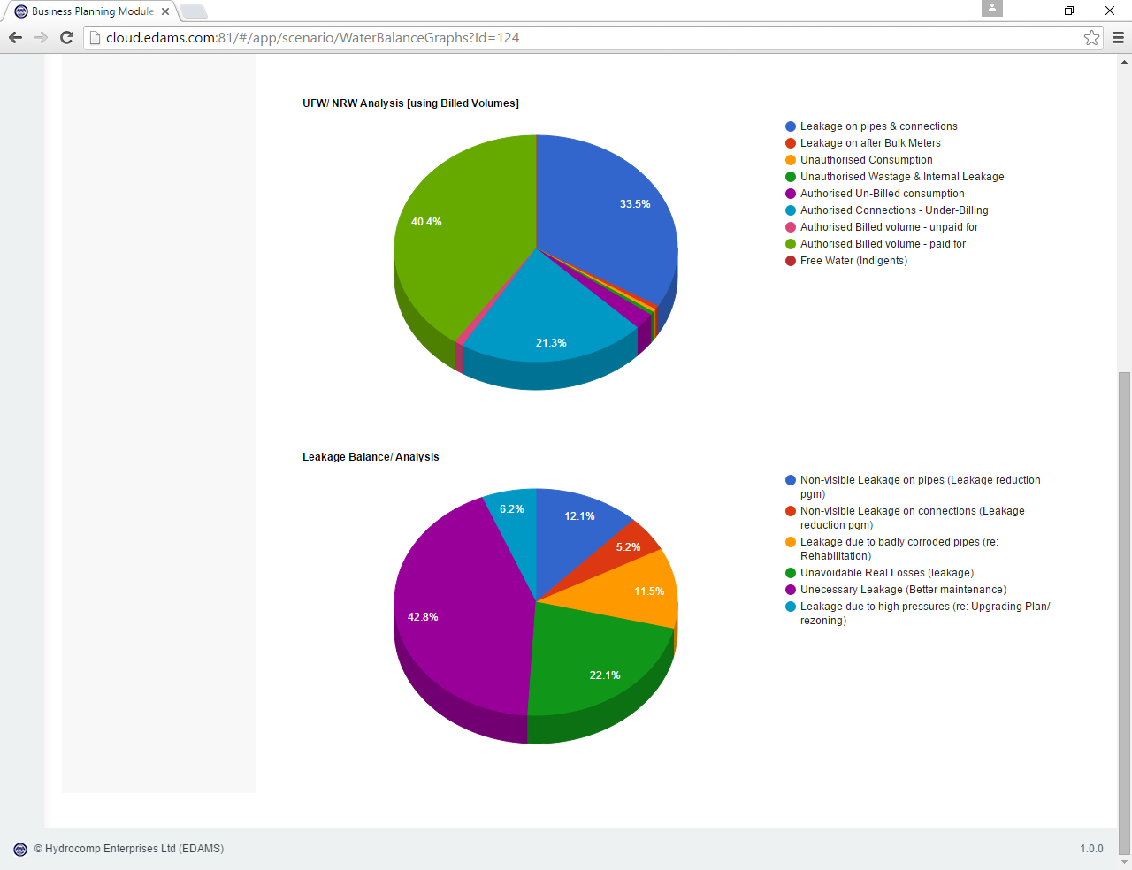
Implementation of AM-BPΜ
Data Validation & Modeling

Slide 10
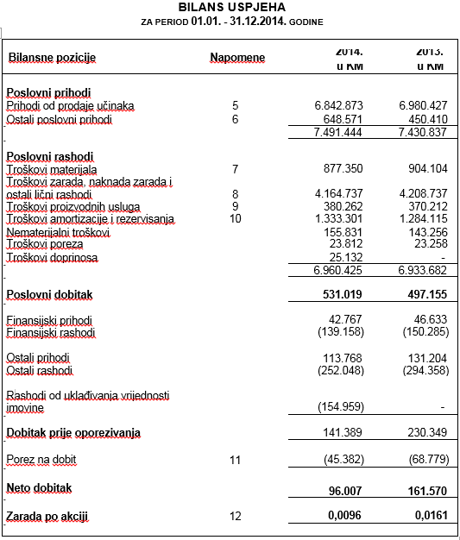
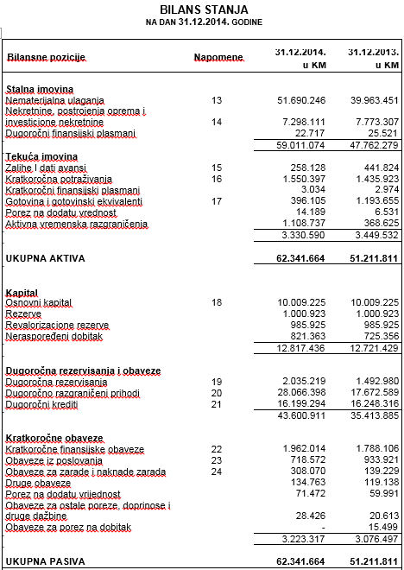
Implementation of AM-BPΜ
Data Validation & Modeling

Slide 11
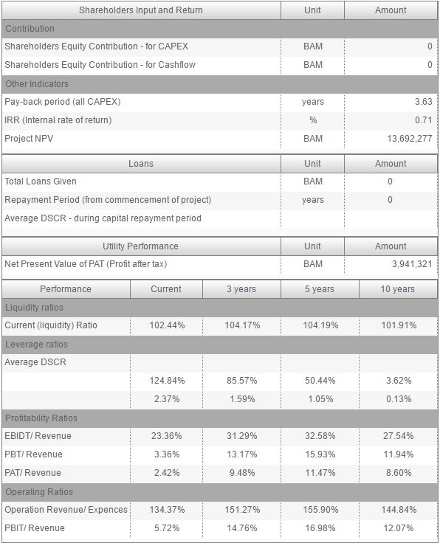
Implementation of AM-BPΜ
Data Validation & Modeling
  Performance & Sustainability Assessment – KPI: A summary of Utility’s performance (present and projected) based on suitable Key Performance Indicators (KPI).

Slide 12
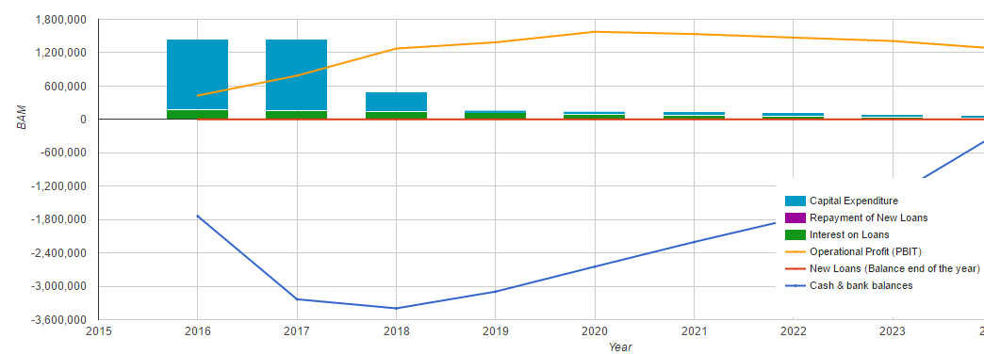
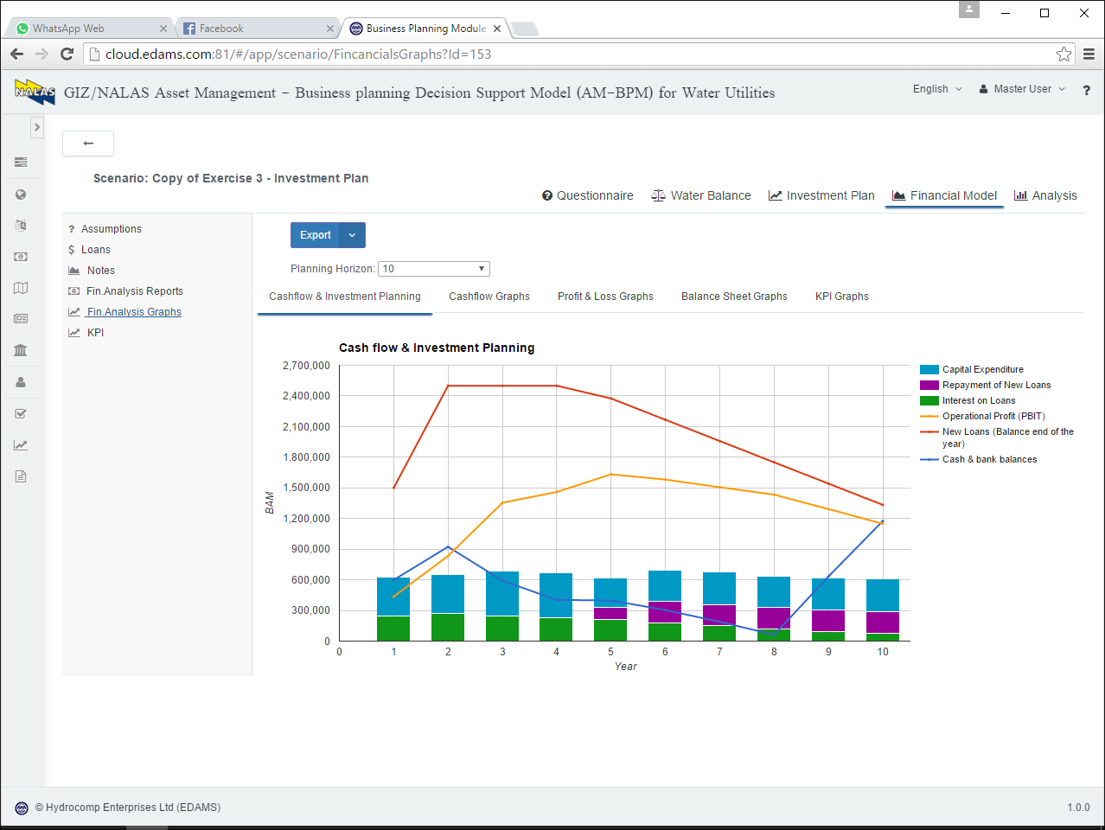
Implementation of AM-BPM
Phase III: Investment Scenario Analysis
Cashflow & Investment Planning

Slide 13
WATER SERVICE DATA COLLECTION AND MANAGEMENT: WHAT FOR?
MAIN ISSUES DETERMINING DATA COLLECTION
  Objective
  Methodology
  Data Availability
  Data Accuracy, Reliability
  Raw vs Processed data
  Data Validation & Modeling

Slide 14


