Slide 1
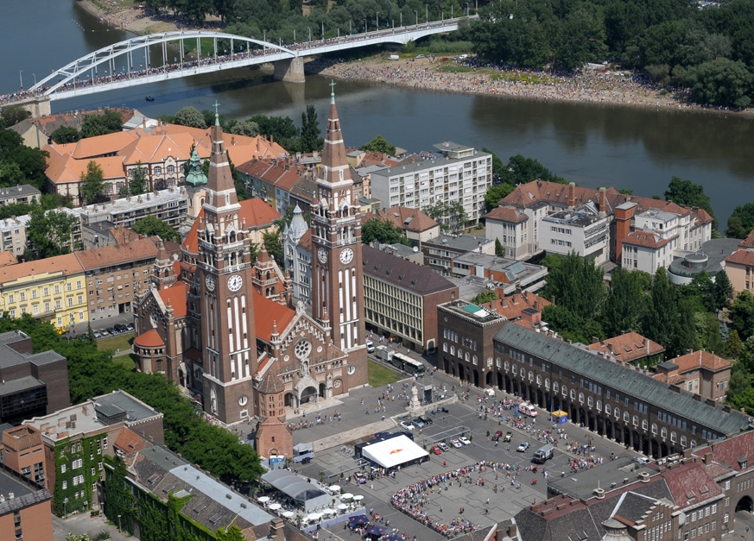
Szegedi Vízmű Zrt.
Internal governance: the importance of sound HR practices

Slide 2
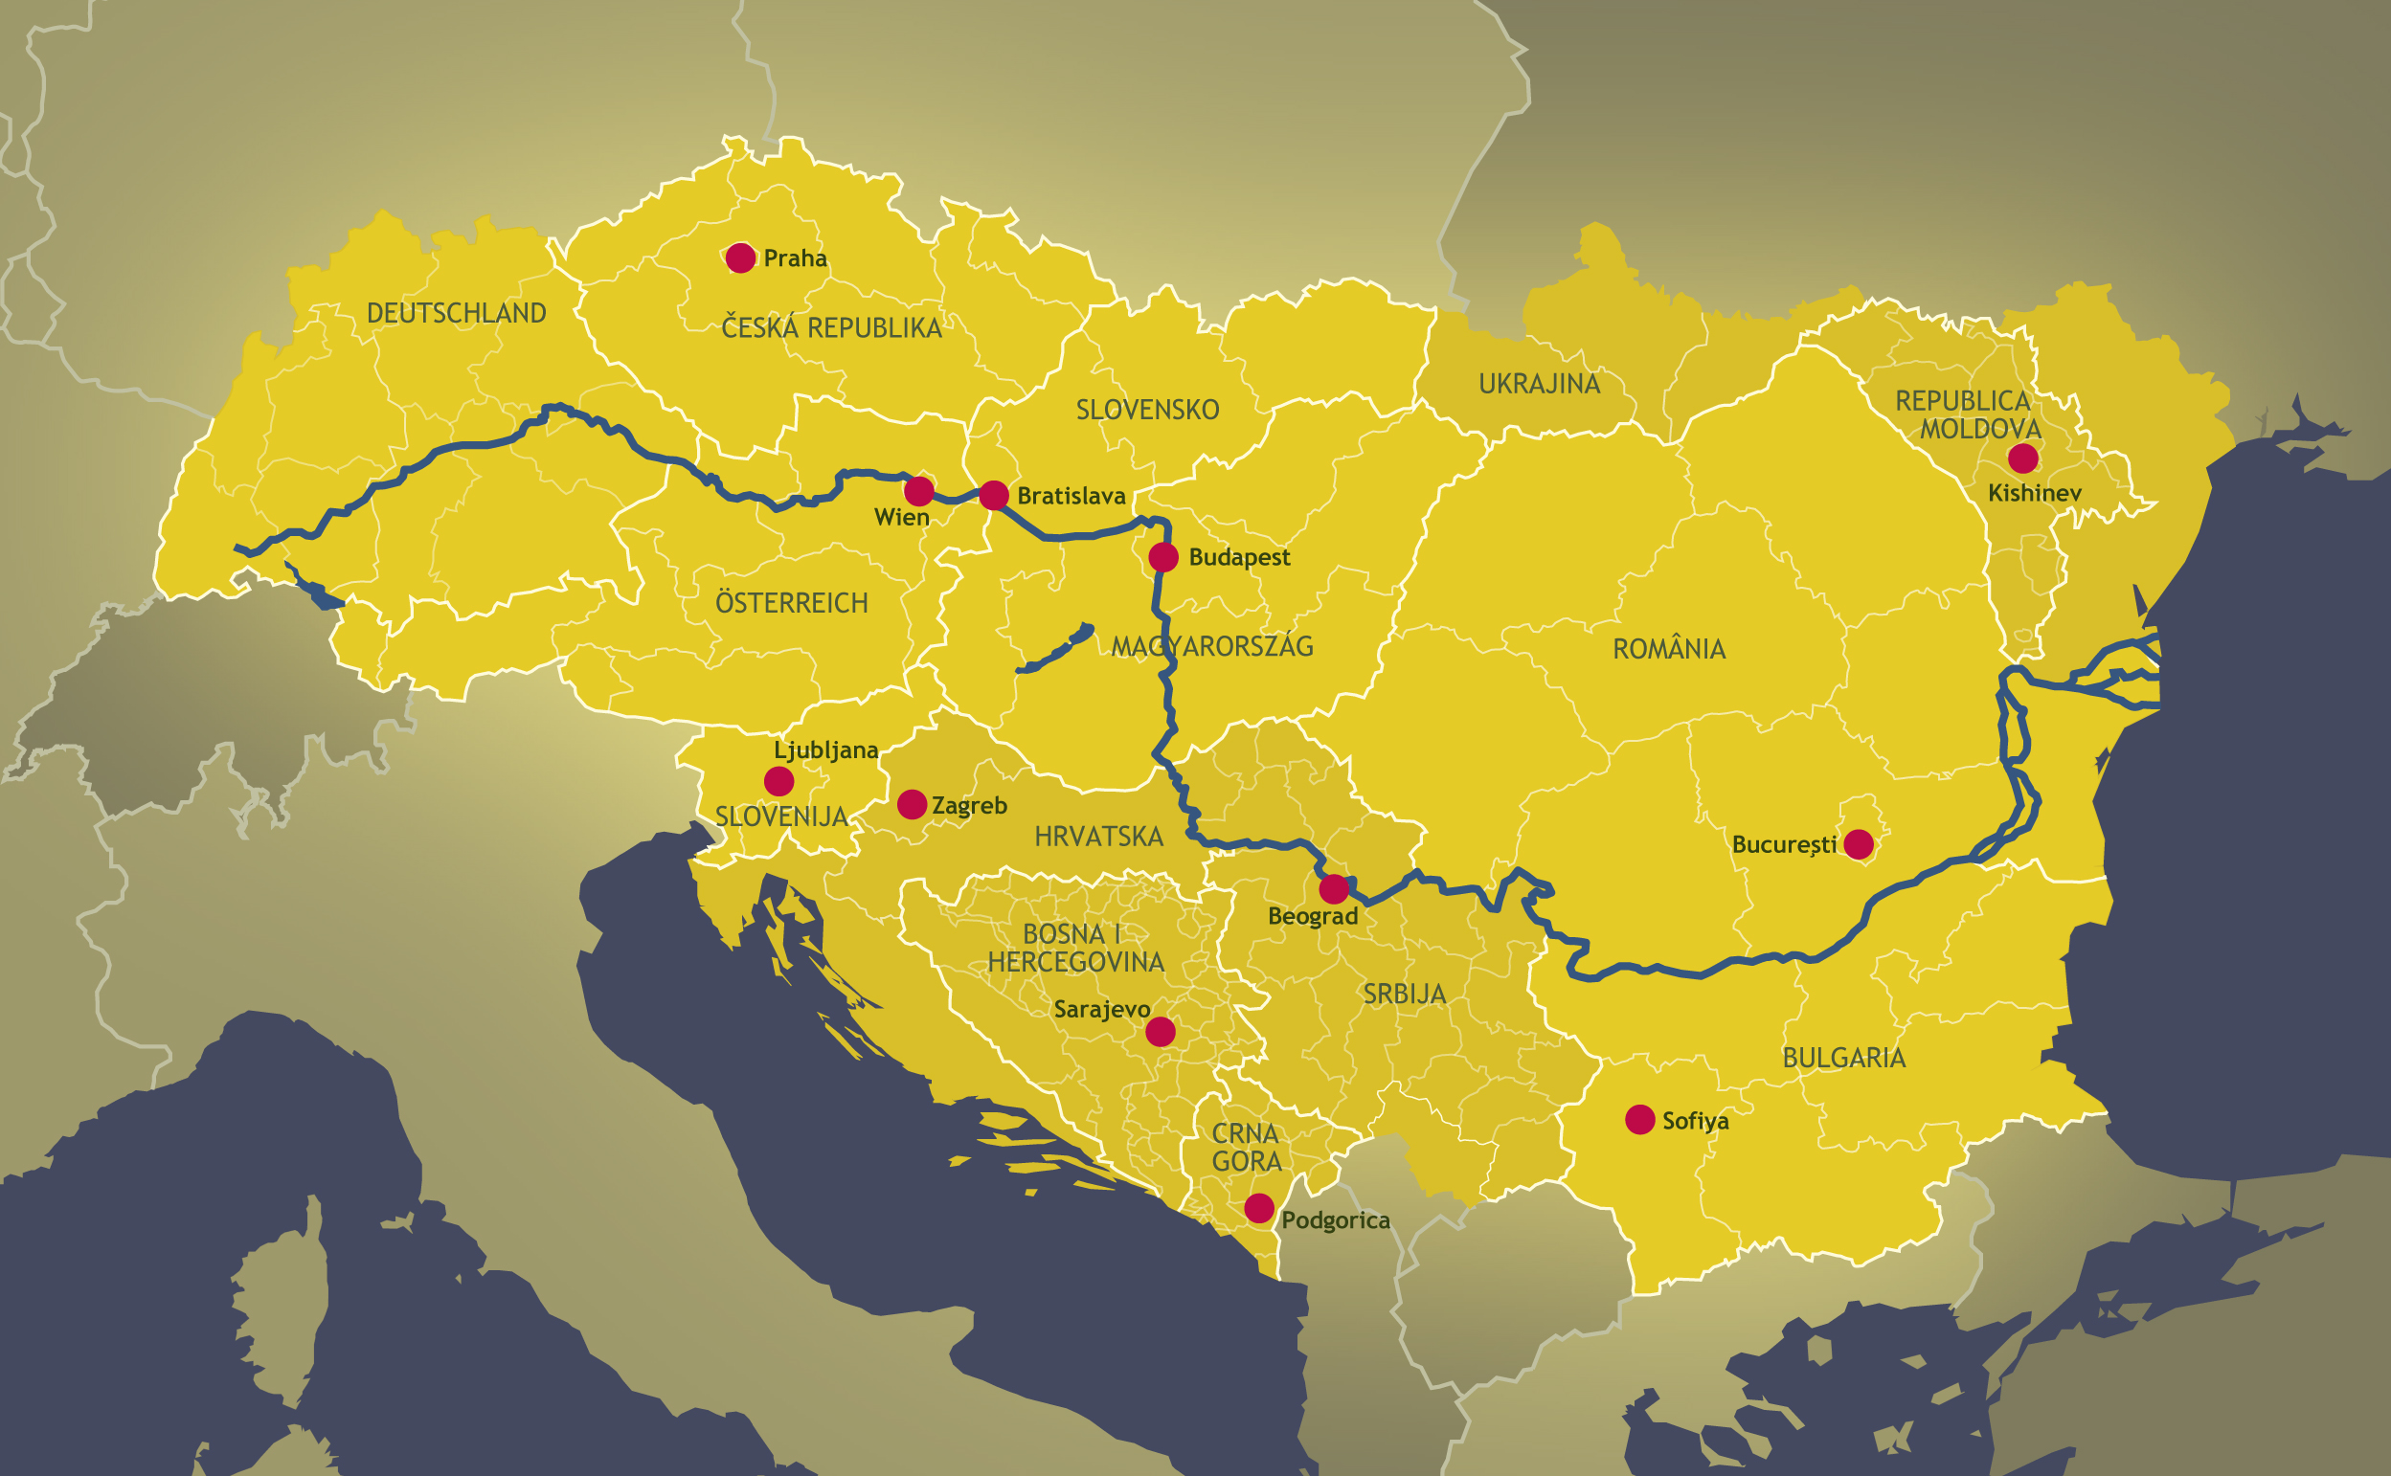
Countries of the Danube

Slide 3
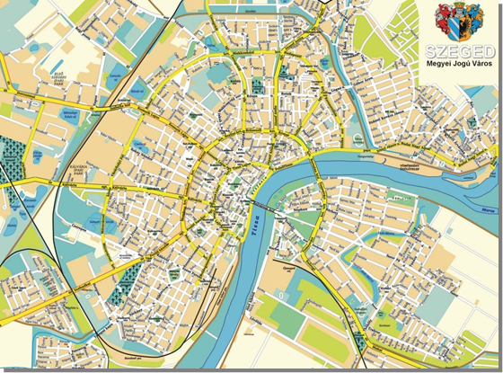
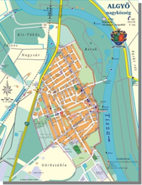
General data
Operational form:
Szeged: Asset rental contract until 2024
Algyő: concession until 2018
Utility owners:
Local municipalities
Operated utility asset:
EUR 145 million
Main activities:
Drinking water network (690 km)
Sewage network(618 km), waste water treatment
Rainwater open ditches (249 km)
Reconstruction of networks
Inhabitant supplied
175 th people, 81,5 th consumers

Slide 4
Shareholders
Municipality of Szeged 51 %
Veolia Víz Zrt. (management right)
49 %
Period of cooperation: 1994 – 2024
Original term of contract: 15 years
Enlengthened twice

Slide 5
Framework of the cooperation
Frame Agreement
between shareholders
Stipulates rights and obligations of the parties
Management rights remain with the professional investor
5-member Board (3 members from Veolia, 2 members from municipality
1 of them the president)
6-member Supervisory Board (3 members from Municipality 1 member from Veolia 2 employee delegates)
→ Municipality control over the company through Supervisory Board
General Meeting decides on significant matters only via unanimous voting (Balance Sheet, P&L account, delegation issues, etc.)
Includes the tariff formula
Defining Starting tariffs in 1994. which did not include coverage
Profit based on efficiency increase
Inflation index increase
Possibility for correction of quantity volume (has not been implemented)
Ensuring the recovery of new assets

Slide 6
Framework of the cooperation
Operation Contract
Between Municipality and the Waterworks company
Water supply, wastewater disposal and treatment, rainwater disposal
Operation rights and obligations
Defining technical and financial details
Rental contract for utility assets
The assets are owned by Municipality (EUR 145 millions)
Rental fee defined by formula
Rental fee depends on:
Supplied volume
Receivables collection ratio
Rental fee is 1/3rd of turnover
Rental fee only used for development and reconstruction of utility assets (50%-50%)

Slide 7
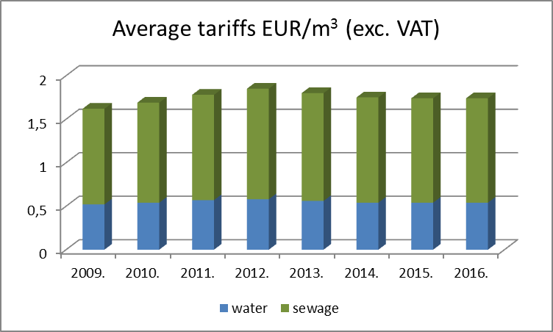
Business figures

Slide 8
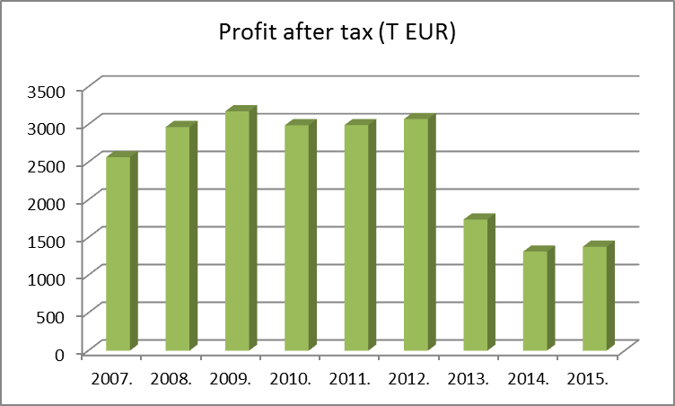
Business figures

Slide 9
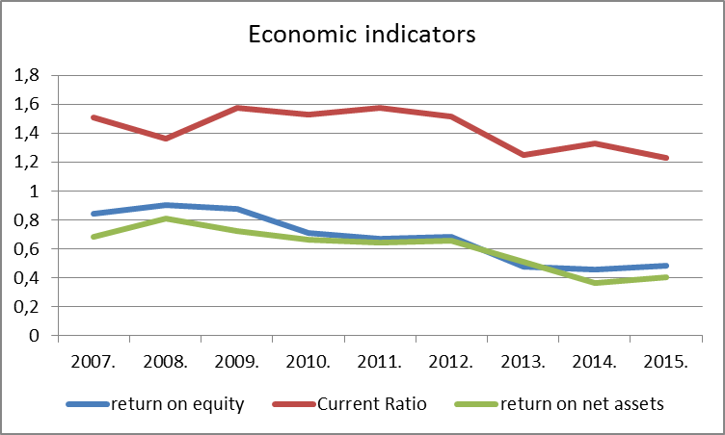
Indicators

Slide 10
Mixed capital model advantages
Ensures the independence of the company’s professional governance
Operational governance based on exclusively professional aspects
Politics-free management
Veolia provides support and strict control
Municipality negotiates with company throw their professional staff and elected commities, mainly about development and reconstruction issues
Exercising ownership rights via General Assembly

Slide 11
Main activities of professional investors
Strict professional support and control
SOX/CAP - action plan
ELC - value creation index
Veolia Finance Transformation - performance evaluation
Common projects for example:
Reduction of net WCR current assets
Danube project
Direct debit
Increase of the number of electronic services
Reduction of meter readings
Monitoring of efficiency improvement
actions

Slide 12
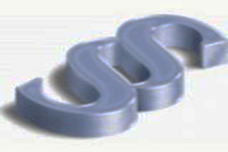
Legal environment changes
Before 2012
No sectoral law, only lower level regulations
Water supply is the municipality’s obligatory task
Price authority is the municipality
After change of political system out of 33 service provider companies nearly 400
Different levels of service
Tariffs are in wide range (EUR 0.3/m3 –EUR 3.0/m3)
From 2012
The obligatory supply task of the municipality remains and is supplemented by the State’s obligations, but…
Price authority right withdrawn, delegated to the minister of development
Stricter legal environment
Harder financial conditions
Increase of the State’s role

Slide 13
Legal environment changes
New sectorial law effective date 23:00 h 31-12-2011
Principles
sustainability of resources
security of supply
responsibility for supply
responsibility of service provider
„polluter pays” principle
regionality
return of costs (2000/60/EC)
„lowest cost” principle
no cross-financing

Slide 14
Legal environment changes
Main objectives
Service provider integration
Defining the minimum number of consumers
Appointing the State Supervision Authority (Hungarian Energy and Public Utility Regulatory Authority, MEKH)
Operational licenses issued by MEKH (1541- page long application for our company)
State control instead of municipality control
Increasing supply security and quality of operations
Increasing efficiency through scales of economy

Slide 15
In practice…
Principles defined by law are continuously violated:
Short-term political decisions instead of professional aspects
Extra burdens
(SZV: EUR 2.4 million, 12% of revenue of main activities in 2015)
from 01-07-2013, 10% reduction of residential tariffs,
other water charges are constant
unfair pipeline tax
„Robin Hood” tax
authority supervision fee
Uncertainty of legal changes
Uniform tariffs on the agenda
Level of supply quality deteriorating due to tariffs not covering costs
Defining tariffs for EU financed projects delayed

Slide 16
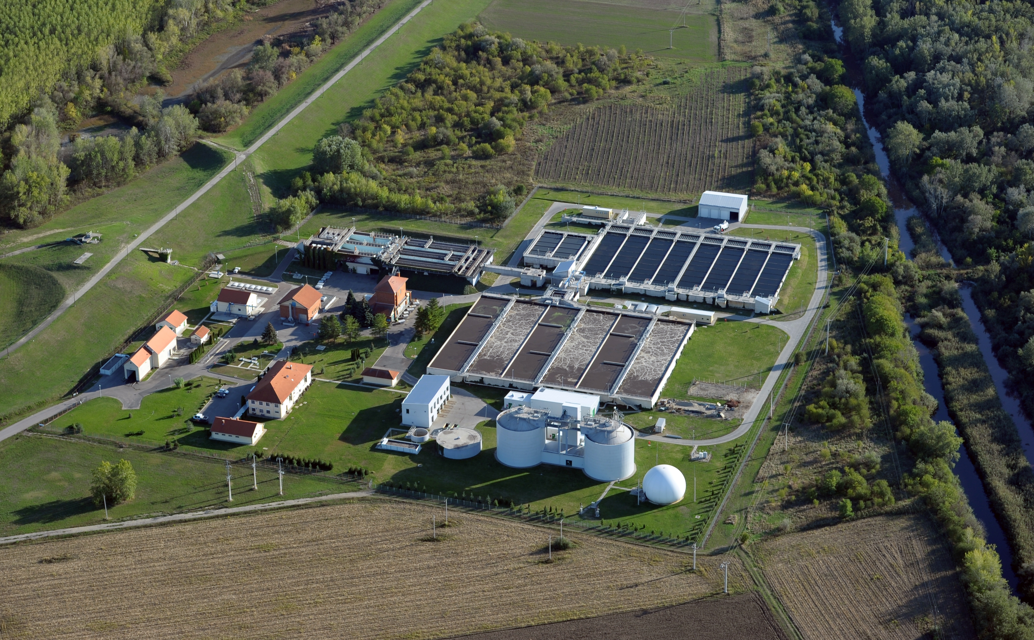
Usage of renewable energy
Utilization of biogas (production of electricity and heat-energy)
Usage of heating pump (drinking water, heat and waste water heat utilization)
Renewable energy production in 2015. 5551 MWh, 40,6% of total energy usage

Slide 17
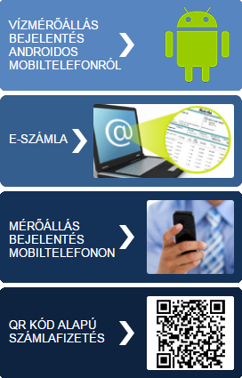
Innovative customer service solutions
E-customer service (www.szegedivizmu.hu )
Meter readind data registration
By mobile, sms or wap (for registered clients);
By Android mobile (without registration)
On the website
By phone
E-invoice
QR code payment
Credit card payment on the wesbsite from 06-2016)

Slide 18
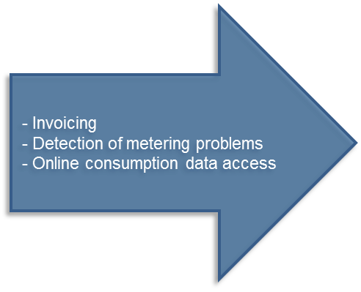
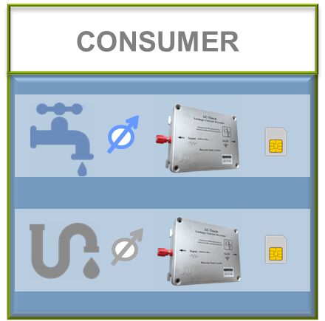
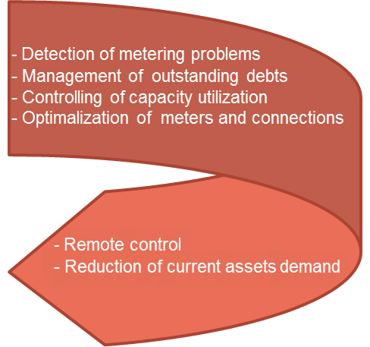
Smart Metering Solutions Intelligent consumption measurement system
Consumption points | Monthly volume sales /month | (%)
 |  | Smart metering volume / Total volume | Smart metering volume / Non-residential volume
336 | 180 000 m³ | 25 | 79

Slide 19
Thank you for your attention! Zoltan Istokovics

