Slide 1
Customer Care Management
TIRANA Water Supply and Sewerage Utility
Danube Water Conference
12-13th of May, 2016
Vienna, Austria

Slide 2
Presentation Overview
Legal Status, Ownership, Mission
General Information
Utility Performance 2010-2015
Current Status of Customer Service Management (CSM)
Problems with CSM
Intervention and Improvement of CSM

Slide 3
GENERAL OVERVIEW
UKT is a mixed joint stock company established in 12/05/2000.
Management of the Company:
1. Shareholders Assembly
2. Supervisory Council
3. General Manager (CEO)

Slide 4
MISSION
“To provide quality water and sanitation services at commercially sustainable levels to our customers”.
✓

Slide 5
MAIN SERVICES
Water Supply:
Provision of drinking water supply
Guarantee a technically adequate water supply network and protection of water resources
Reducing losses and the amount of non-revenue water in water supply system
Increasing revenue from billing.
Sewerage:
Removal of wastewater discharged from the consumers
in the service area.
Maintenance of the constituent elements of the sewerage system.
Collection of fees from consumers for these services.

Slide 6
General Overview of UKT
Total number of population | ∼1 million inhabitants
Production volume 2015 | 101 million m³
Length of water supply network | 2652 km
Length of sewerage network | 597 km
Volume of billed water 2015 Non-revenue water | 34’946’712 m³ ^{67%}
Total number of connections 2016 | > 220, 542

Slide 7
UKT Administrative Structure
CENTRAL DIRECTORATE
Unit 1
Unit 6
Regional Directorate
Unit 2
Unit 3
Unit 4
Unit 5
Notes:
UKT operates throughout 7 units under the administration of the Central Directorate.
These units are distributed around the coverage area and have in their structure : the sales sector, maintenance sector, sewerage sector, Protocol and Support Sector.
The Regional Directorate was established in April 2016. The new Territorial Reform has brought new challenges for UKT with regard to the expansion of the coverage area. More than 20 000 of contracts are to be added to the customer database of UKT and there is work to be done towards the construction/rehabilitation of water supply and sewerage network.

Slide 8
Customer Categories and Types of Billing
CUSTOMER CATEGORIES
Households ∼ 191,000
Private/ Business ∼ 29,500
Public Institutions ∼ 600
Bulk sale (13 former Communes) now to Kamza.
BILLING
Per consumption
Per capita
Notes:
In year 2013 u hoq faturimi afrofe
Faturimi “per fryme” perdoret ne ndertesat ku nuk ka mundesi (kushte teknike) per vendosje te matesit.
Shesim ujin me shumice per njesite administrative derisa te krijojme kushtet e rrjetit dhe te pajisjes me sahate (Evisss check)
Peshen me te madhe e zene konsumatoret familjare me 87 %

Slide 9
Water Coverage and Sewerage Coverage
OPERATIONAL PERFORMANCE 2010-2015
Notes:
WRA stands for Water Regulatory Authority which is an independent body

Slide 10
Staff for 1000/connections and water supply hours/day

Slide 11
Proportion of metered connections

Slide 12
Water Sale, Water Production and Non-Revenue Water
Note: Non-Revenue Water in 2015 is 70.02 %

Slide 13
TOC Coverage by Revenues (W&S) and TOC Coverage-Collections (W&S)
Note: Subsidies between 2010-2015 in Water Supply and Sewerage Utility of Tirana (UKT sh.a) are 0
Notes:
Arsyeja qe TOC Coverage by Collections eshte me e madhe se revenues eshte sepse ne arketimet futen edhe detyrimet e prapambetura nga konsumatoret.

Slide 14
TOC per m³ produced and bought (W&S), TOC per m³ sold (W&S) and Average Price W&S

Slide 15
Customer Service Management CSM
Sales Department
Reception
Information
Sector of Complaints
and Information
Complaint’s Specialist
Verifiers of Complaints
Drafting Responses Specialist
Only 9 Employees deal with the management of complaints received by the Central Directorate and 7 units of Tirana !!!!
Notes:
Para nje viti, ne zonen e mbulimit te UKT kane operuar rreth 30 zyra te marredhenieve me konsumatorin neper te cilat konsumatoret mund te paguanin dhe njekohesisht te kryenin procedurat per ankesa dhe kerkesa. Gjithasthu, Njesite e UKT kane patur “tagrin” per te verifikuar ankesat e qytetareve.
Ne Dhjetor te 2015 u mbyllen ZMK dhe qe prej atehere UKT sh.a i menaxhon ankesat vetem nepermjet struktures se mesiperme e cila ka problematikat e veta.

Slide 16
COMPLAINTS/ REQUESTS CATEGORIES AND CHANNELS
APPLICATIONS
Network connection
Contracts
Water-Meters
Booklets
2. COMPLAINTS
Billing
Water Quality
Network failures
Water Contamination
Problems with the water-metering
CHANNELS
Written/ official
Telephone
E-mail
On-line
Personal customer contacts
Other institutions

Slide 17
Billing Complaints 2010-2015
Notes:
CSM deals an average of 100 complaints for 2015.
The statistics are for total of complaints and not according to categories.
The above statistics are for billing only. There is no database for other types of complaints.

Slide 18
Current Status of Customer Orientation
Multiple options for costumers to pay their water bills (UKT offices, Banks, Easy Pay, Pay& Go, Western Union, Mobile).
Customers are informed about service changes or interruptions via TV announcement, Facebook, press in due time.
Customers are provided different service delivery based on network configuration (piped system, truck distribution, wells, septic tanks).

Slide 19
Problems with Customer Service
Currently only 9 persons dealing with CSM and with expansion of coverage area (13 more ex communes)- large influx of complaints.
Lack of reliable, updated database of complaints and loss of information (no integration of complaints treated by other departments).
Currently CSM manages only billing-complaints.
No survey of the customer to learn their opinion and views to improve CSM quality.
No mechanism to involve customers in decision making.
No awareness campaign to educate consumers in treating water.

Slide 20
Intervention and Improvement of CSM
Introduction of one-stop- shop customer service
Customer Service IT system connected to new IT program of Billing, accounting and IT system
Need for setup of telephone call management system
Improvement of the customer service channels
Working out an organization- and personnel development program
Quality management: exact documentation of the processing, making the documentations up-to- date, maintenance of the forms and printed papers.
Electronic document management.
Notes:
We are currently in process of changing the Billing and Information System of UKT based on a MoU signed with USAID

Slide 21
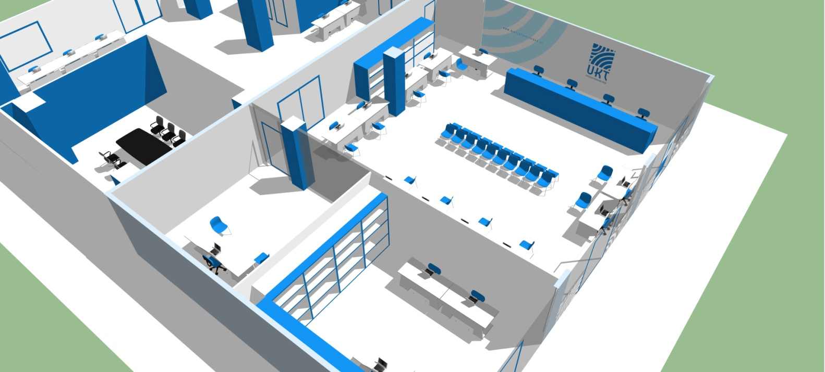
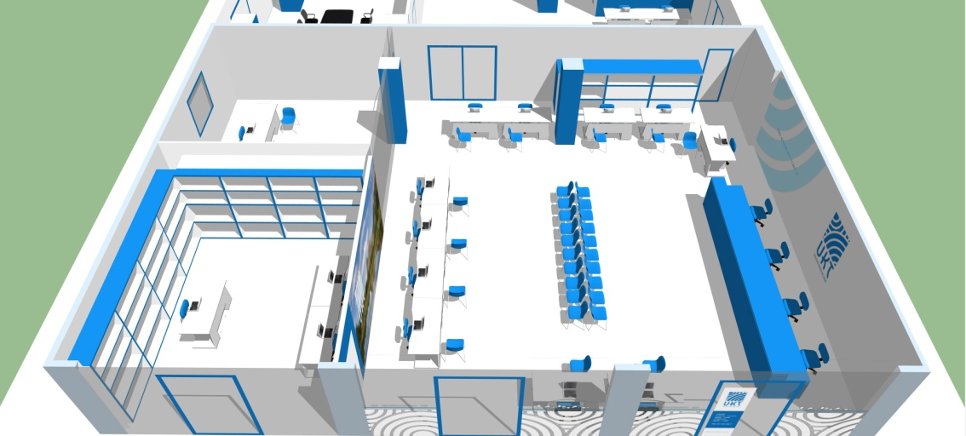
One- Stop Shop Preview

Slide 22
THANK YOU

