Slide 1
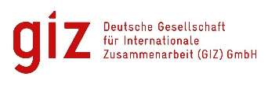



2016 Danube Water
Conference
Addressing the double challengE
Vienna, May 12 and 13, 2016
With the financial support of:
Notes:
Phil

Slide 2
Simultaneous translation
English
Albanian
Ukrainian
Serbian/Croatian/Bosnian/Montenegrin
Bulgarian
Romanian
Notes:
Phil

Slide 3
Words of Welcome
Günther Schönleitner
Director, Austrian Ministry of Finance
Ellen Goldstein
Country Director, World Bank
Lorenz Petersen
Director, GIZ
Vladimir Tausanovic
President, IAWD
Notes:
Phil

Slide 4
2016 Danube Water Conference
190 Participants, 100+ national and local institutions, utilities and associations from 20 countries around the Danube and beyond.
Organized jointly by the World Bank, IAWD and GIZ with support from the Danube Water Program and the Open Regional Fund.
With funding from Austrian, German and Swiss Governments:
How can the region leverage EU accession to address the double challenge of meeting EU acquis communautaire and providing sustainable services to all?
Notes:
David

Slide 5
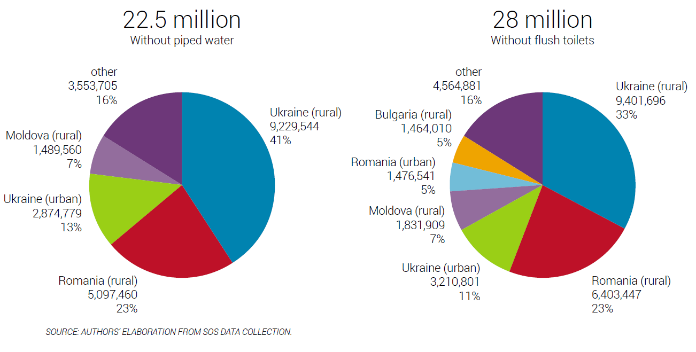
Access
Still millions lacking modern services at home

Slide 6
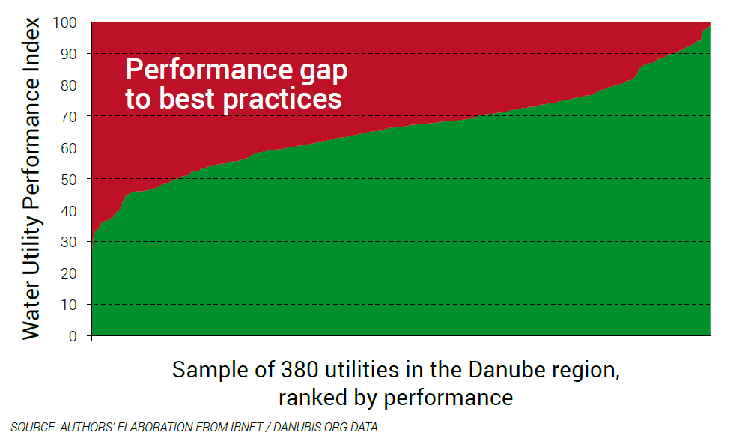
Service providers
Significant gap to international best practices

Slide 7
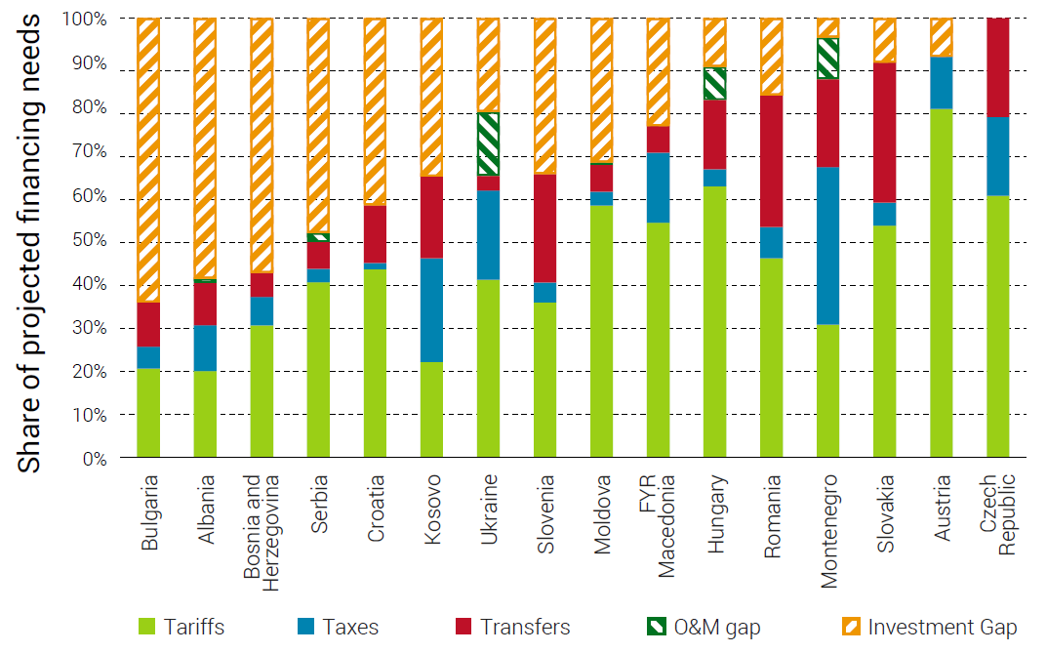
financing
Space and need to increase financing, tariffs

Slide 8
Conclusions
Countries of the Danube region…
Are on a shared European trajectory, but at different levels and following different paths;
See overall improvements, but significant gaps in particular in recent and candidate EU countries;
Face a double challenge of meeting EU acquis and providing sustainable services to all.

Slide 9
Housekeeping
Group photograph at 12:30 today
Cocktail in foyer at 18:00 today
Gala dinner 20:00@Donauturm
Questions on logistics?
  IAWD: Philip Weller / Katherine Wagner
  GIZ: Georgi Hristov / Aleksandra
  Karaevska-Dimovska
  World Bank: David Michaud /
  Angelika Heider
Program page 45
Notes:
David

Slide 10
The Venue
Plenary sessions in Gustav Mahler
Parallel Sessions in Sigmund Freud (also translated)
Coffee breaks in foyer
Lunch breaks downstairs
Work stations
across the foyer
Side Meeting room
across the foyer
We are
here!
Program
page 46
Notes:
David

Slide 11
Country (and topic) Groups
YOUR idea to address the double challenge
Coordinate place & time among country participants
Summarize idea on the form, and return by tomorrow 13:30 to David Michaud or Philip Weller
Decide on potential rapporteur and message
NOTE: also for technical sessions!
Program pages 35-36
Notes:
Phil

Slide 12
Evaluation forms
In your conference bag
Please help us get better
Fill it out as you go
Leave the completed form on your table or
in the box at the end
of the conference!
Notes:
Phil

Slide 13
Ensuring a successful conference
Open Dialogue and active involvement
Be on time,
stick to time allocations
Please keep questions and responses brief and to the point in the sessions
  Participate
  Time management
  Productive use of session time
  Taking discussions further & deeper
Use the breaks
Notes:
Phil

Slide 14
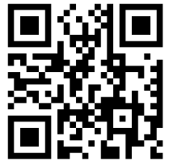
Participate!
Connect to Internet
  SSID: NETGEAR59_EXT
  Password: luckycurtain267
Open Pollev.com/2016DWC (Pollev.com/2016DWCsmall for SF room)
on your tablet, smartphone or laptop
Questions will change through the conference
Let’s try it!
Program
page 44
Notes:
David

Slide 15
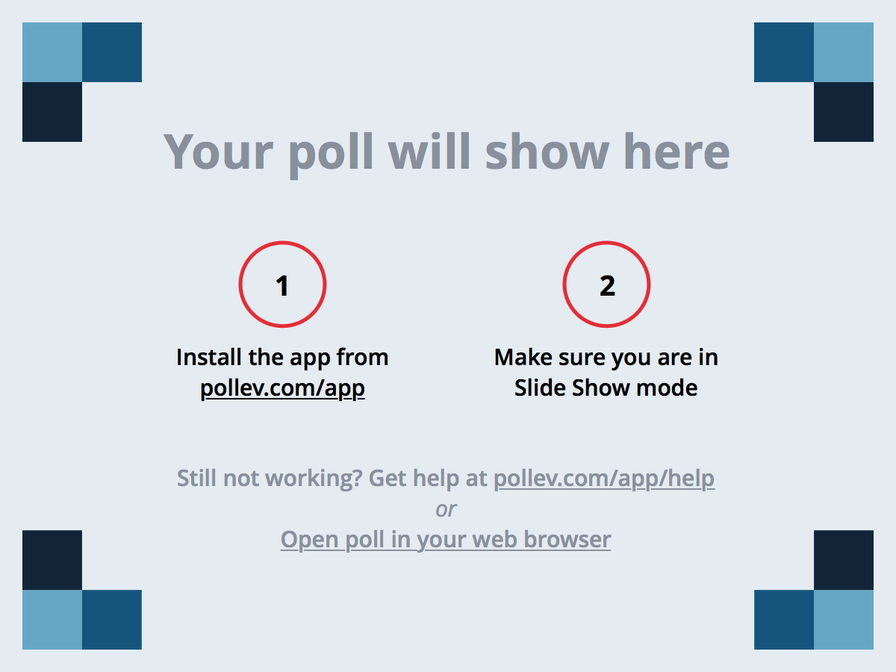
Participate!
Notes:
Poll Title: How many times have you participated in the conference?
https://www.polleverywhere.com/multiple_choice_polls/O0584323SJ3YPir

Slide 16
Participate!
Notes:
Poll Title: How many people do you know personally in this room?
https://www.polleverywhere.com/multiple_choice_polls/ho3DMLAT2SOzBXJ

Slide 17
Participate!
Notes:
Poll Title: What language do you work in primarily?
https://www.polleverywhere.com/multiple_choice_polls/DIyu1p4IuCgwWNR

Slide 18
Participate!
Notes:
Poll Title: What is the size of the city in which you work primarily
https://www.polleverywhere.com/multiple_choice_polls/JLqzuOglmnLOZC3

Slide 19
Participate!
Notes:
Poll Title: What describes most closely your role with regards to WSS services
https://www.polleverywhere.com/multiple_choice_polls/TkTBbTOmqsMKECf

Slide 20
Participate!
Notes:
Poll Title: Where you see the biggest sector challenge in your country (or the region)?
https://www.polleverywhere.com/free_text_polls/v5hjZCEifZe2EtZ

Slide 21
OPENING KEYNOTE SESSION
Addressing the double challenge
Chair: Walter Kling
Keynote speeches
  Marianne Wenning, Director, Quality of Life, Water & Air,
  Directorate General for the Environment, European Commission
  Jennifer Sara, Director, Water Global Practice, World Bank
Dialogue and Open Discussion

Slide 22
Notes:
Poll Title: Keynote: EU Accession and Sustainable Development
https://www.polleverywhere.com/free_text_polls/e2lk6IDpz9puyWY

Slide 23
Closing Session
The double challenge, addressed?
Chairs: David Michaud and Philip Weller
Summary of key sessions
Audience vote and ignite speech on best ideas
Closing panel discussion:
  TBD

Slide 24
PROPOSED POLLEV QUESTIONS
Will you pay to come next time?
How many new people have you met
Evaluation questions?
One word you take away?

