Slide 1
2016 Danube Water Conference
Addressing the double challengE
Vienna, May 12 and 13, 2016
With the financial support of:
Notes:
Phil

Slide 2
The experience of bulgaria
Overview by Chair
Ivaylo Kolev, World Bank
Presentation
Nevena Ivanova, MRDPW
Panel discussion and Q&A
Conka Dryankova, Ministry of Environment
Dimitar Kochkov and Ivaylo Kaschiev, Regulatory Commission
Ivan Ivanov, Bulgarian Water Association
Lyubomir Filipov, Sofia Waterworks
Notes:
Phil

Slide 3
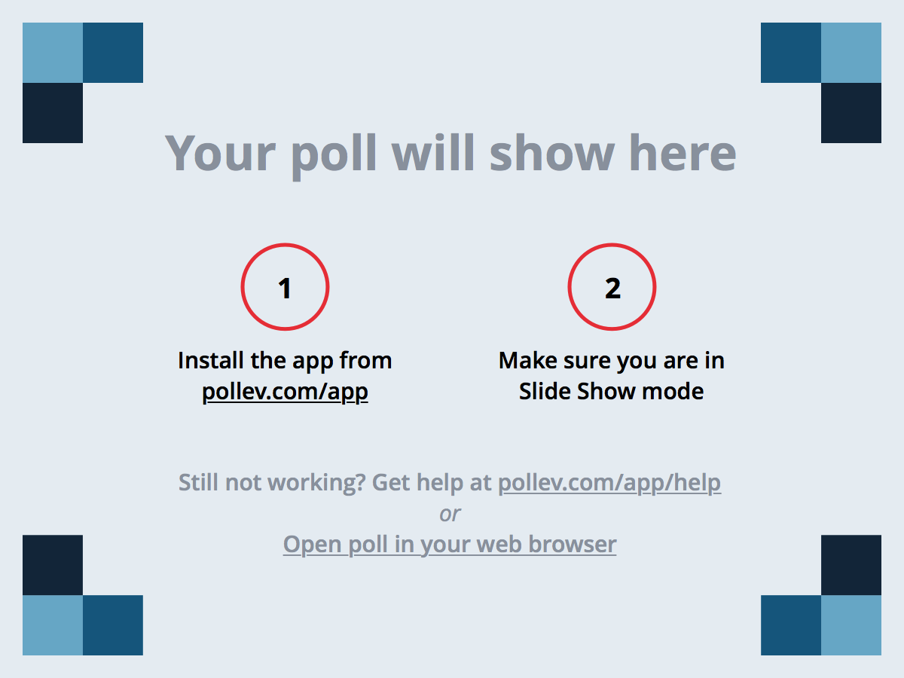
Your questions and comments
Notes:
Poll Title: Questions for Session on Bulgaria https://www.polleverywhere.com/free_text_polls/IVOUAaKvFJVoXPr

Slide 4
Institutions: getting utility governance right
Overview by Chair
William Kingdom, World Bank
Presentation
Michael Klien, WIFO
Q&A
Presentations
Evis Gjebrea, Tirana Utility
Zoltán Istókovics, Szeged Utility
Q&A
Coffee break
Presentations
Darius Bör, Apaserv Satu Mare
Dani Milan Cabré, Tarragona water utility
Panel discussion and Q&A
Voltana Ademi, Shkodra, Albania
Victoria Gratii, Ministry of Environment, Moldova
Andrei Busuioc, World Bank
Group discussions

Slide 5
Your questions and comments
Notes:
Poll Title: Questions for Session on Institutions https://www.polleverywhere.com/free_text_polls/A1jgDT4OYpRegar

Slide 6
Speed networking
Presentations
Hari Shutoski, GIZ
Katharina Steinbacher, IWA YWP
Miodrag Kolic, NALAS
Tamara Nikolic, World Bank
Zoran Nikolic, ConWeb
Jelena Janevska, NALAS
Philip Weller, IAWD
Cocktail
Notes:
Phil

Slide 7
Your questions and comments
Notes:
Poll Title: Questions for Speed Networking https://www.polleverywhere.com/free_text_polls/I3zzozEMxGNRQuN

Slide 8
Keynote: the example of leipzig
Overview by Chair
Christophe di Marco, GIZ
Presentations
Juergen Wummel, Sachsen Wasser
Q&A
Notes:
Phil

Slide 9
Your questions and comments
Notes:
Poll Title: Questions for Keynote: Leipzig https://www.polleverywhere.com/free_text_polls/zUyTJHT6SNabcjk

Slide 10
Non-Revenue water
Overview by Chair
Georgi Hristov, GIZ
Presentations
Bambos Charalambous, IWA
Jurica Kovac, IWA
Sead Badnjevic, AQUASAN
Bojan Ristovski, Aquasave
William Kingdom, World Bank
Coffee break
Presentations
Andreas Lutschounig, SETEC
Zoran Nikolic, National Consumer Organisation
Panel discussion and Q&A

Slide 11
Your questions and comments
Notes:
Poll Title: Questions for Session on NRW https://www.polleverywhere.com/free_text_polls/gtXtSvRDRB88mpr

Slide 12
Closing session
Overview by Chairs
David Michaud, World Bank
Philip Weller
Presentations by YWP rapporteurs
Panel discussion and Q&A
Frank Wiederkehr, Swiss Cooperation
Lindita Sotiri, Ministry of Transport and Infrastructure
Behric Edin, Mayor of Velika Kladusa
Csaba Haranghy, Budapest Waterworks
Ivaylo Kastchiev, State Energy and Water Regulatory Commission
William Kingdom, World Bank
Elena Elisabeta Manea, Young Water Professional
Milos Raznatovic, Association of Waterworks of Montenegro

Slide 13
Vote for the best country idea
Notes:
Poll Title: Country groups https://www.polleverywhere.com/ranking_polls/1tTSNBv2crtnl2M

Slide 14
Vote for the best topic idea
Notes:
Poll Title: Topic groups https://www.polleverywhere.com/ranking_polls/hFRC9zWBVkzwvT7

Slide 15
Your questions and comments
Notes:
Poll Title: Closing pannel https://www.polleverywhere.com/free_text_polls/Mt8MlNgRD0oaL88

