Slide 1

Governance and water utility performance
Michael Klien
Danube water conference Mai 2016

Slide 2
Does governance matter?
Snapshot of the empirical literature on the effect of governance modes
  Private sector paricipation
  Benchmarking and regulation
  Corporatization
Yes, governance does matter, but…
Next stop: Aggregation/consolidation

Slide 3
Performance comparison I
Private sector paricipation can improve efficiency
  Gassner, Popov, and Pushak (2008)
    977 water utilities in 48 countries, 1973 to 2005
    SOEs vs concessions, lease and management contracts
    Connection rate ↑, output per worker ↑, residential sanitaiton service coverage ↑, hours of daily water service ↑
  Marin (2009)
    65 PPP projects in developing countries, 1990 to 2007
    Effect after implementation of PPP
    Mixed result for access and service continuity →, operational efficiency (water losses, labor productivity) ↑, no clear effect on tariffs

Slide 4
Performance comparison II
Benchmarking and regulation can improve efficiency
  Saal and Parker (2001)
    10 water utilities England and Wales, 1985 to 1999
    Privatization and introduction of regulatory price review
    Regulatory price review dampened future cost increases ↓; no effect of privatization →
  De Witte and Dijkgraaf (2010)
    20 Dutch water utilities, 1992 to 2006
    Introduction of voluntary benchmarking
    Negative effect of benchmarking on cost ↓

Slide 5
Performance comparison III
Corporatization can improve efficiency and reduce political interference
  Cambini, Filippini, Piacenza, Vannoni (2010)
    33 local bus companies in Italy, 1993 to 2001
    Transformation of municipal unit into autonomous enterprise
    Switch has a negative effect on production cost ↓
  Klien (2014)
    73 water utilities in Austria, 1992 to 2009
    In-house vs legally separated, autonomous water utilities
    Corporatization reduces political interference in water tariffs ↓

Slide 6
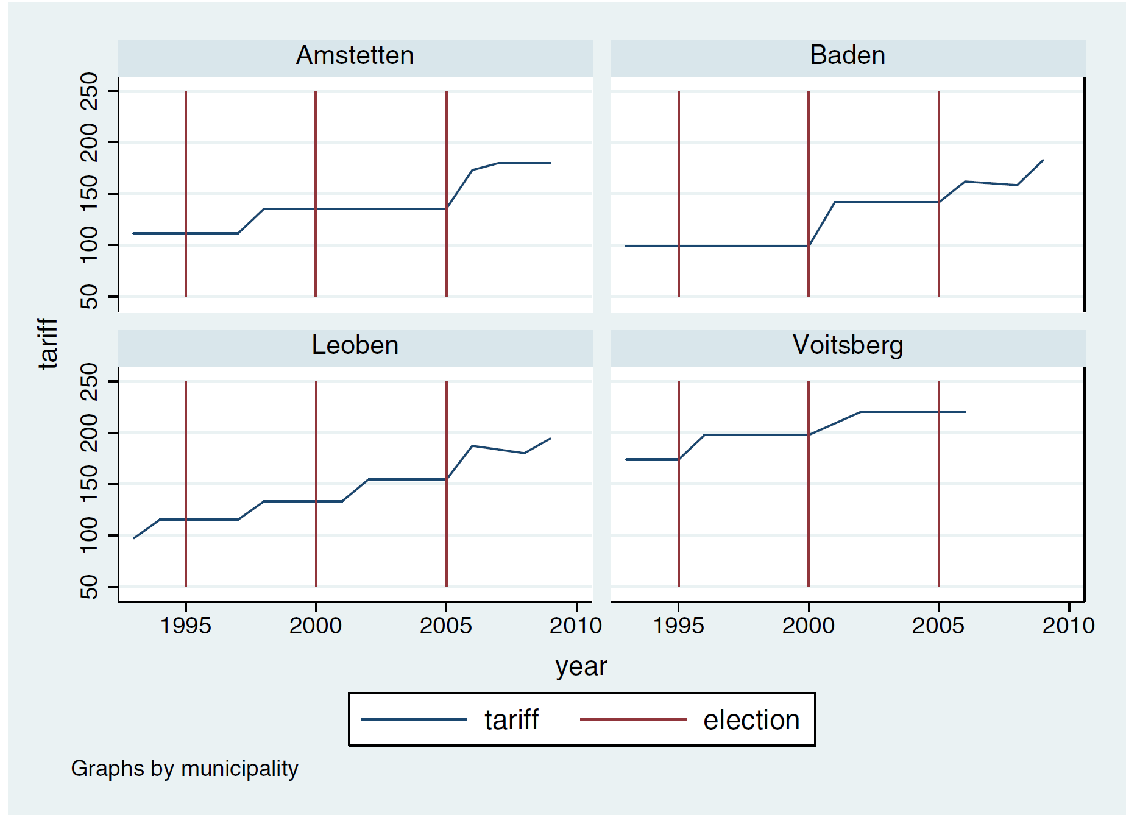
Performance comparison III
Example of political price setting

Slide 7
Performance comparisons IV
But the effects differ:
  across countries
    Shirley and Xu (1999) find no effect of corporatization on performance in developing countries
  across time
    Bel and Warner (2008) find that the reported advantages of contracting-out seem to have disappeared in recent years
  sometimes opposite results for same governance mode
    Contracting out leads to higher cost (Martinez-Espineira et al., 2009) particularly for small utilities (Chong et al., 2015)
Very few consistent results, why?

Slide 8
Next stop: Aggregation/Consolidation
50+ studies since the 1970s suggest there are important economies of scale in water provision
A safe bet for water utility reform?
  Actual consolidation studies tend to show small or no effect
  Some studies, e.g. Klien and Michaud (2016) find adverse effects on cost and quality, at least in the transition phase
We need focus on the question, why governance reforms succeed or not!

