Slide 1

Importance of Data Pooling
& Transparency
Heidrun Maier-de Kruijff

Slide 2
Who we are?
○ founded in 1952 to represent the interests of public economy
○ many members from all sectors of public interest
○ office in Vienna
What we do?
○ representation of interests on a national and European level
○ analysis and information on EU legislative initiatives
○ cooperation with European partner organizations / part of the European social partners
○ preparation of position statements on national and European level
○ concessions directives – internal market

Slide 3

Challenges for Water Resource Management
Circular Economy in Water Related Sectors
Importance of Data Pooling & Transparency
Raising Consciousness
ECI: Right2Water

Slide 4

I. Challenges for Water Resource Management I
Formulating the right goals:
  adequate water supply
  conserving resources
  reliability of supply - sustainability
  Providing and generating the necessary infrastructure
  adequate water pricing in consideration of the principle of equivalency

Slide 5
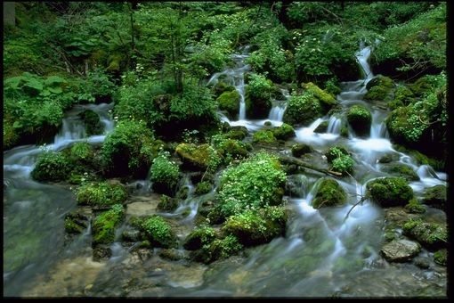
I. Challenges for Water Resource Management II
Formulating a business case
  Sources
    Local water deposits?
    Regional water resources?
    Supra-regional water resources?
  Investment costs
  Water pricing
  Long-term planning

Slide 6
I. Challenges for Water Resource Management III
Quality & Quantity
  Analyse pollutants
    Nitrate
    Hormones
    Pesticides
    Micro-pollutants
    Metabolisms
  Water treatment
  Competence
    Technical & operational
    Know-how transfer

Slide 7
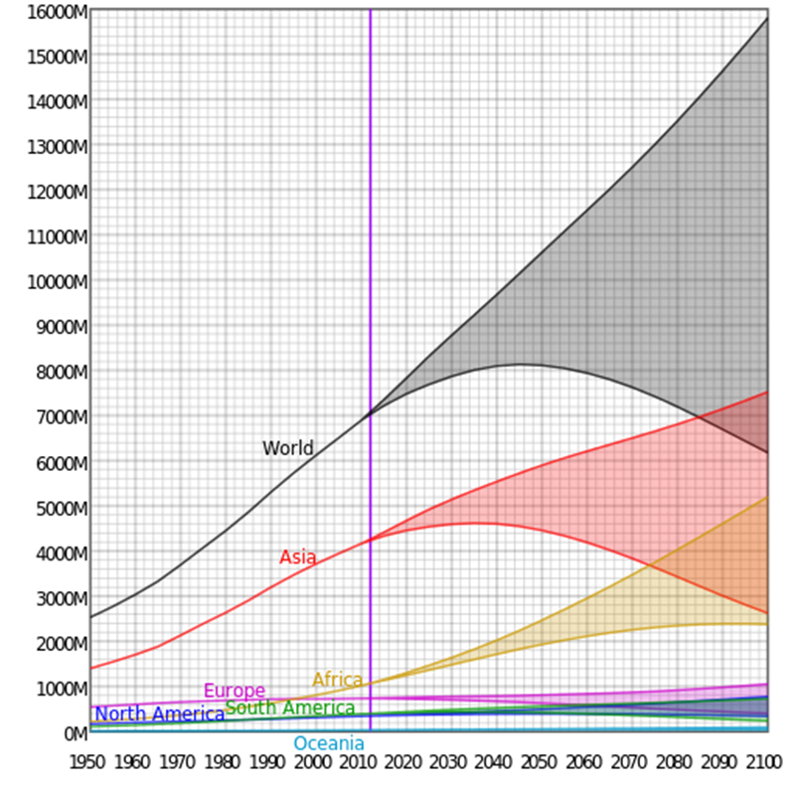
I. Challenges for Water Resource Management IV
Sustainability
  Economical & ecological
  Water Stress
  Demographic changes
  Water consumption
  Water Leakage
  Move away from global solutions to regional solutions
Estimated and projected populations of the world and its continents (except Antarctica) from 1950 to 2100. source: wikipedia

Slide 8
I. Challenges for Water Resource Management V
Demographic changes in Europe:
  Different growth and shrinking rates in Europe require for different, localized solutions.
Shrinking Study - Brüssel, Europäisches Parlament, 2008)

Slide 9
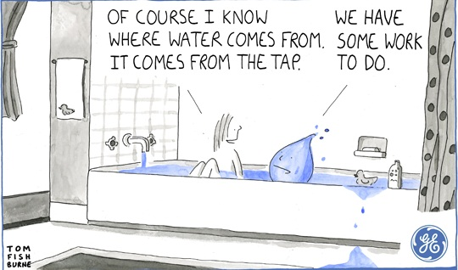
II. Circular Economy in Water Related Sectors I
Closing the Circle
  Water is a limited resource. Proper circular economy ensures that water is given back to nature – unspoilt!
  Before we talk about grey-water recycling, we have to ensure, that the network is operating properly
    Leakage is a main reason for water loss
  Keeping the system balanced and working
  Always consider where you are and in
  which sector you operate
There is no way to store water for the future
– all we can do is keep it clean!

Slide 10
III. Importance of Data Pooling & Transparency I
Why?
  Sustainability
    Is your water consumption sustainable?
  Benchmarking
    Is your water supplier operating at peak performance?
  Quality Assurance
    Are your standards high enough?
Roman Neunteufel, 2015

Slide 11
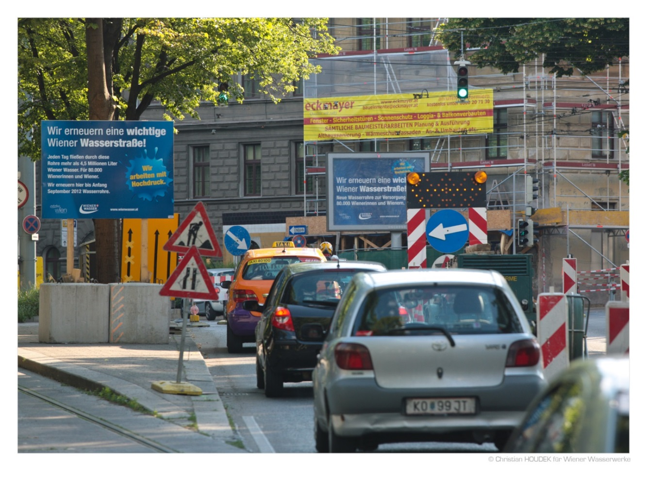

III. Importance of Data Pooling & Transparency II
  Know-How-Transfer
    What can we learn from each other?
  Improving public trust
    What kind of data needs to be shared with the public?
© Christian Houdek für Wiener Wasser, 2012

Slide 12
III. Importance of Data Pooling & Transparency III
Who?
  International Cooperations and Initiatives (WISE, IWA, EWA, EUREAU, WssTP etc.)
  Local Governments & Water Suppliers
  Experience is priceless – use it!
  Return to core competences
  Avoid short-term projects
  Focus on sustainable, long-term measures

Slide 13
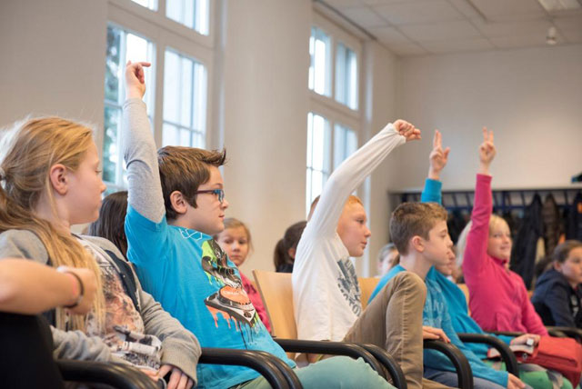
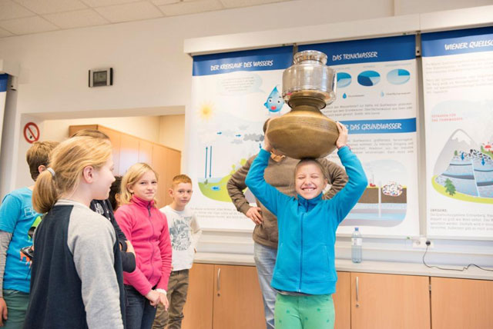
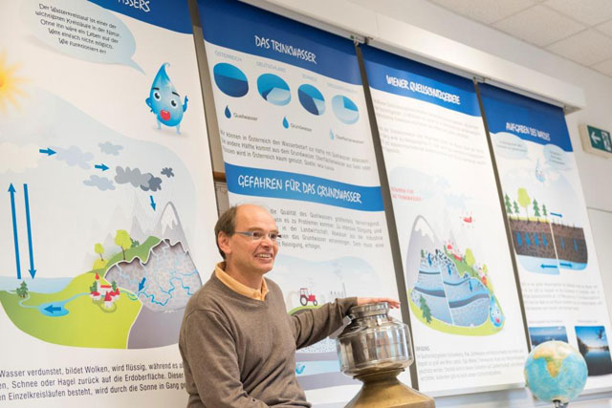
IV. Raising Consciousness I
Importance of Public Relations
  Raising public awareness is among the most important factors in achieving a more sustainable use of public water supplies.
  Means to raising awareness include, but are not limited to:
  Informational websites, leaflets, notices in local newspapers etc.
  School programmes (example: Wasserschule Wiener Wasser)
  Social Media, mobile apps
  Eco-labelling/-certificates
  Raising awareness by communicating needs & expectations and supplying information allows the consumer to make educated choices about water efficiency and conservation
© Wiener Wasser, source: wien.gv.at

Slide 14

IV. Raising Consciousness II
Example: The concept of Virtual Water and the Water Footprint
  Developed to describe the amount of water required to produce a particular good or service (Allan, 1996)
  Can be used to improve consumer awareness of water use and highlight the significant variations in water use to produce different goods
  The Water Footprint Network is a global network
  and consists of over 200 partners

Slide 15

V. ECI: Right 2 Water I
Initiated by multiple stakeholders, including VÖWG
Goals:
  Guaranteed water and sanitation for all in Europe.
    The EU institutions and Member States be obliged to ensure that all inhabitants enjoy
    the right to water and sanitation.
  No liberalisation of water services.
    Water supply and management of water resources not be subject to ‘internal market rules’ and that water services are excluded from liberalisation.
  Universal (Global) access to water and sanitation.
    The EU increases its efforts to achieve universal access to water and sanitation

Slide 16
V. ECI: Right 2 Water II
Why?
  Water and Sanitation have been recognised as a universal human right as of 6.28.2010
  Water and sanitation are key factors to the accomplishment of all human rights
  States and international Organisations should provide financial resources, help in capacity-building and technology transfer.

Slide 17
V. ECI: Right 2 Water III
How?
  Collecting 1 mio. signatures from citizens of the EU-27 within a year
  Gaining the attention from media and the general public
  Initiating a Europe-wide debate about the Right 2 Water
1,884,790 signatures were collected

Slide 18
Keep in mind that drinking water is a precious commodity and should be handled with care
In order to keep up a sustainable supply in drinking water, water pricing must be adequate and fair, and resource efficiency must be ensured.
You are providing thousands of people with a vital resource – be proud of what you do!
Every time someone drinks a glass of tap water, Nestlé cries

Slide 19
  Thank you for your attention!

